Slide 1
Helping Your Students Cultivate a Growth Mindset
Presented by Elizabeth Bryer, English Instructor (ebryer@glendale.edu)

Slide 2
1. Introduce the concepts “growth mindset” and “fixed mindset” and the research on them early in the semester so that you can link them to the day-to-day activities of the class throughout the semester.
Resources for Teaching Your Students about the Growth Mindset Without Taking Up Too Much (or No) Class Time:
Give your students extra credit for attending the Keys to College Success Workshops in the Learning Center
Download the module “Grit and the Growth Mindset: Two Secret Ingredients of Success” from Canvas Commons and edit it to fit your class
Use the resources available in the online professional development course on Growth Mindset as part of the “Helping Students Develop Learning Skills” course found under “Professional Development” on the GCC Faculty Development Webpage.

Slide 3
2. Design activities and assignments that help students link the different mindsets to the day-to-day activities of class.
Sample Lesson Plan
Before giving back a graded essay or exam, start a discussion or activity to get students to reflect on how they can prepare themselves to embrace feedback with a growth mindset.
Possible discussion questions:
“What do we know from the research about how someone with a fixed mindset handles feedback? What are the consequences of that reaction?”
“What do we know from the research about how someone with a growth mindset handles feedback? What are the consequences of that reaction?”
“Feedback can be hard. What steps can you take to learn the most from the feedback you get?”
It’s amazing how powerful it can be just to create space in the classroom for students to reflect on their habits with feedback and be intentional about cultivating new ones.

Slide 4
3. Give feedback that emphasizes process rather than “natural” talent and that links the ”messy” parts of learning to success.
Talent-Focused Feedback
“You’re smart!” “You’re great at math!
“That’s a sentence fragment. You have a problem with those.”
“You got an F last time, but a C this time.”
Process-Focused Feedback
“You solved those problems quickly, which was great, but let’s find problems that are more challenging for you so that you can learn even more.”
“This is a sentence fragment. Read it aloud to yourself. Do you have any ideas what keeps it from being a complete sentence? What questions do you have about it?”
“Your understanding of the material is growing because you’ve asked for help and persisted. What other strategies have you used to understand the material better?”

Slide 5
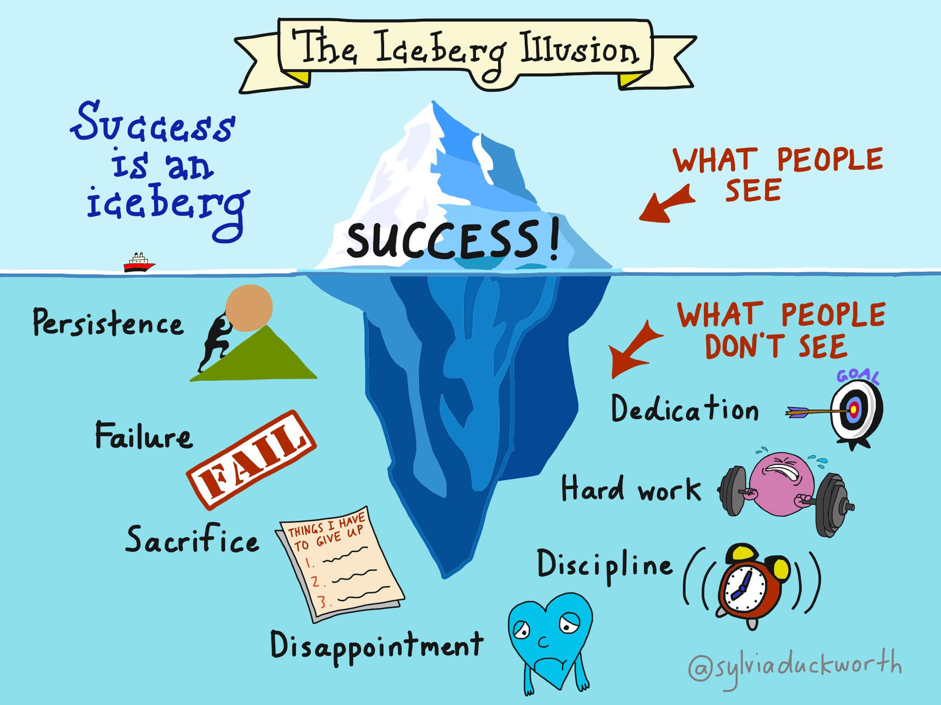
3a. Use the “Iceberg Illusion” graphic to discuss with students how “messy” success can be.

Slide 6
4. Don’t forget the power of the word “YET.”
Student: I just don’t get operant conditioning.
Instructor: You don’t get operant conditioning YET. But you will if put in effort, ask for help from others, and practice good strategies.

Slide 7
5. Share your stories of students and others “growing” their skills they didn’t have before.
We’ve all been privileged to witness students who have always struggled in our subjects overcome their obstacles and succeed. Students need to hear these stories. Share them.

Slide 8
6. Remind students that the difference between low skills and high skills is practice.
Students often think the learning process is something over which they have no control. Remind them that a big part of becoming proficient at anything is simply practicing over and over again – and reaching out for help at those moments when practice alone is not enough.

Slide 9
7. Cultivate a growth mindset in yourself and point out the growth mindset of the “giants” in your discipline.
Our disciplines are full of ”giants” who failed multiple times and learned from their failures but kept going. Share the stories of these failures and the successes they eventually led to.

Slide 10
8. Cultivate empathy for your students’ struggles and share your own.
Most teachers at GCC are fortunate enough to spend their days sharing their knowledge about a subject they feel confident with. But we all understand how it feels to believe we just “can’t” do something. If you were once struggling in school, share that with your students and tell them how you handled it. Be willing to let your students see you as a person who has struggled and still struggles sometimes, and share your stories of how you handle the “can’ts” in your life.

Slide 11
9. Acknowledge a distinction between cultivating a growth mindset and “pulling yourself up by your boot straps.”
Perceptive students may raise the issue that even if they cultivate a growth mindset, they may be facing obstacles other students don’t face, and they may misinterpret information on the growth mindset to mean that if they aren’t succeeding, that’s because they have the wrong attitude. It’s important to acknowledge that cultivating a growth mindset will not solve the many other obstacles many face like income inequality, racism, learning differences, or disabilities. Acknowledge to students we must work together to create more equity and better support to lessen those obstacles. Until these problems are adequately addressed, we can keep in mind that some research shows cultivating a growth mindset may help disproportionately impacted students persist and thrive even under less-than-ideal conditions.

Slide 12
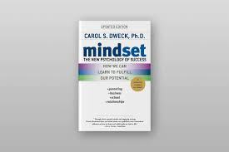
10. Read Mindset by Carol Dweck and encourage your students to also!
The book is highly accessible and engaging, and students love it.

