Slide 1
Student Retention
Where are my students?

Slide 2
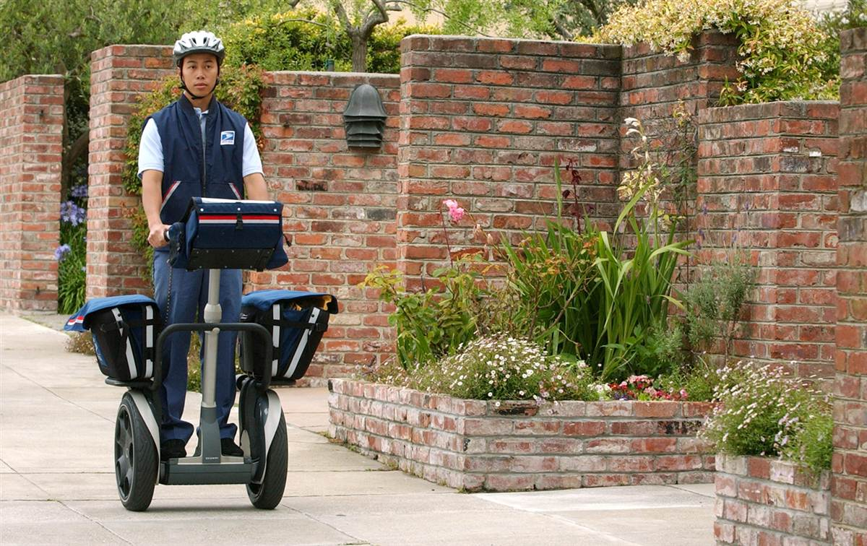

Slide 3
In your group, make 6 sentences. Every sentence must have a capital letter, a subject, a verb, and a period.
Who is he?
What does he do?
What can he do?
When does he work?
Where does he work?
What does he wear?

Slide 4
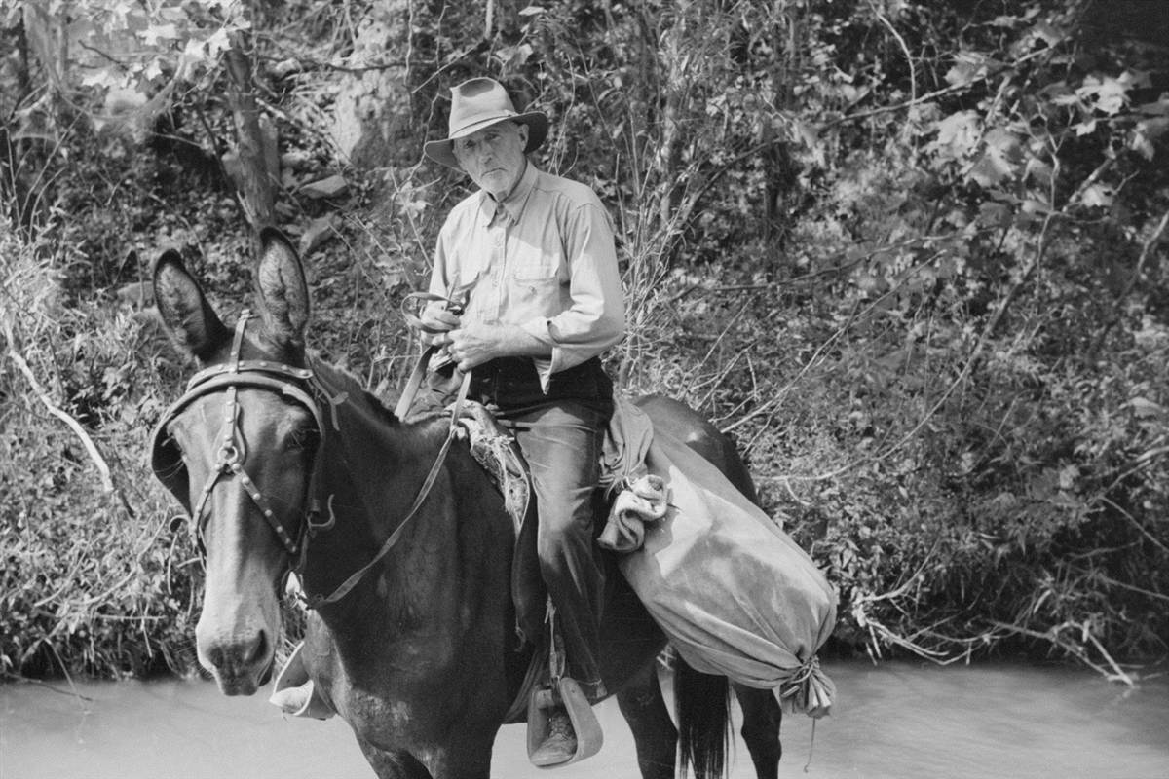

Slide 5
What did mail carriers use to do? Use the vocabulary to make sentences with “used to”.
HAT
HORSE
BAG

Slide 6
What about you?
 | U.S. | Your Country
JOB TITLE
JOB DUTIES
JOB SKILLS
JOB HOURS
JOB LOCATION
JOB UNIFORM

Slide 7
Internal Factors
Persistence is always an issue with high risk student populations
Persistence is affected by student’s ability to manage positive and negative forces
Lack of discipline, fear, anxiety, and the inability to balance the demands of life
Influence of cultural capital and cultural reproduction, “Equitable access does not mean equal success”

Slide 8
Internal Factors
Students defined as task-oriented achieved higher test results than students whose motives related to self-esteem or work-avoidance (gender).
Three different developmental levels: instrumental, socializing, and self-authorization - socializing learners need an “interpersonal connection” with the teacher in order to feel “comfortable”; these students focus on maintaining their own positive attitudes, hopefulness, and motivation to learn.

Slide 9
External Factors
Cohorts improve student persistence
Students need support from school staff in terms of self-efficacy
Content should relate with real-life interests and obstacles and foster student empowerment, as well as address the needs of different types of learners
Establishment of real and attainable goals (object), desire for upward socio-economic mobility (self-constructed goals), and opportunities to assess progress.

Slide 10
Group Activity #1
What are some challenging behaviors that your students exhibit?

Slide 11
Group Activity #2
Select one of the challenges
Discuss ways in which you can surmount these challenges, either by instructional techniques, classroom management procedures, etc.
Select one member of your group to share out with the “class”.

Slide 12
Open Discussion
Other ideas to share
More tough issues to address and ways to do so
Plans for follow-up

Slide 13
References
Becker, Liza A. (2011) Noncredit to credit transitioning matters for adult ESL learners in a California community college. In T. H.Bers & H. D. Calhoun (Eds.), New Directions for Community Colleges (pp.15-26).doi: 10.1002/cc
Campbell, C. & Shaw, V. (1994). Language anxiety and gender differences in adult second language learners: Exploring the relationship. In Carol A. Klee (Ed.). Faces in a crowd: The individual learner in multi-section courses (pp. 215-240). Boston, MA: Heinle & Heinle
Kanno, Y., & Varghese, M. M. (2010). Immigrant and refugee ESL students’ challenges in accessing four-year college education: From language policy to educational policy. Journal of Language, Identity, and Education, 9, 310-328
Kim, T. (2011). Sociocultural dynamics of ESL learning (de)motivation: An activity theory analysis of two adult Korean immigrants. Candadian Modern Language Review, 67(), 91-122.
Lambert, O. (2008). Who are our students? Measuring learner characteristics in adult immigrants studying English. Adult Basic Education and Literacy Journal, 2, 162-173
Menard-Warwick, J. (2004). “I always had the desire to progress a little”: Gendered narratives of immigrant language learners. Journal of Language, Identity, and Education, 3, 295-311. Retrieved from http://www.eric.ed.gov/
O’Donnell, V., & Tobbell, J. (2007). The transition of adult education students to higher education: Legitimate peripheral participation in a community of practice? Adult Education Quarterly, 57(312). doi: 10.1177/0741713607302686
Ramsey, K. & Robyn, A. (1992). Preparing adult immigrants for work: The educational response in two communities (Report: ED352454). Berkeley, CA: National Center for Research in Vocational Education
Razfar, A. & Simon, J. (2011). Course-taking patterns of Latino ESL students: Mobility and
mainstreaming in urban community colleges in the united states. TESOL Quarterly, 45(4), 595-627
Tercanlioglu, L. (2004). Achievement goal theory: A perspective on foreign-language-learners’ motivation. TESL Canada Journal, 21(), 34-49. Retrieved from www.teslcanadajournal.ca
Zacharakis, J., Steichen, M., Diaz de Sabates, G. and Glass, D. (2011). Understanding the experiences of adult learners: Content analysis of focus group data. Adult Basic Education and Literacy Journal, 5, 84-95. Retrieved from http://www.coabe.org/html/abeljournal.html

