Slide 1
Expressing Impossibility and Disbelief about the Past
Couldn’t have/can’t have + past participle
Created by Harriet Cohen
Copyright 2013

Slide 2
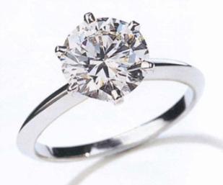
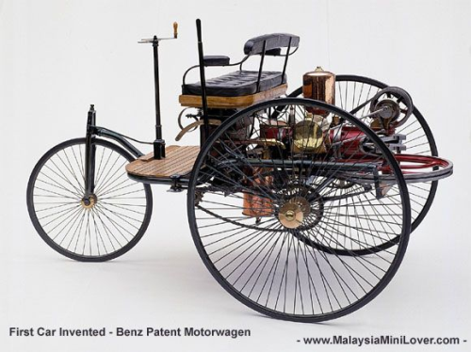
Do you agree with the information next to each picture?
If not, explain why not by using couldn’t have/can’t have
+ past participle and the word ‘because’.
Ex. “I saw your husband in Las Vegas last weekend.”
“You couldn’t have seen my husband because he was with me all weekend!”
Joe bought this authentic, new 1 ct. diamond ring, set in platinum, for only $300.
In 1825 Bill's great great grandfather bought his first new car for only $100.

Slide 3
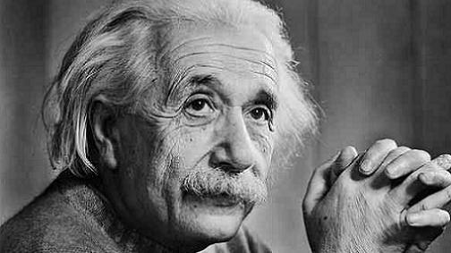
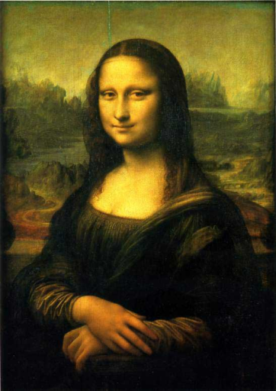
A traveler broke his leg in two places while he was skiing in Saudi Arabia. Poor guy!
“I heard that Albert Einstein just invented a new theory about black holes. It’s amazing!”
Last week Sharon took her family to see the “Mona Lisa” by Da Vinci at the Los Angeles County Museum of Art. Incredible smile!

Slide 4
Now make up 4 unbelievable statements about the past
with your partner.
ex. “I went to China last weekend.”
Then share the statements with your classmates.
Your classmates will then react with statements of
disbelief and impossibility!
ex. “You couldn’t have gone to China last weekend.
It takes about 18 hours in each direction!”
Have fun!

