Slide 1
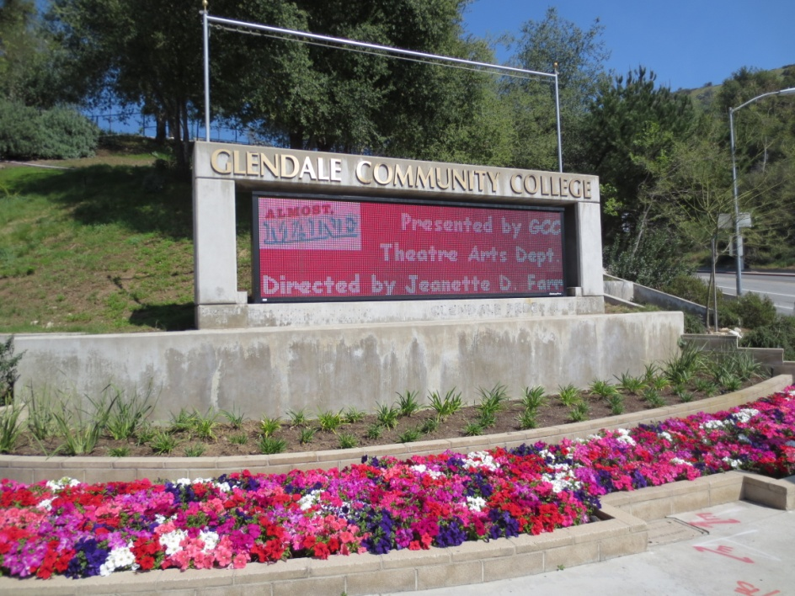
Glendale Community College Facility Index
July 15, 2013
1

Slide 2
Current State
Current Maintenance Practices
Primarily needs based
Reactionary
Fix when broken
Minor work order management
2

Slide 3
Facility Index
What is it?
Why is it important?
Relationship to educational goals?
3
Notes:
What is it? A tool that the college can use to move from being reactive to proactive.
Importance: Unplanned and Planned failures, costly repairs, downtime, premature aging, staff frustration, customer complaints, equipment performance. For planning on staffing levels as we bring new buildings and spaces online we will know how the required staffing levels.
Education: Occupant comfort, healthy learning environment

Slide 4
Preventive Maintenance (PMs)
What are PMs?
Benefits
Beyond PMs
Predictive Maintenance
Proactive Maintenance
4
Notes:
PMs: Scheduled and budgeted maintenance. Benefits: Equipment life, downtime, planned and forecasted.
Predictive: With time our goal will be to implement measures that can predict failures to avoid potential occupant disruptions.
Proactive: With time our goal will be to monitor equipment to ensure it’s operating within parameters and operate efficiently. Example is the energy projects M&V of the equipment to ensure that we are reaching our energy savings goals and they continue to run within the levels we set forth.

Slide 5
Facility Index - Inventory
5
Notes:
Sample of the inventory that we took. Attention to detail and information gather. Over 1000 line items of equipment that the team is responsible for, most of which can cause interruptions to the classroom.

Slide 6
Facility Index – Custodial
6
Notes:
STILL BREAKING OUT THE CUSTODIAL BY BUILDING….. But, this shows the rounds that the custodial team is responsible for on a daily basis.

Slide 7
Facility Index – Schedules/Hours
7
Notes:
Each of the 1000 line items is also given a schedule of when tasking should be performed for proper maintenance and the estimated time it will take to perform the tasking during each occurrence.

Slide 8
Facility Index - Tasking
8
Notes:
The tasking associated with each occurrence of preventive maintenance scheduled.

Slide 9
Proposed GCC's Labor FTEs
Benchmark
 | SQ/FTE | GCC Applied | GCC Actual | Variance | Recommendation
Trades
Custodial | 22,536 | 31.81 | 24.00 | -7.81 | Hire 2 Custodians (2.31)*
Electricians | 285,000 | 2.19 | 1.00 | -1.19 | Increase contract labor for electrical
Mechanical (Includes Plumbers) | 264,000 | 2.36 | 2.00 | -0.36 | Increase contract labor for mechanical
Controls | 567,000 | 1.10 | 1.00 | -0.10 | No changes
Painters | 533,000 | 1.17 | 0.00 | -1.17 | Hire 1 Painter
General Maintenace/Gardener | 121,000 | 5.15 | 4.00 | -1.15 | Hire 1 Gardener
Carpenters | 420,000 | 1.48 | 0.50 | -0.98 | Hire 1 Carpenter
Locksmiths | 850,000 | 0.73 | 0.50 | -0.23 | No changes
Administration and Supervision | 142,000 | 4.39 | 4.00 | -0.39 | No changes
 |  |  |  | -13.38 | Adjusted (13.38 - 5.5) = 7.88
*We partially cover the gap for custodial with 5.5 hourly (General Workers)
Resources:
International Facility Management Associate (IFMA)
Building Owners and Managers Association (BOMA)
Whitestone's Building Operations Cost Reference
Mckinstry Facility Maintenance Expertise

Slide 10
Lab College Services Building
Impact
System Types
Equipment Types
9
Notes:
This is to show that we are looking forward towards the new building. We are learning about what types of systems are being installed and entering them into the WO management system. We can learn more about what types of systems perform the best for future construction and prepare standards. We know sq foot and equipment we will know staffing levels and required work.

Slide 11
Capital Planning
30 Year Capex
O&M Costs
Soft Costs
10
Notes:
With time we are going to develop a capital management report. Estimated remaining life.
Also, understand what costs will go into operating the buildings. Including energy, repairs, manpower, and custodial.

Slide 12
Questions?
11

