Slide 1
Future Tenses
You have a choice!
Created by
Susan Ryan 2012

Slide 2
1. Future with WILL
I will study for my test this weekend!

Slide 3
2. Future with be going to
I am going to study for my test this weekend.

Slide 4
3. Future with the FUTURE CONTINUOUS
I will be studying for my test this weekend.

Slide 5
4. Future with Present Continuous *
I am studying for my test this weekend.

Slide 6
5. Future with Simple Present*
We have a test on Monday. Don’t forget!

Slide 7
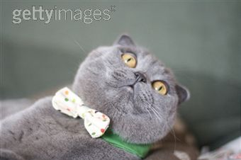
I’ll be hanging out this weekend!

