Slide 1
Glendale College
Our Great Mission
System Report
Access
Success
Budget
Workforce

Slide 2
An evolving mission!

Slide 3
1907 Established - Transfer
1917 Added Vocational Ed
Mission Evolution
2014 Added
Bachelor’s
1996 Added Workforce
1988 Adult Education
1976 Added Community Services

Slide 4
2014
State of the System
Report

Slide 5
Improving Access!

Slide 6
Notes:
revised

Slide 7
Annual Unduplicated Headcount
Year | Headcount | Pct. Change
2008-2009 | 2,667,733
2009-2010 | 2,539,790 | -4.8%
2010-2011 | 2,362,359 | -7.0%
2011-2012 | 2,198,989 | -6.9%
2012-2013 | 2,079,559 | -5.4%
2013-2014 | 2,094,910 | 0.7%
Total Lost: | 444,880 | -17.5%

Slide 9
Course Sections Offered
Year | Courses | Pct. Change
2009-2010 | 388,010
2010-2011 | 366,794 | -5.5%
2011-2012 | 341,923 | -6.8%
2012-2013 | 329,122 | -3.7%
2013-2014 | 352,516 | 7.1%
Total Lost: | 35,494 | -9.1%

Slide 12
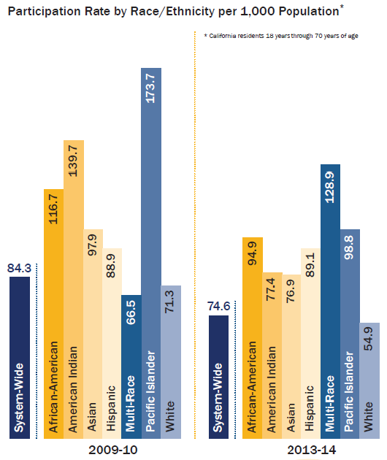

Slide 13
Statewide Participation Rates (Per 1,000 adult population)
08-09 | 09-10 | 10-11 | 11-12 | 12-13 | 13-14
89.4 | 84.2 | 82.5 | 78.2 | 74.6 | 74.6

Slide 14
Improving Student Success!

Slide 15
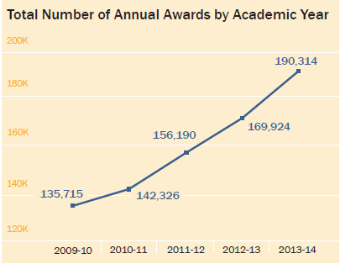
Annual Number of Awards

Slide 16
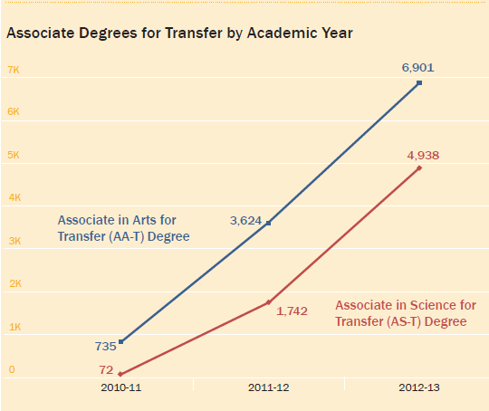
Associate Degrees for Transfer

Slide 17
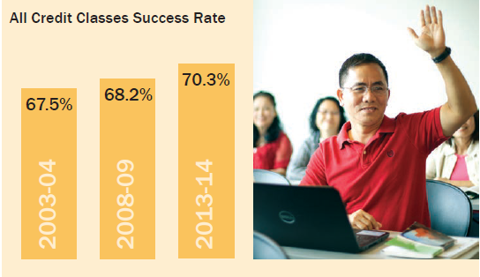
Credit Course Success Rate

Slide 22
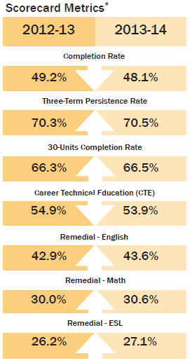
Scorecards
Metrics

Slide 23
Community College System Goals

Slide 25
Improving Finances!

Slide 26
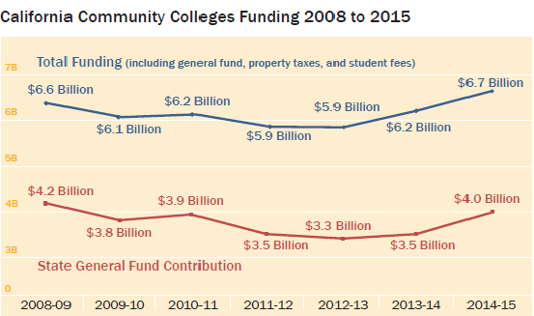
Fiscal Environment

Slide 27
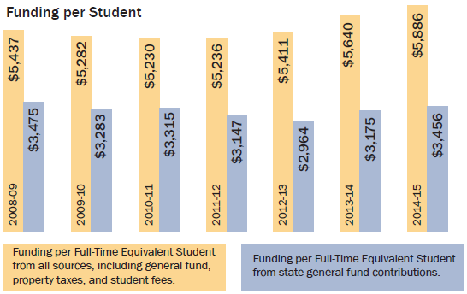
Funding Sources (per FTES)

Slide 28
Governor’s January Budget More than $1.1 Billion plus $500 million for Adult Education!

Slide 29
Governor’s January Budget
Student Success and Support - $100 M
Equity - $100 M
Base Increase - $125 M
Access - $107 M
Cost of Living - $92 M
Non-credit CDCP Equalization - $49 M
Career Tech Education - $48 M
Apprenticeship – $14 M
Prop 39 - $ 40 M
Deferrals Payoff - $95 M
Mandate claims - $353 M

Slide 30
A focus on the California Workforce!

Slide 31
Board of Governor Task Force on Workforce, Job Creation and a Strong Economy

Slide 33
Major CCCCO-Led Initiatives
Implementation
Student Success
Task Force
Restoration and Increase of Access
Implementation
2011
2012
2013
2014
2015
2016
2017
2018
2019
Revised System Strategic Plan
New System Strategic Plan
Transfer Degrees
Community College Bachelor’s Degree
Technology Initiatives

Slide 34
Develop strategies, policies, practices that would:
Prepare students for high-value jobs that currently or will exist in California.
Position California’s regions to attract high-value jobs from other states and around the globe.
Create more jobs through workforce training that enables small business development.
Finance these initiatives by braiding state and federal resources.

Slide 35
Roll Out
Board of Governors
Commission
Task Force
Recommendations
To BOG
Task Force
Mtg 1
Kick Off
Mtg
2
Mtg
3
Mtg
4
Mtg
5
Field & Stakeholder
Input
Strong Workforce Town Hall meetings
w External Stakeholders
Regional
College Conversations
Consultation
Council
Communications Infrastructure
Website, eNewsletter, Facilitation, Documentation, Media
Nov
2014
Dec
2014
Jan
2015
Feb
2015
Mar
2015
Apr
2015
May
2015
Jun
2015
Jul
2015
Aug
2015
Sept
2015

Slide 36
Composition of Task Force
Faculty
Staff
Students
Administrators
Trustees
Employer community
Labor
Public workforce training/economic development agencies
K-12 education
Community based organizations
Veterans

Slide 37
The Goal
Increase individual and regional economic competitiveness
by providing California's workforce
with relevant skills and quality credentials
that match employer needs
and fuel a strong economy.

Slide 38
Educational Attainment is the Key to the Future of the Economy
1970s
28%
Required more
than a high
school diploma
1992s
56%
Required more
training
2020
65%!
Required some
postsecondary
education
Source: Georgetown Center on Education and the Workforce analysis
4

Slide 39
Window of Opportunity between now and 2018!

Slide 40
Stability

Slide 41
Gov. Brown re-elected - Administrative stability.

Slide 42
Democratic Majority- Legislative stability.

Slide 43
Proposition 30 - Financial Stability.

Slide 44
Willingness to tell us what they want accomplished… rather than how to get there!

Slide 45
Administration Legislature BOG Same Goals

Slide 46
Restore Access, Improve Success… AND close performance gaps!

Slide 47
Biggest challenge?
Staying
focused!

