Slide 1

Success Indicators and
Key College Profile Data
2015
Board of Trustees Retreat
December 9, 2015
Edward Karpp
Dean of Research, Planning & Grants

Slide 2
Success Indicators and Key College Profile Data
Student Success Scorecard
Shorter-Term Outcome Measures
Key College Profile Data

Slide 3
Student Success Scorecard
In 2013, the Student Success Scorecard replaced ARCC (Accountability Reporting for the Community Colleges)
The Scorecard was included in the Student Success Task Force recommendations as Recommendation 7.3
Scorecard indicators are similar to the ARCC indicators but include more detail
  Outcomes by student preparedness
  Outcomes by gender, age, and ethnic group

Slide 4
Indicators
Persistence (3 Terms)
30 Units
Completion
Persistence (Prepared and Unprepared Students)
30 Units (Prepared and Unprepared Students)
Completion (Prepared and Unprepared Students)
Remedial Progress (Math, English, and ESL)
Career Technical Education (CTE)
Career Development & College Preparation (CDCP)

Slide 5
Comparisons
Statewide (112 colleges providing data)
State-Defined Peer Group 3 (24 colleges) – new group in 2015
  Alameda, Cabrillo, Cuesta, De Anza, Diablo Valley, Folsom Lake, Fullerton, Glendale, Golden West, LA Pierce, Las Positas, Mira Costa, Moorpark, Ohlone, Orange Coast, Palomar, Pasadena, San Diego Mesa, San Jose City, Santa Barbara, Santa Monica, Santiago Canyon, Sierra, Skyline
  GCC’s peer group has the highest averages for the indicators: For 10 of the 14 indicators, GCC’s peer group ranks either first or second among the seven peer groups
Region 7 (14 colleges)
  Compton College (El Camino College Compton Center), East Los Angeles College, El Camino College, Glendale Community College, Los Angeles City College, Los Angeles Harbor College, Los Angeles Mission College, Los Angeles Pierce College, Los Angeles Southwest College, Los Angeles Trade-Technical College, Los Angeles Valley College, Pasadena City College, Santa Monica College, and West Los Angeles College

Slide 6
Persistence
Cohort Tracked: Entering students who, within three years of entry, completed at least 6 units and attempted any Math or English course
Outcome: Student enrolled in the first three consecutive primary semesters at any California community college
Prepared Students: First Math and English courses attempted were college-level courses
Unprepared Students: First Math or English course attempted was below college level

Slide 7
Persistence Rate
Cohort tracked from 2008-2009 to 2013-2014
 | Glendale | Statewide | Peer Group | Region 7
Overall | 79% | 72% GCC 10th of 112 | 73% GCC 5th of 24 | 66% GCC 2nd of 14 (after Pasadena)
Prepared Students | 83% | 73% GCC 5th of 112 | 74% GCC 3rd of 24 | 65% GCC 1st of 14
Unprepared Students | 76% | 71% GCC 17th of 112 | 73% GCC 7th of 24 | 66% GCC 2nd of 14 (after Pasadena)

Slide 8
Persistence Rate

Slide 10
30 Units Rate
Cohort Tracked: Entering students who, within three years of entry, completed at least 6 units and attempted any Math or English course
Outcome: Student earned at least 30 units in the California Community College system
Prepared Students: First Math and English courses attempted were college-level courses
Unprepared Students: First Math or English course attempted was below college level

Slide 11
30 Units Rate
Cohort tracked from 2008-2009 to 2013-2014
 | Glendale | Statewide | Peer Group | Region 7
Overall | 77% | 67% 2nd of 112 | 70% 2nd of 24 (after De Anza) | 64% 1st of 14
Prepared Students | 83% | 71% 1st of 112 | 72% 1st of 24 | 67% 1st of 14
Unprepared Students | 73% | 65% 6th of 112 | 68% 3rd of 24 | 63% 2nd of 14 (after Pasadena)

Slide 12
30 Units Rate

Slide 14
Completion Rate
Cohort Tracked: Entering students who, within three years of entry, completed at least 6 units and attempted any Math or English course
Outcome: Student earned an AA degree, AS degree, or credit certificate; or transferred to a four-year institution; or became transfer prepared (by earning 60 or more transferable units with a GPA of 2.0 or higher) within six years of entry
Prepared Students: First Math and English courses attempted were college-level courses
Unprepared Students: First Math or English course attempted was below college level

Slide 15
Completion Rate
Cohort tracked from 2008-2009 to 2013-2014
 | Glendale | Statewide | Peer Group | Region 7
Overall | 56% | 47% 14th of 112 | 53% 9th of 24 | 41% 1st of 14
Prepared Students | 78% | 70% 9th of 112 | 72% 5th of 24 | 66% 1st of 14
Unprepared Students | 40% | 39% 39th of 112 | 42% 15th of 24 | 35% 3rd of 14

Slide 16
Completion Rate

Slide 17
Corrected

Slide 18
Remedial Progress Rates
Cohort Tracked: Students attempting a course below transfer level in Math, English, or ESL
Outcome: Student successfully completed a college-level course in the same discipline

Slide 19
Remedial Progress Rates
Cohort tracked from 2008-2009 to 2013-2014
 | Glendale | Statewide | Peer Group | Region 7
Math | 34% | 31% 39th of 111 | 36% 16th of 24 | 27% 5th of 14
English | 50% | 43% 32nd of 111 | 50% 15th of 24 | 38% 3rd of 14
ESL | 35% | 28% 24th of 104 | 30% 8th of 24 | 26% 3rd of 14

Slide 20
Remedial Progress Rates

Slide 22
Career Technical Education (CTE) Rate
Cohort Tracked: Students attempting a CTE course and completing at least 8 units in the same CTE discipline within three years
Outcome: Student earned an AA degree, AS degree, or credit certificate; or transferred to a four-year institution; or became transfer prepared (by earning 60 or more transferable units with a GPA of 2.0 or higher) within six years of entry

Slide 23
Career Technical Education (CTE) Rate
Cohort tracked from 2007-2008 to 2012-2013
 | Glendale | Statewide | Peer Group | Region 7
CTE | 55% | 50% 21st of 111 | 53% 10th of 24 | 50% 3rd of 14

Slide 24
Career Technical Education (CTE) Rate

Slide 25
Career Technical Education (CTE) Rate

Slide 26
Career Development & College Preparation
(CDCP) Rate
Cohort Tracked: Students attempting two or more noncredit CDCP courses with a minimum of 4 attendance hours in each course within three years
Outcome: Student earned a CDCP certificate, AA degree, AS degree, or credit certificate; or transferred to a four-year institution; or became transfer prepared (by earning 60 or more transferable units with a GPA of 2.0 or higher) within six years of entry

Slide 27
Career Development & College Preparation
(CDCP) Rate
Cohort tracked from 2007-2008 to 2012-2013
 | Glendale | Statewide | Peer Group | Region 7
CDCP | 7% | 8% 14th of 43 | 6% 2nd of 7 (after Santa Barbara) | 6% 3rd of 9

Slide 28
Career Development & College Preparation
(CDCP) Rate

Slide 29
Career Development & College Preparation
(CDCP) Rate

Slide 30
Shorter-Term Outcome Measures
Most Scorecard indicators require six years of data
Additional shorter-term measures:
  Transfer rates
  Basic skills improvement rates
  Fall-to-Spring persistence rates

Slide 31
Shorter-Term Transfer Rates
Note: These rates define student cohorts over shorter time periods than the six-year standard shown on the Chancellor’s Office data mart.

Slide 32
Shorter-Term Basic Skills Improvement Rates

Slide 33
Fall-to-Spring Persistence Rates

Slide 34
Key College Profile Data

Slide 35
Gender of Credit and Noncredit Students

Slide 36
Age of Credit and Noncredit Students

Slide 37
Ethnicity of Credit and Noncredit Students

Slide 38
Employed Hours of Credit Students

Slide 39
Credit Student Language and Origin

Slide 40
Noncredit Student Language and Origin

Slide 41
Internet Access at Home

Slide 42
Mobile Device Access

Slide 43
Mobile Device Access

Slide 44
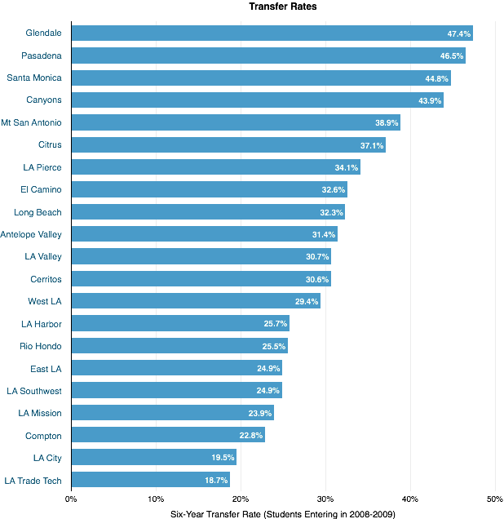
Transfer Rates: Community College in LA County

