Slide 1
PURCHASING POLICIES PROCEDURES AND GUIDELINES

Slide 2
INTRODUCTION
The purchasing of goods and services is one of the most important and sensitive support functions of the District. There is an inherent conflict between the need to comply with the various government codes and good business practices while ensuring that District employees receive the best service in a timely manner. The Purchasing Department is committed to providing competent and responsive purchasing procedures for the District that endeavors to balance the aforementioned needs.

Slide 3
Requirement for policies
The importance of the policies and procedures is apparent by the fact the policies must be provided as part of the accreditation process as well as evidence that the polices are being complied with.
The District is required to comply with all requirements of its fiscal agent, LACOE in order for a warrant to be issued. The District is also under the requirement to retain external auditors to review and report as to compliance of all governmental accounting procedures. This audit report is submitted to the Board of Trustees and any exceptions are required to be included in their report.
The Board of Trustees, in its Administrative Regulations and Board Policies has specified that all purchasing activity be coordinated through the Purchasing Department so Purchasing is tasked with ensuring compliance of all of these rules and regulations.

Slide 4
Purchasing manual
The Purchasing Policy Manual is posted on the District website. Many of the other forms, links, and other useful information is also available on the District website under Administration - Administrative Services Department – Business Services.
Only Purchasing can authorize the an District expenditure. All expenditures must be properly authorized by the issuance of a Purchase Order.

Slide 5
Purchase order requirement
Purchase Orders are only issued when there are unencumbered funds available or arrangements have been made for additional appropriations through established channels.
This approval shall be in advance of purchase.
The first step is an transaction is to verify the available of sufficient funds for the expenditure.
A valid PO is required to obligate any District expenditure.

Slide 6
Financial Reporting
The Financial Report is available to the entire campus. Access is through SharePoint under Admin Login.
There is prompting for the Fiscal Year, Fund, Program, Sub-Program, TOPS, and Object Code.

Slide 7
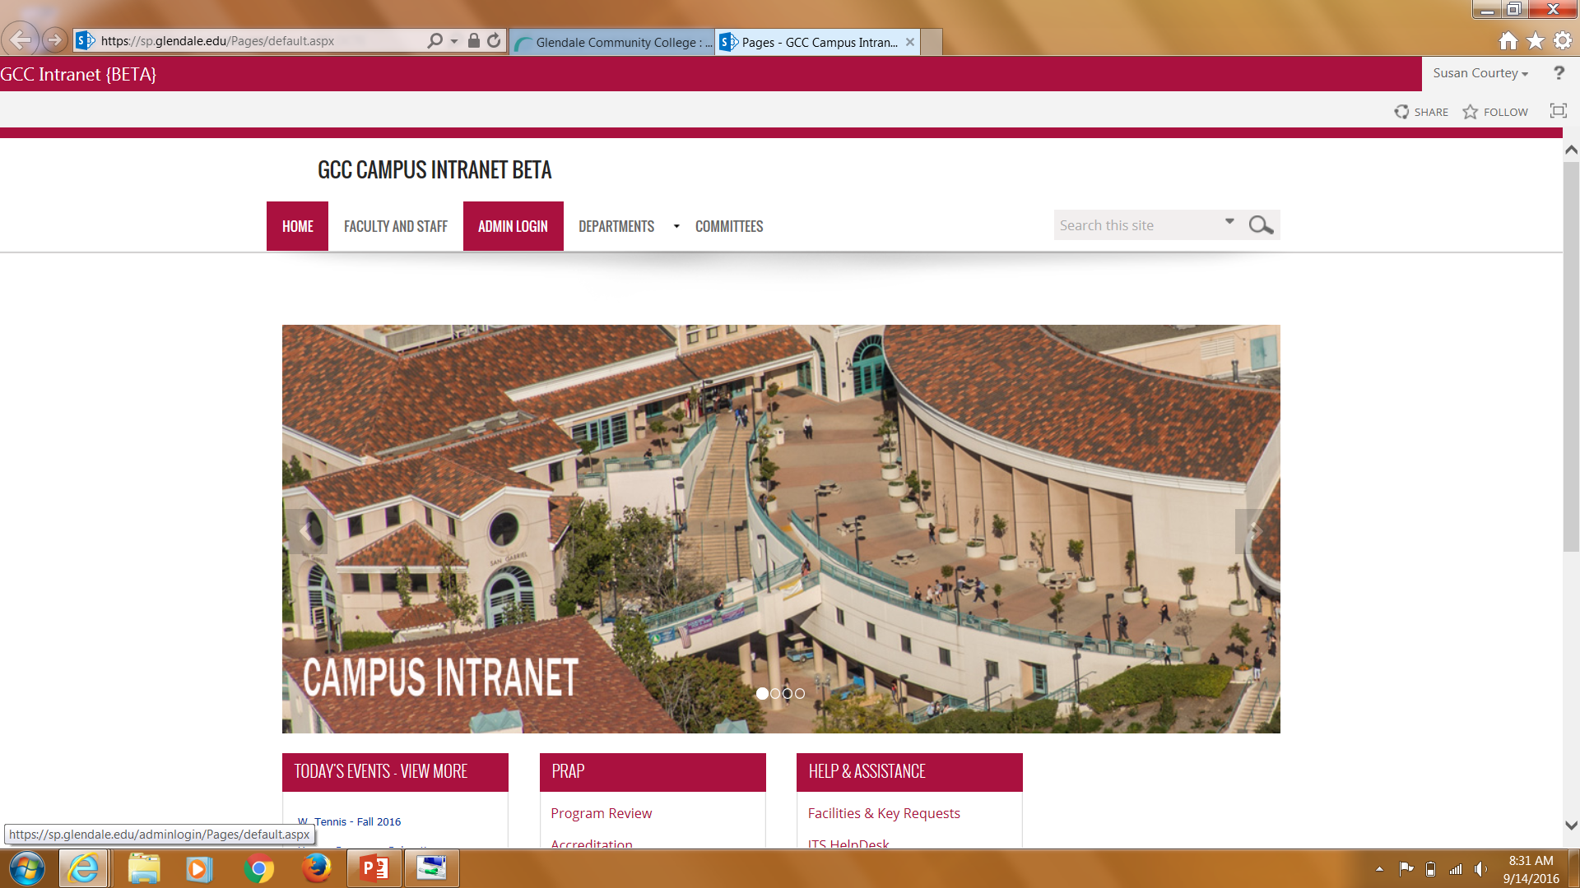

Slide 8
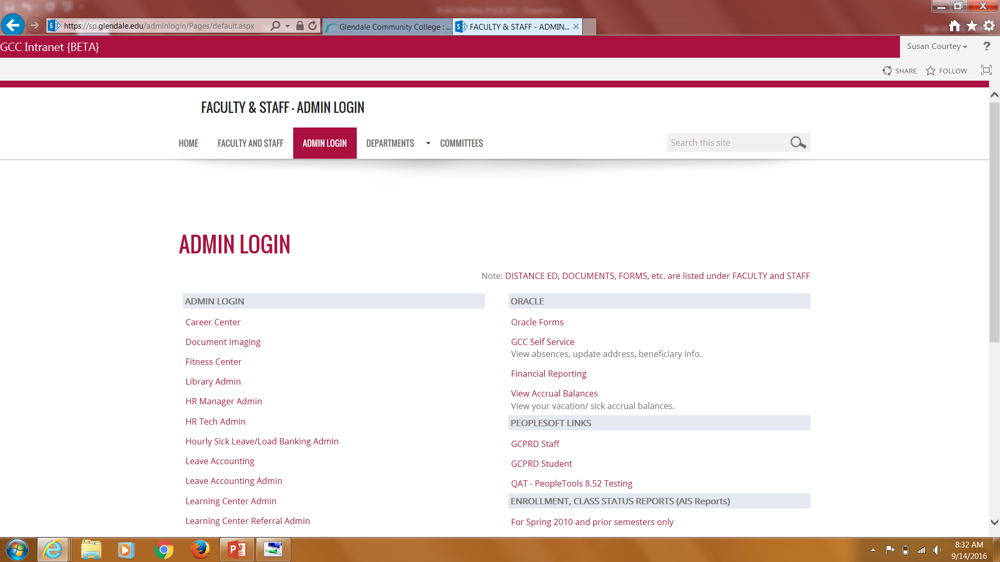

Slide 10
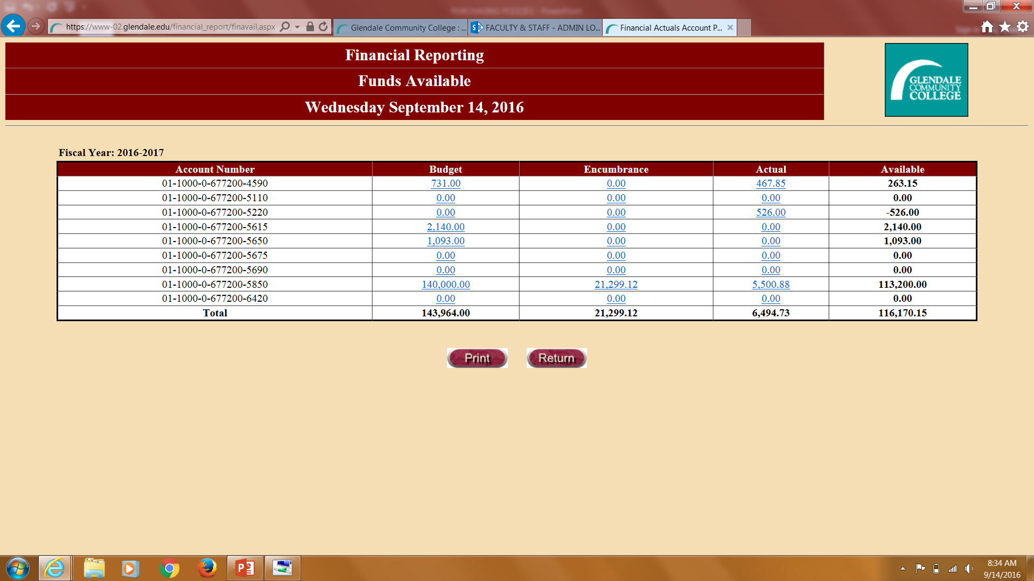

Slide 11
Accounts and available balances
Check the available balance in the account. If insufficient, transfer can be made from within the account stream.
The correct object code for the purchase must be used.
1000-3000 - Payroll and Benefits
4000 – Supplies
5000 – Services
6000 - Equipment

Slide 12
Requisitions
An Oracle Requisition is done online and the instructions and requirements are posted on the District website. Training is also done periodically and upon request. The responsibility of GCC Requisitioning must be added to your Oracle account and log on link is also through SharePoint under Oracle Forms.
A Buy Out requisition is the paper form used for the purchasing of goods and services for the District.
The requirements for both are the same.

Slide 14
Types of requisitions
Purchase of good or services
Itemized list if necessary
Contract or quote must be available to Purchasing at the time of encumbrance
Blanket Purchase Orders
May be for the Fiscal Year or shorter
Must state who is authorized to make the purchase, if applicable
Pre-encumbrances for Reimbursements

Slide 15
Reimbursements
Pre-encumbered reimbursements allow a person to go out and make a purchase from any vendor and submit the receipts to the District for reimbursement.
May not exceed $200
Submit an itemized and approved paper or online requisition to Purchasing prior to making the purchase.
Requisition amount will be encumbered and funds set aside from the requisition account.
Authorization will be given to requestor by Purchasing to make purchase after the PO is set up.
Requestor will return original invoice and/or receipt to Purchasing within the (10) working days of receipt of purchase to process the reimbursement to requestor.

Slide 16
CREDIT CARD and amazon PURCHASES
Credit and Amazon card purchases are only to be made under the following conditions:
Emergency purposes only by the Departments approved for such credit card use.
By the Purchasing Department if no other acceptable means is available for the purchase.

Slide 17
Warehouse requisitions
8 ½ BY 11 White Paper, Colored Paper, Cardstock Paper, Letterhead and Envelopes are ordered on Warehouse Requisitions.
Purchasing will verify the availability of funds and direct Central Receiving to deliver the goods to the requestor.
The form is available in Purchasing.

Slide 18
Office supplies
The District has an account with Office Depot through a statewide purchasing contract.
In an effort to save money and standardize on office supplies, Purchasing has come up with some office standard. The list is available on the website.
For other office supplies, there is a online catalog with GCC pricing. This log on is also available on the GCC website.
Please state the item number along with a brief description when ordering.

Slide 19
FORMAL BIDS
When an individual, or department, wishes to purchase materials and/or equipment in excess of the maximum bid threshold, or the securing of services in excess of the required amounts under the California Education Code requiring a formal bid be must be prepared. A formal bid requires advertising in a local, regularly published newspaper. This action will solicit bids from vendors.
The initial request made by the department/individual is sent to the Purchasing Department for validation of encumbrance of budgetary funds. Additional specifications and/or delineation of services required is then communicated to the Purchasing Department.
Upon dissemination of the request for bids, and after the prescribed time limit, the bids are opened in a public forum at the time and place announced in the bid documents. The bids are then analyzed for appropriate responses to the bid documents and the inclusion of a bid bond. Subsequent to that review, a Board action item is prepared for the next scheduled Board of Trustee meeting recommending the award of the contract for materials/services to the lowest responsive, responsible bidder. By acceptance of the bid by the Board of Trustees, a purchase order is then entered into the computer which allocates the funds for the materials/services and notification is made to the successful bidder. The successful bidder then provides the appropriate forms properly executed as required in the bid documents.

Slide 20
Technology purchases
All purchases for computers and technology must meet the standards set forth by the ITS. Standards are set by the ITS and appropriate Committees.

Slide 21
Personal service agreements
The Personal Services Agreement form is utilized when the District contracts with Individuals to provide a service. The individual is acting as an independent contractor and not associated with any company or firm. Personal Services Agreement forms require both a board approved signatory and that of the contractor. The social security number and correct contact information for the individual contractor is also necessary. The contractor must submit a request for payment under the terms and conditions set forth in the Personal Services Agreement after the services have been rendered and signed off by the manager/requestor.
A prepared Personal Services Agreement is presented with a requisition to encumber the monies prior to the performance of the requested services. The creation of the PO creates the inclusion in the Contract Board Report.
At the end of the calendar year, Accounting is required to issue IRS 1099 forms on all Personal Services Agreements in excess of $599.99.

Slide 22
Equipment purchases
Purchasing will assist in obtaining quotes and proposals to assure compliance with Government Codes and Purchasing Guidelines. Equipment requests must be made on a Buy Out or Oracle Requisition describing in detail the services to be provided and other related terms and conditions A completed requisition with the Proposal, Agreement, or Quote is forwarded to the Purchasing Department to encumber the total amount of the agreement. A printed purchase order is then forwarded, along with a copy of the agreement, to the vendor/company.
All items over $500 must be tagged and tracked upon receipt either by Central Receiving or Information Technology Services for inclusion in the asset database to comply with codes and regulations. All items over $5,000 must be capitalized and depreciated to track the “useful life" and are kept on the physical inventory books until they are officially removed from the inventory as surplus or scrap.

Slide 23
GRANT, CATEORICAL, AND OTHER SPECIAL FUNDING PURCHASES
The budget and the parameters of the funding source must be ascertained and followed. The budget must be set up prior to any purchases. For Federal Grants for all expenditures for a supplier in an amount over $25,000, the supplier must be checked for debarment prior to ordering.
All items over $500 must be tagged for tacking purposes under the Grant. Items over $5,000 will be capitalized. (See Receiving and Equipment Purchases)
Managers are responsible for knowing the rules, regulations and scope of the funding source. The Director of Business Services is always available as a resource for assistance in interpretation of these provisions to ensure compliance.

Slide 24
RECEIVING REQUIREMENTS
All merchandise ordered through the Purchasing Department must be delivered through Receiving to insure that a three-way check system is satisfied. The barcode of item will be scanned and the item will be shown received on Oracle.
Any fixed asset item with a value of over $500 and/or technology purchase must be inventoried and assigned an inventory number. The fixed asset item is any consumable with an estimated life of 3-5 years. It is identifiable by Model, Serial Number or other information specific to that item. Technology equipment will be delivered to ITS who will tag those assets. All other equipment will be tagged by Central Receiving. Both Departments will regularly submit the spreadsheets to Accounting for inclusion on the asset listing. Items will remain on the list until Board Approval as surplus or other in accordance with Board Policies.

Slide 25
EXCHANGE/RETURN OF MERCHANDISE
All exchanges or returns are to be processed through the Purchasing Office to insure proper credits and/or adjustments can be made to the original purchase order.
Notification of any exchange or return will be made to the Purchasing Office in writing.
All exchanges, returns or disposal of surplus merchandise needs the approval of the Director of Business Services, prior to being processed.

Slide 26
travel
Travel forms must be completed prior to the travel.
Forms are available in Purchasing
All rules and processes are stated on the back of the document
Must be signed by the VP. President approval required for out of state travel.
Advances limited to those stated on Form. Flight, Lodging, Registration.
Allow time for processing advance.
Upon return, promptly submit receipts. Forms states within 20 days of return.
A separate requisition can be done for just the registration especially if a group is attending and it is more convenient.

Slide 27
Miscellaneous information
Bookstore - Purchase Orders to the Bookstore should be limited to exact items needed. Most office supplies and other items are cheaper through Office Depot and can be receive within a day or two.
New Suppliers – New vendors must be approved by Purchasing prior to the issuance of the PO. Plan ahead so the department can complete the credit application if necessary, obtain a W-9, and enter the supplier in the system.
Emergency Orders – Please contact Purchasing as soon as the need for the expenditure arises. Purchasing should be able to facilitate any request within a day when necessary. Communication is key on these orders.
Catering and Food – The District has accounts with several suppliers that will accept POs and/or prepayment. When the need arises please let Purchasing know so that they can expedite any needs. New accounts can also be set up with enough time and information.

Slide 28
conclusion
Purchasing has many resources and accounts set up with volume discounts so do not hesitate to contact Purchasing for assistance with obtaining quotes and proposal and seeking out the best supplier for the needs.
Communication and timing are crucial to getting the best results as expeditiously as possible within the framework of the rules, regulations and, processes.
Questions are welcome, especially ahead of the transaction as it gives the best opportunity for great service.
The Purchasing Department and me personally are always able and willing to work with everyone to assist in getting what is needed as quickly as possible.

