Slide 1
Guided Pathways
Faculty Meeting 4.11.2017
Thomas Voden
Mathematics Division
Glendale Community College

Slide 2
Brief Presentation Outline
Why?
What is it?
Brief history
Principles and Components
Comparing models
Student perspective
Snapshots of effectiveness
Closing & Discussion

Slide 3
“Equity is at the core of the Guided Pathways movement”
- Dr. Sonya Christian, President of Bakersfield College
Lost in a Maze
3

Slide 4
New Students Want to Know
What are my career options?
What are the education paths to those careers?
What will I need to take?
How long will it take and how much will it cost?
How much financial aid can I get?
Will my credits transfer?
4

Slide 5
Returning Students Ask
How far along am I toward completing my program? How much more will I have to pay?
What will I need to take next term and what will my scheduled be?
What if I want to change programs?
Will my credits transfer?
How can I get work experience in my field of interest?
5

Slide 6
What Is the “Pathways Model?”
An integrated, institution-wide approach to student success based on intentionally designed, clear, coherent and structured educational experiences, informed by available evidence, that guide each student effectively and efficiently from her/his point of entry through to attainment of high-quality postsecondary credentials and careers with value in the labor market.
Notes:
We have many effective student support resources available, but whether a student comes into contact with the service is pretty random.

Slide 7
A National Movement
Achieving the Dream (2004)
Developmental Education Initiative (2009)
Growing CCRC Research
College too complex & confusing
Gateway courses in 1st year
Basic Skills Acceleration
Completion by Design (2011)
“Redesigning America’s Community Colleges” (2015)
AACC Pathways Project (2016)
California Guided Pathways Project (2017)
$150M from State for GP Implementation at CCCs (proposed for 2017-18)

Slide 8
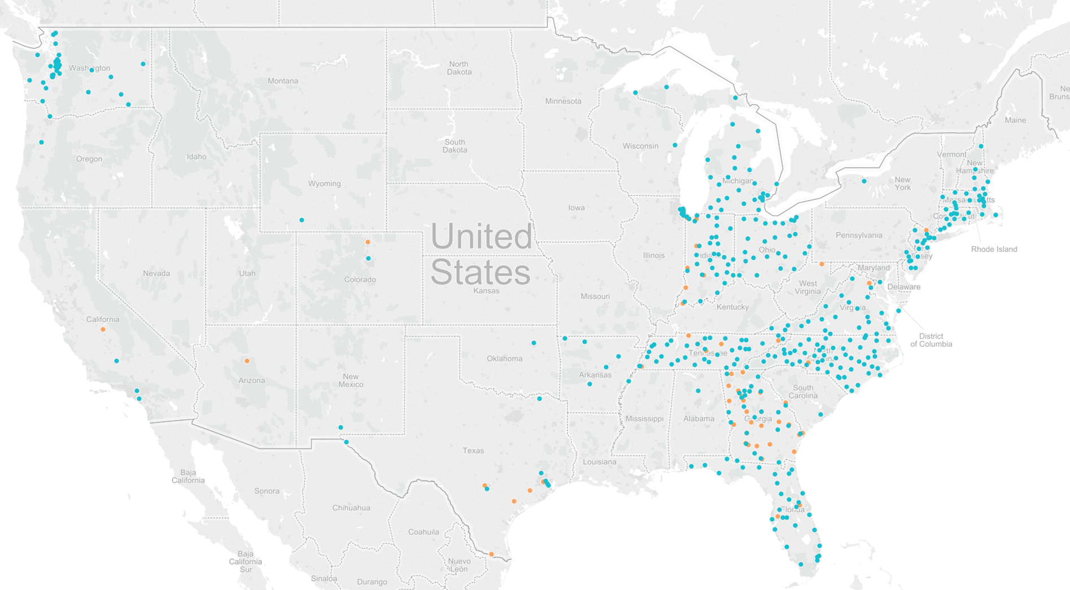
A National Movement
8

Slide 9
Design Principles
Entire student experience
Unifying framework for initiatives
Backward design

Slide 10
Four Essential Practices of Pathways – “the Four Pillars”
Clarify paths to student end goals
Help students get on a pathway
Help students stay on path
Ensure that students are learning

Slide 11
Clarify Paths to Student End Goals: What Does It Look Like?
Features:
Detailed information on target career and transfer outcomes
Course sequences, critical courses, embedded credentials, and progress milestones
Math and other core coursework aligned to each program of study

Slide 12
Help Students Get on a Pathway: What Does It Look Like?
Features:
First-year experiences to help students explore the field and choose a major
Full program plans based on required career/college exploration
Contextualized, integrated academic support to help students pass program gateway courses
K-12 partnerships focused on career/college program exploration

Slide 13
Help Students Stay On Path: What Does It Look Like?
Features:
Ongoing, intrusive advising
Systems for students to easily track their progress
Systems/procedures to identify students at risk and provide needed supports
A structure to redirect students who are not progressing in a program to a more viable path

Slide 14
Ensure That Students Are Learning: What Does It Look Like?
Features:
Program-specific learning outcomes
Project-based, collaborative learning
Applied learning experience
Faculty-led improvement of teaching practices
Systems/procedures for the college and students to track mastery of learning outcomes

Slide 15
Two Models Compared (1 of 4)
Cafeteria Model | Guided Pathways Model
Academic Program Structure
Paths to student end goals are unclear. Program requirements are confusing; guidelines for progression are not clear and consistent. There is a lack of curricular coherence across courses, and students may not acquire needed skills. Course schedules are unpredictable and often set to accommodate college needs, not student needs. Curriculum in high schools and other feeders is not aligned to college requirements. | Programs are fully mapped out and aligned with further education and career advancement. Critical courses and other milestones are clearly identified on program maps. Student learning outcomes are specified across programs. Predictable schedules are set based on analysis of courses students need to progress on their plans. HS and other feeder curriculum is designed to prepare students to enter college programs in particular fields.
From CCRC’s “What We Know About Guided Pathways”

Slide 16
Two Models Compared (2 of 4)
Cafeteria Model | Guided Pathways Model
New Student Intake
Career and college planning is optional. Undecided students are allowed to explore on their own. Assessment is used to sort students into remediation or college- level courses. Prerequisite remediation is narrowly focused on college algebra and English composition. | Academic plans, based on program maps, are required. Students are required to enter exploratory majors and choose specific programs on a specified timeline. Assessment is used to diagnose areas where students need support. Instruction in foundation skills is integrated into and contextualized with critical program courses.
From CCRC’s “What We Know About Guided Pathways”

Slide 17
Two Models Compared (3 of 4)
Cafeteria Model | Guided Pathways Model
Instruction
Learning outcomes are focused on courses, not programs. Instructors are often isolated and unsupported. Metacognitive skills are considered outside the scope of instruction. | Faculty collaborate to define and assess learning outcomes for entire programs. Faculty are trained and supported to assess program learning outcomes and use results to improve instruction. Supporting motivation and metacognition is an explicit instructional goal across programs.
From CCRC’s “What We Know About Guided Pathways”

Slide 18
Two Models Compared (4 of 4)
Cafeteria Model | Guided Pathways Model
Progress Monitoring and Support
Student progress is not monitored, or there is limited feedback on progress. Students do not have a clear idea of what they need to do to complete program requirements. Students’ performance in critical program courses is not closely monitored. Communication between advisors and academic departments is poor; advisors lack accurate program information. | Student progress on academic plans is closely monitored, with frequent feedback. Students can see how far they have come and what they need to do to complete programs. Early warning systems identify students at risk of failing critical courses and initiate timely interventions. Advisors work closely with program faculty, with a clear division of labor for monitoring student progress.
From CCRC’s “What We Know About Guided Pathways”

Slide 19
Student Support(Re)defined RP Group
The RP Group asked nearly 900 students from 13 CCCs what supports their educational success, paying special attention to the factors African Americans and Latinos cite as important to their achievement.

Slide 20
Six Success Factors
Directed: Students have a goal and know how to achieve it
Focused: Students stay on track—keeping their eyes on the prize
Nurtured: Students feel somebody wants them to succeed as a student and helps them succeed

Slide 21
Six Success Factors (cont.)
Connected: Students feel they are part of the college community
Engaged: Students actively listen and participate in class and are involved in extracurricular activities
Valued: Students’ skills, talents, abilities and experiences are recognized; they have opportunities to contribute on campus and feel their contributions are appreciated

Slide 22
Crosswalk: Success Factors and Guided Pathways
Clarify paths to student end goals
Directed
Help students choose and enter a pathway
Directed, Focused, Connected, Nurtured, Engaged
Help students stay on path
Directed, Focused, Connected, Nurtured
Ensure that students are learning
Directed, Focused, Engaged, Connected, Valued, Nurtured

Slide 23
Evidence of Effectiveness
From LAO’s Higher Education Analysis for the 2017-18 budget

Slide 24
Acknowledgements
This presentation includes content developed by:
Community College Research Center (CCRC)
AACC Pathways Project
CA Guided Pathways Project
Dr. Darla Cooper (RP Group)

Slide 25
More Opportunities for Discussion
Guided Pathways Roundtable Series
Invitation emails sent to GCC
April 14, May 5, May 19
glendale.edu/guidedpathways
Funded by Title V Abriendo Caminos
Thank You!!
Tom Voden
tvoden@glendale.edu

