Slide 1
Just Move It
How Exercise Can Change the Physiology and Fitness of Your Heart

Slide 2
Cardio - “aerobic” physical activity
CDC: Every adult
150min/week of moderate PA
75min/week of vigorous PA
Moderate PA: breathing and heart rate, conversational pace
Vigorous PA: breathing and heart rate, only words or short sentences possible
Notes:
Cardio is often referred to as aerobic physical activity or aerobic exercise, yet it is often anaerobic as well at higher intensities. The center for disease control recommends that all healthy adults get a minimum of 150 minutes of moderate aerobic physical activity per week OR 75 minutes of vigorous aerobic physical activity per week just to maintain a basic level of heart health and prevent many chronic diseases (like heart disease and diabetes). Exercise puts stress on the heart - but why does exercise equate to a healthier heart? How does this stress work to make us healthier and more fit?

Slide 3
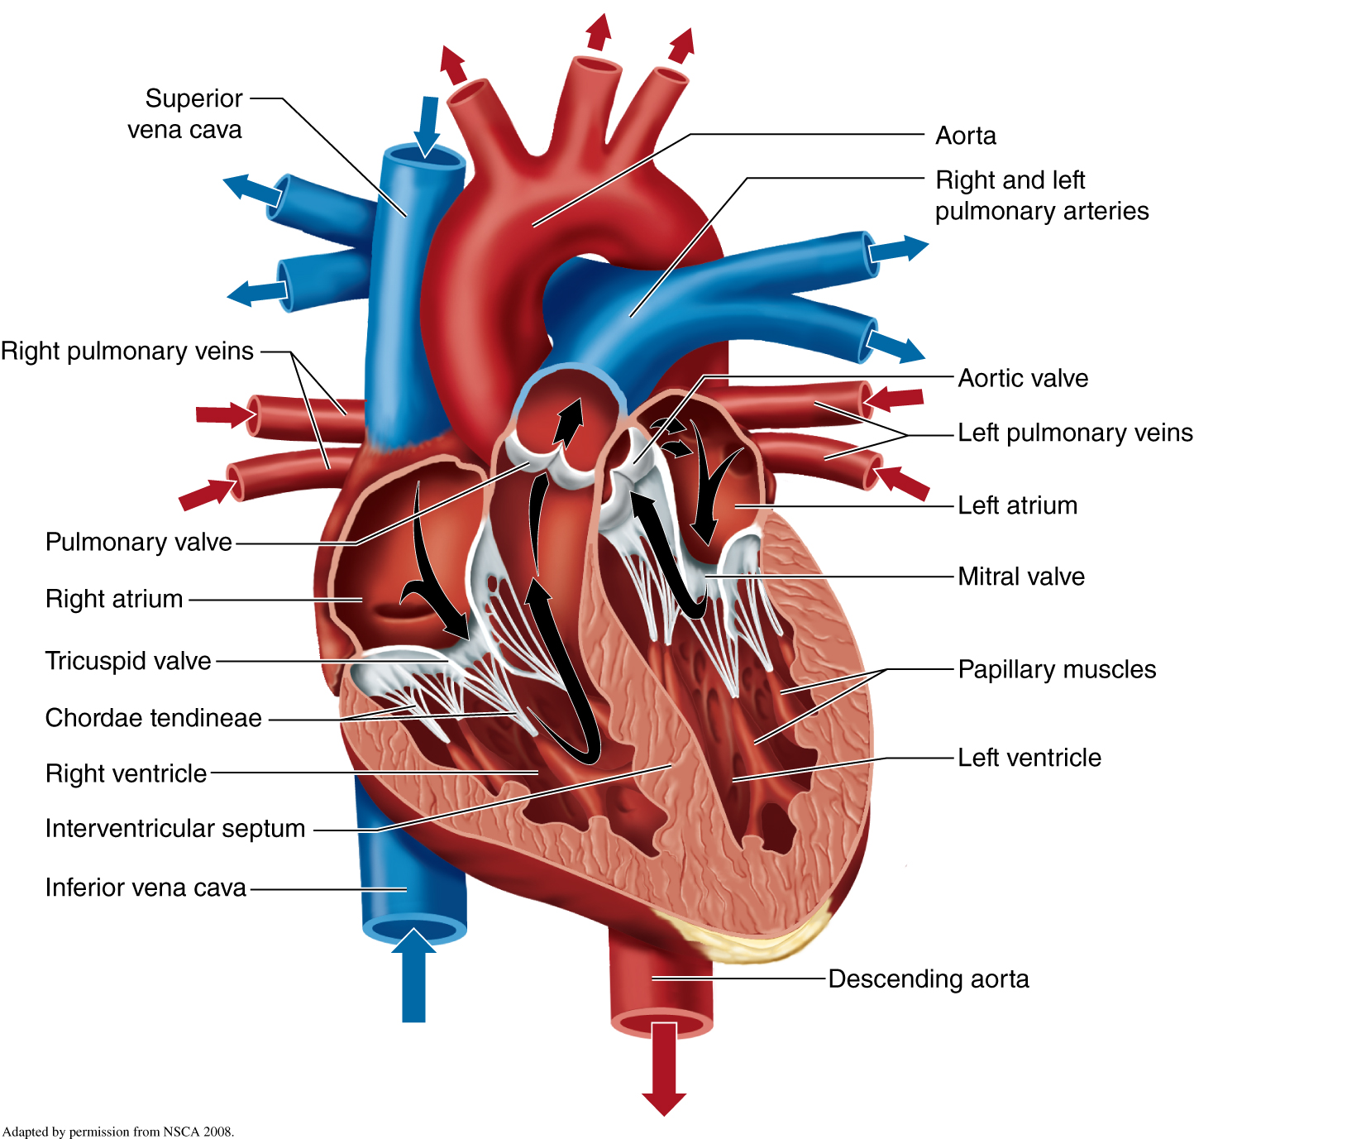
Notes:
Go over basic heart anatomy using Human app. Identify: Atria, ventricles, blood flow through heart, importance of left ventricle in heart function. The left ventricle pumps blood through the aorta to the rest of the body. It must create enough force to overcome the resting (diastolic) pressure in the arteries and create a pressure wave that drives blood flow. Usually it is the larger and stronger of the two ventricles for this reason, and responds the most to cardio exercise. The muscle in the heart is elastic and when stretched further will cause a stronger contraction. During exercise, the sympathetic nervous system (fight or flight) increases the neural drive to the heart muscle and increases the force of contraction that way as well. Also if there is lower pressure in the aorta to overcome, the heart can force more blood out of the left ventricle with each contraction.

Slide 4
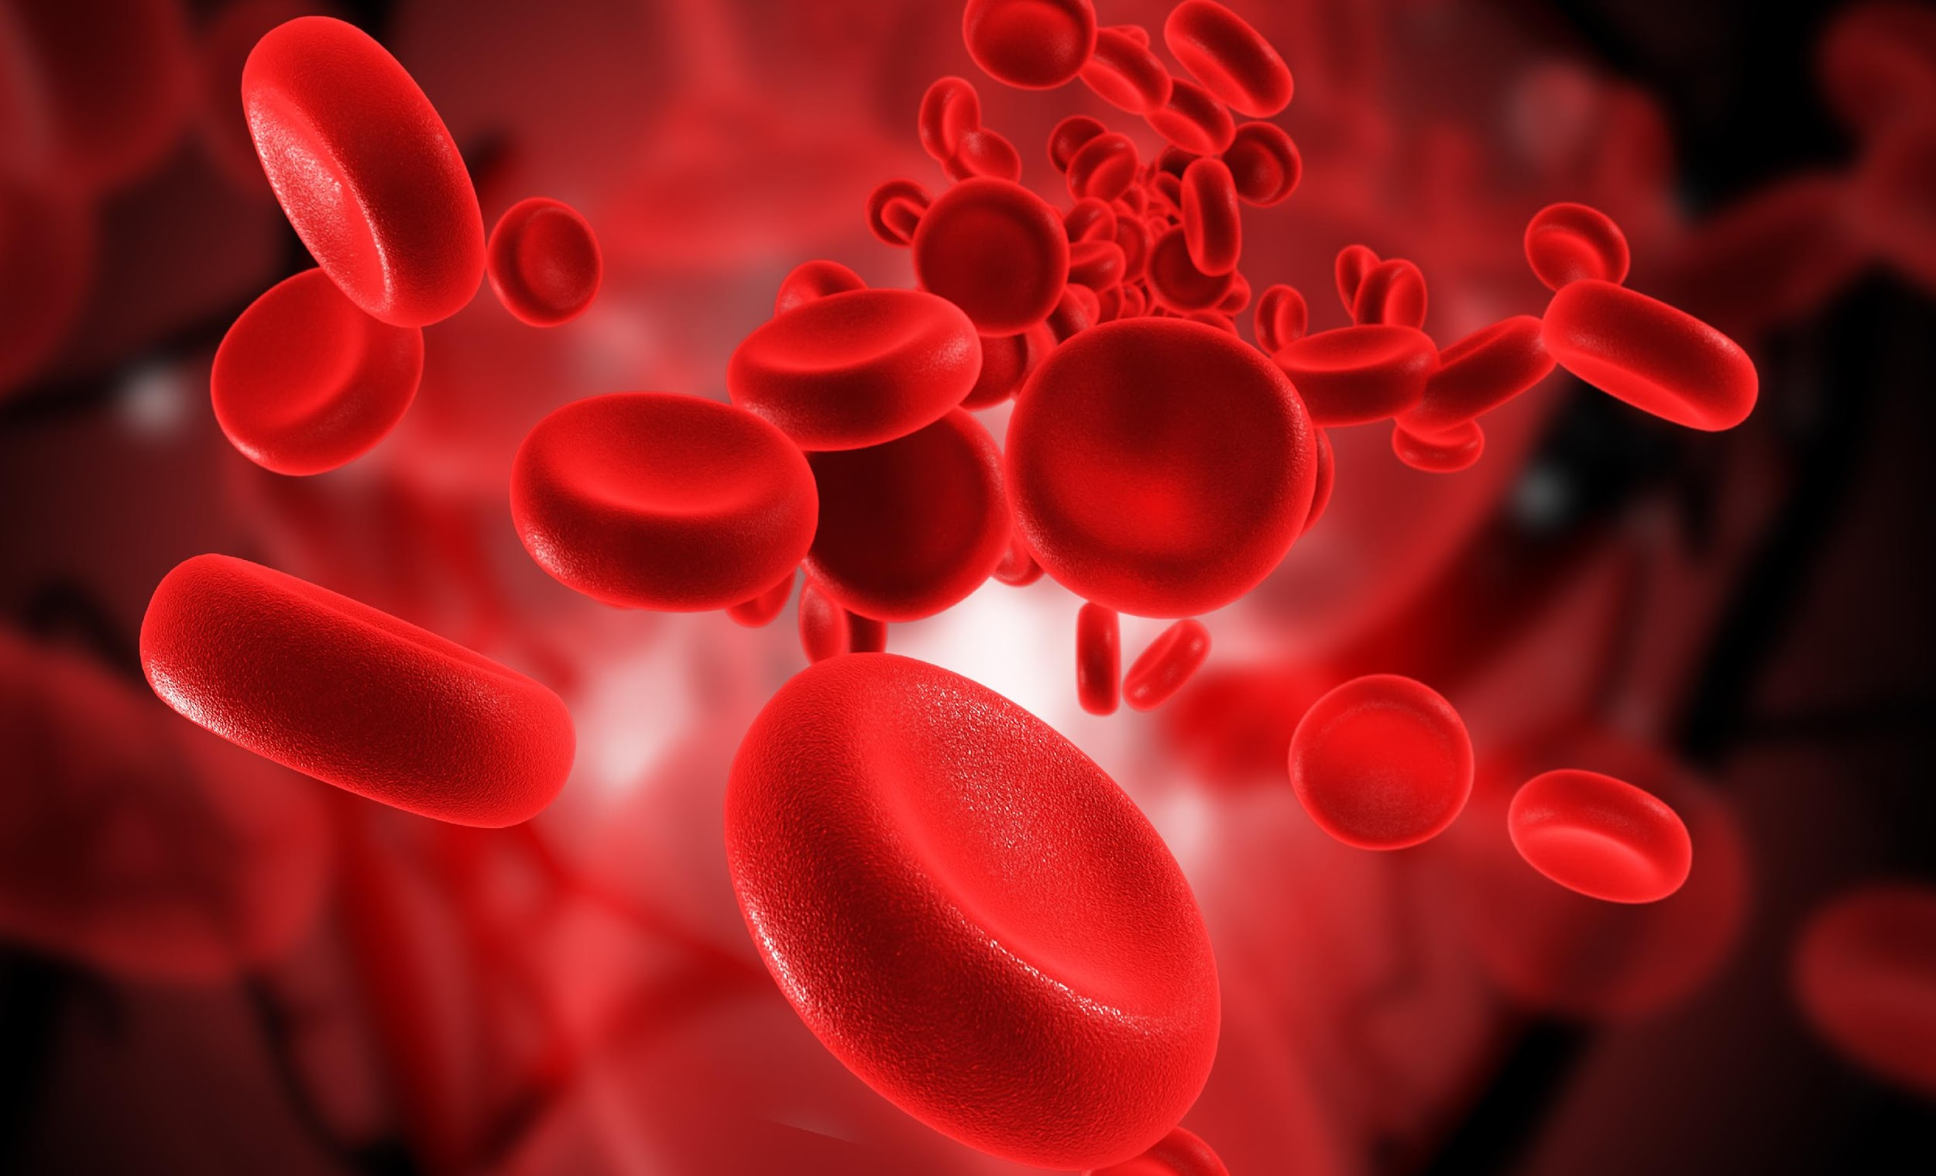
Notes:
The primary role of the heart is to create this pressure wave that pushes blood through the entire body. This pressure wave drives blood flow carrying oxygen rich red blood cells to tissues that need it. In our case, these tissues will be the major muscles that cause movement. Oxygen is particularly important for large muscle, dynamic movement because the body can only make so much energy (ATP) without oxygen before fatiguing. The amount of ATP that can be made with oxygen is almost unlimited. So getting oxygen and nutrients (fat and carbs) to the working muscles becomes of utmost importance during exercise.

Slide 5
At the onset of exercise, working muscles demand more O₂ to make energy – how do we get it to them?
Notes:
This is why Caitlyn Jenner looks so good now, right?
When we start exercising, our muscles immediately need more oxygen to make ATP - but how do we get it there quickly?

Slide 6
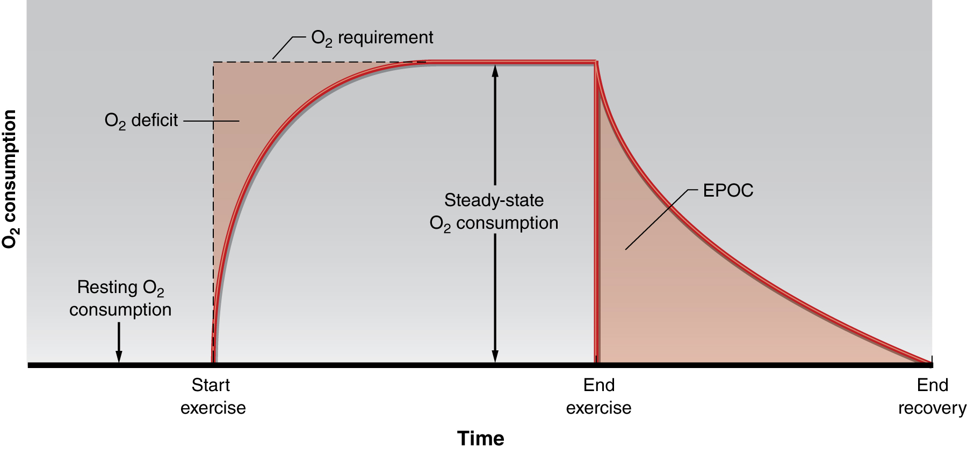
The heart “accelerates” its output to meet the O₂ demand of the body…
Notes:
Initially, the heart is not pumping enough blood to working muscles to meet the demand when exercise begins. This creates what we call the oxygen deficit. In the first few minutes, the body is using energy stores and pathways that do not require oxygen (the anaerobic pathways) to make up for the deficit. Once the heart is pumping enough blood per minute to meet the demand, the oxidative systems become primary. After exercise, the body still uses the oxidative systems to “repay” itself the deficit and recover from exercise. (This is called EPOC)

Slide 7
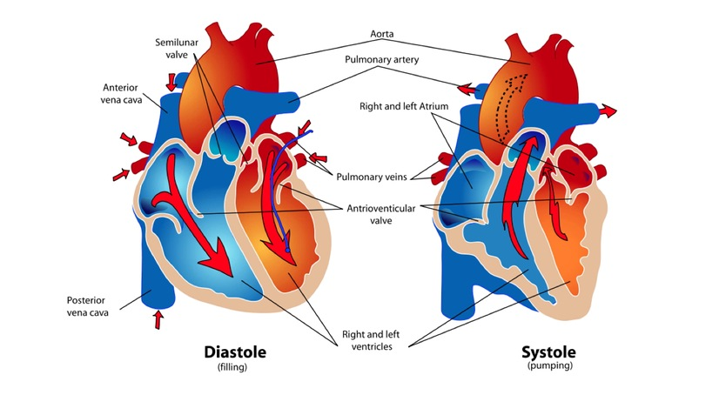
Heart Rate(HR) = number of contractions per minute
Stroke Volume(SV) = amount of blood pumped out of the left ventricle (LV) with each contraction
Cardiac Output(CO) = Total amount of blood pumped out from the heart each minute (HR x SV)
http://www.interactive-biology.com/2283/049-what-stroke-volume-is-and-how-to-calculate-it/
Notes:
During exercise, signals from the autonomic nervous system and circulating hormones (epi/norepi) cause increases in heart rate and muscle fiber contractility.
Go over Frank-Starling mechanism.

Slide 8
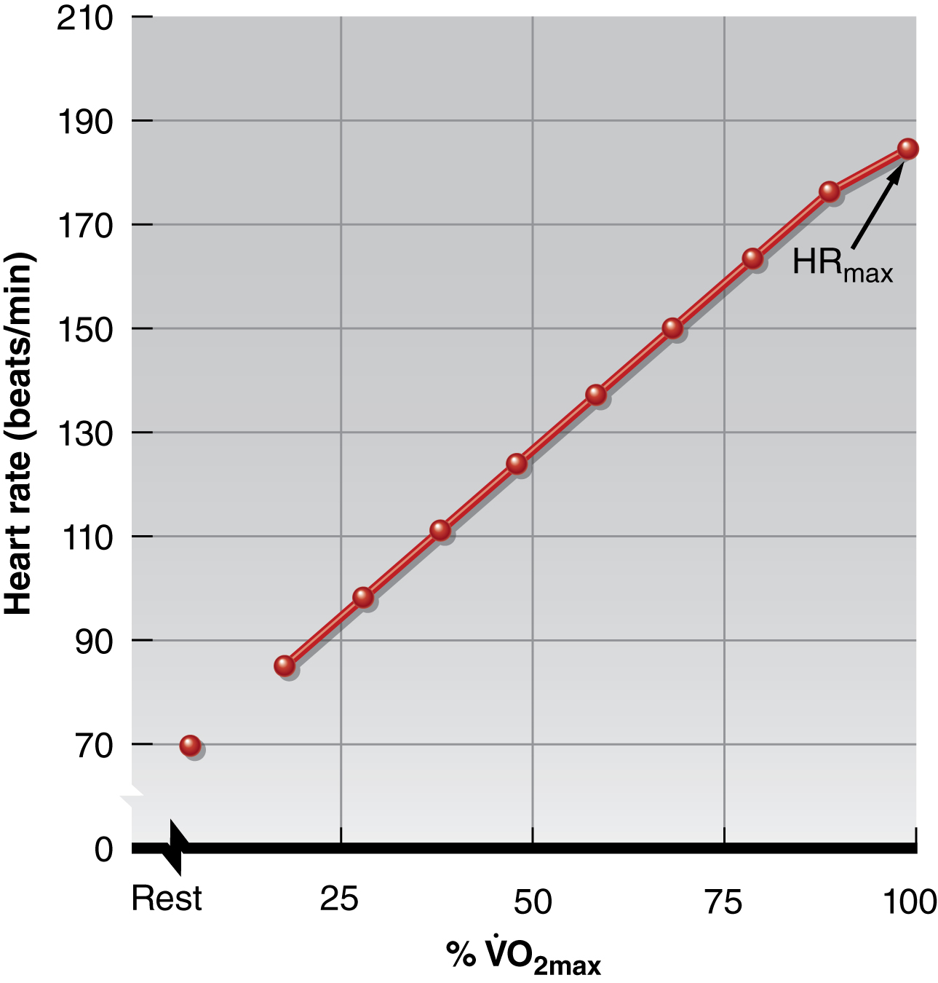
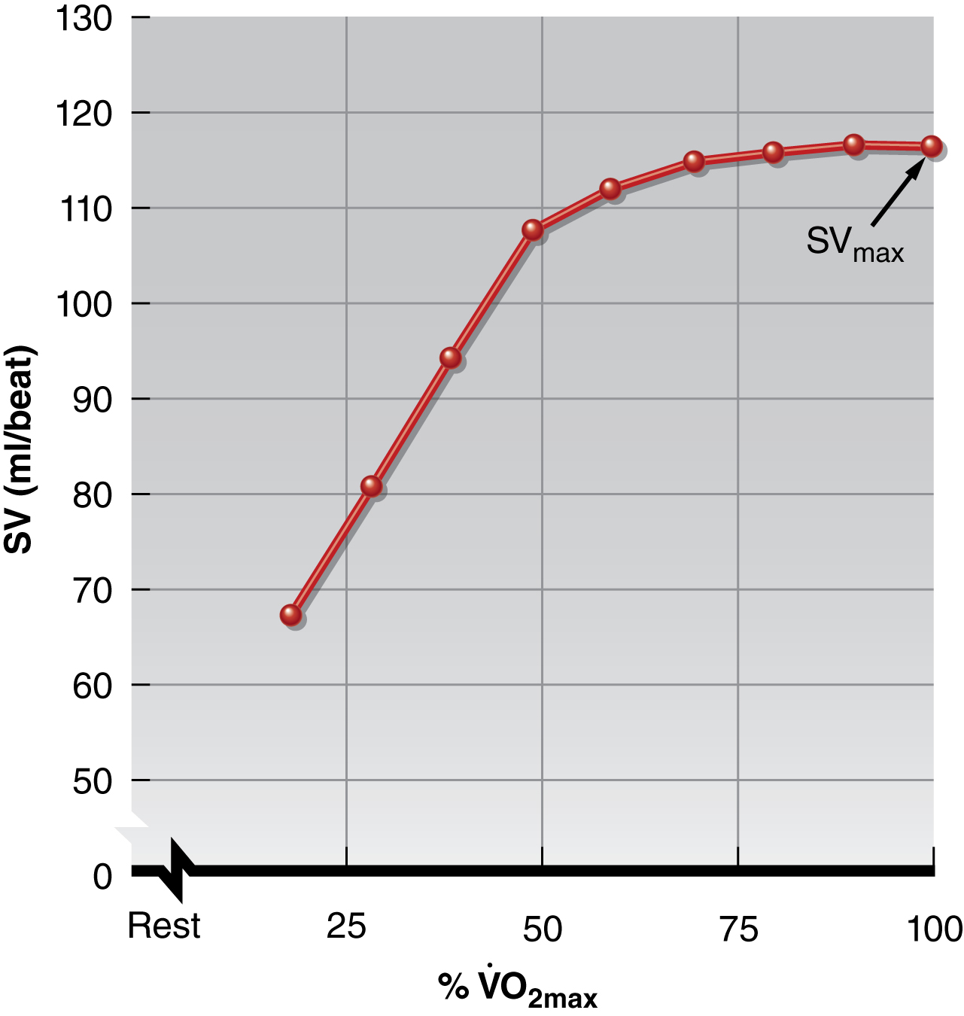
With increasing intensity, both HR and SV increase to meet the cardiac output demand…
SV plateaus between 40-60%max in most non-athletes/untrained individuals - why?
Notes:
The heart meets the demand of the muscles by doing 2 things: increasing heart rate (the number of beats per minute) and increasing stroke volume (the amount of blood ejected from the left ventricle with each contraction.) The sympathetic nervous system will cause the heart rate to speed up, as well as the release of epinephrine (adrenaline). But stroke volume requires a few factors to increase: An increase in preload, higher electrical conductivity and decreased afterload.
Preload: as more blood flow is returned to the heart faster, the left ventricle stretches like a balloon. This stretch actually causes the muscles to be able to produce more force - kind of like stretching a rubber band.
Electrical Conductivity: the SNS increases the electrical stimulation of the heart muscle, causing it to contract with more force each time.
Afterload: because the body is diverting blood flow to the working muscles, and the heart is beating faster and stronger, there is a greater difference between the systolic (contracting) blood pressure or wave that the LV is creating, and the left over (resting, diastolic) blood pressure in the arteries. This is why during exercise systolic blood pressure goes up but diastolic BP may remain the same or even decrease. This allows the heart to not have to work as hard in order to drive that blood flow into the arteries.
SV plateaus between 40-60% VO2max in most non-athletes because 1. the heart is beating so quickly that there is no additional time to increase the filling of the left ventricle, and 2. there is an overall drop in vascular resistance so further increases in venous return may not be possible.

Slide 9
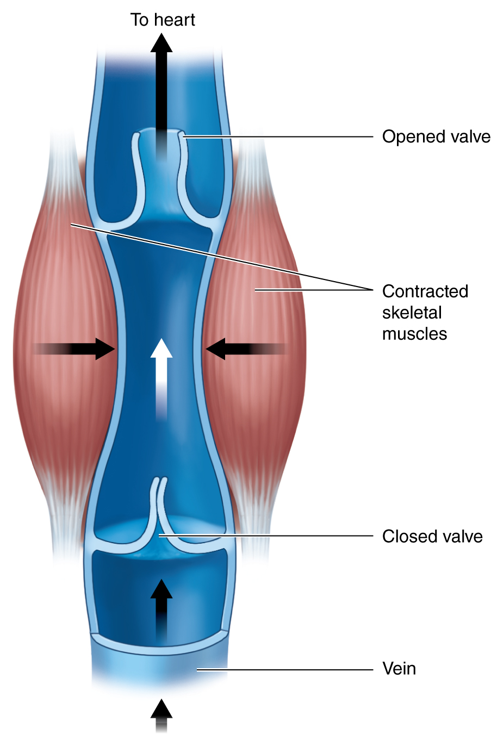
Preload: Amount of stretch in the ventricular myocardium at the end of diastole (filling).
Afterload: Amount of residual blood pressure in the arterial system which the LV must produce enough force to overcome.
Venous Return
More blood back to the heart = more filling = more stretch = higher force of LV contraction!
Notes:
Venous return (the amount of blood returning to the heart) is increased during whole body exercise (especially with the legs and in an upright position). This is facilitated by the muscle pump (pictured) the abdominothoracic pump (from increased diaphragmatic contraction (deeper and more rapid respiration) and venoconstriction.
Afterload drops during exercise because of overall greater vasodilation in arterioles feeding working muscles (less overall vasoconstriction to the viscera). This reduces the resistance to blood flow and therefore the LV can overcome the blood pressure in the aorta more easily.

Slide 10
VS.
Notes:
So what’s the big difference between the ridiculously photogenic runner’s heart on the left, and two-time Olympian Dathan Ritzenhein’s heart on the right?

Slide 11
Notes:
Now here’s the biggest difference between the heart of a trained endurance athlete and an untrained “average” person: the trained person’s heart has a higher stroke volume, and is therefore able to pump out more blood every time it beats – it’s more efficient and has more maximal output. For the same heart rate, a trained person’s heart can pump far more blood per minute than an untrained person’s heart, as we see in this graph.

Slide 12
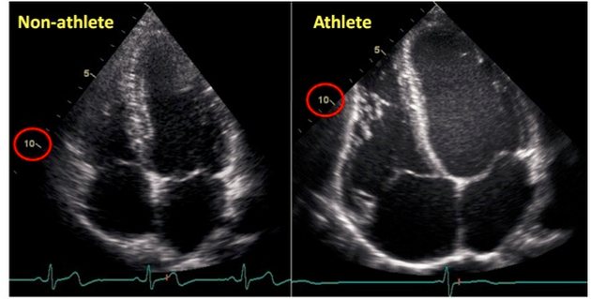
The endurance athlete’s heart has a
Bigger Left Ventricle (internal diameter)
Thicker Left Ventricle Wall (more muscle)
Lower resistance to blood flow (more plasma)
Image: http://cyclingtips.com.au/2010/10/exercise-is-good-for-the-heart…-but-is-there-a-limit/
Notes:
Over time, repeatedly stressing the heart by increasing preload and electrical conductivity, and decreasing afterload, causes the left ventricle to change it’s shape and function. It adapts to the stress by becoming larger - increasing the internal diameter - from the repeated stretching (or preload). It also increases the wall thickness (hypertrophy) by adding more muscle so that each contraction is performed more forcefully than before.
Another cool adaptation is that the blood adapts as well - we get more red blood cells and more plasma, which makes the blood more watery and easier for the heart to push through the arteries. The trained individual has between 20-25% more total blood volume than the untrained person.
This means that with each heartbeat, the heart has to work less and is able to pump more. Basically it’s more efficient - and it doesn’t have to beat as many times every minute to get the same output.
This picture shows the difference in heart size between a non-athlete and an endurance athlete - look at the 10 cm marker! The athlete’s heart is bigger, more powerful and more efficient than the non-athlete’s heart.

Slide 13
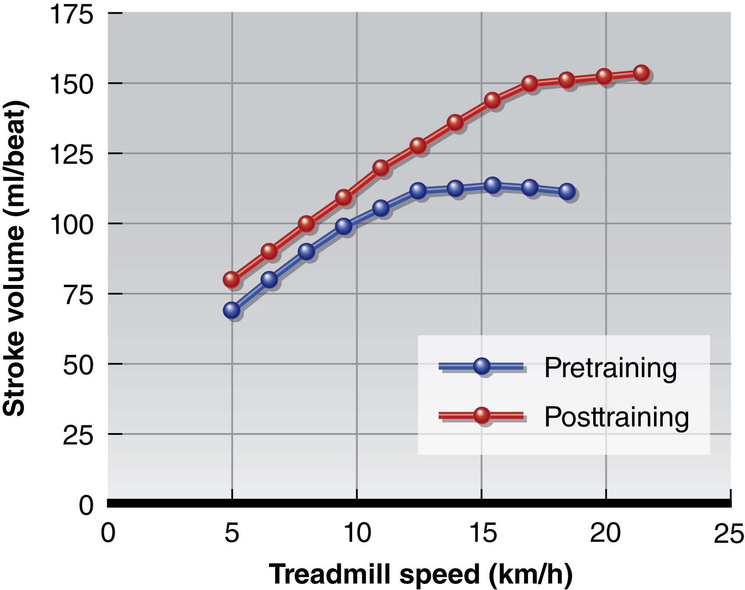
Notes:
If we start with an untrained person, have them perform regular endurance training (cardio) for a period of six months, we see some significant changes in their stroke volume. Not only is stroke volume increased at rest, but also during equivalent submaximal intensity exercise and even at max. Not only is their SV max higher, but as is shown in this graph, the person was able to run faster - so their actual max speed increased as well.
This is caused by several adaptations:
-More plasma volume - which increases filling of the LV during diastole and decreases resistance to blood flow, thereby decreasing afterload.
-An increased internal diameter of the LV - a larger LV allows for greater filling.
-A slower HR at rest and submax: this allows for more time between beats for the heart to fill.
-More muscle in the wall of the LV. This is called LV hypertrophy, and although this would be a very bad sign in a diseased heart, in an exerciser’s heart this adaptation means more force is produced with each contraction.
There are of course other adaptations that occur peripherally to muscle cells, the vascular system, blood and even mechanical efficiency, all of which help to increase speed and efficiency of the cardiovascular system and the effective use of carbohydrates and fats to make energy and cause efficient muscle contractions that move our limbs.

Slide 14
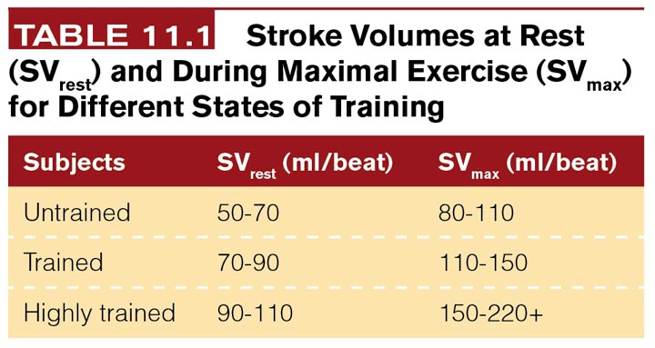
Notes:
Just to show you what those numbers look like: if we compare the stroke volume of an average person’s heart in different states of training. Their heart is more efficient both at rest and during exercise!
One of the ways that you can monitor your improving fitness is tracking your resting and submaximal exercise heart rate.

Slide 15
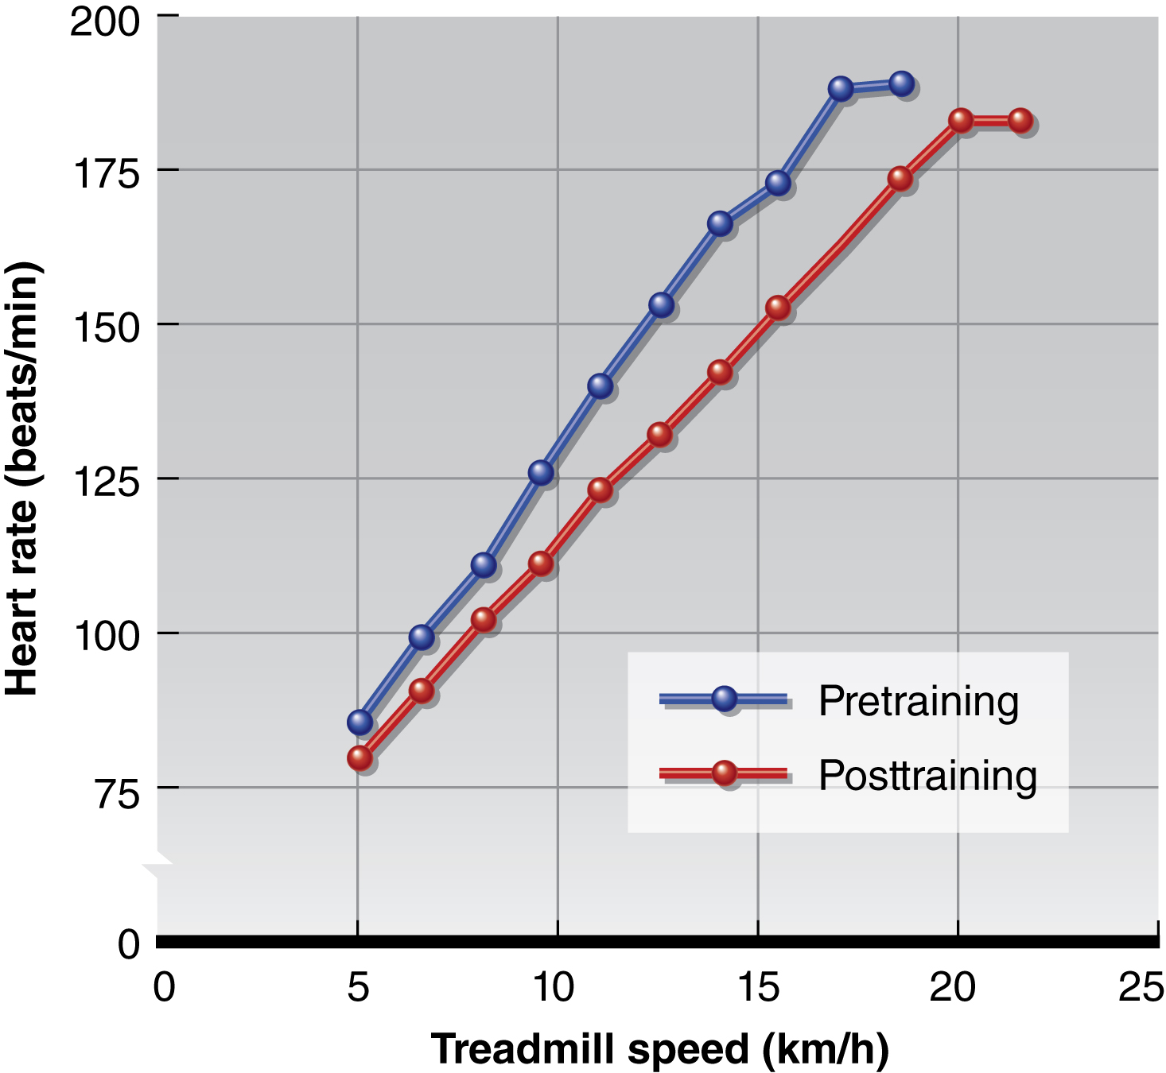
Notes:
That’s what we see here. If we took your average, untrained student and monitored their heart rate on a treadmill as we slowly increased the speed and incline until their max (they either quit or fall off!) then this would be the blue line. Then say they took a couple of running aerobics classes or even the spin classes and we tested them again 6 months later. What we would see is that not only would their max speed be faster, but each incremental speed/incline would be easier. Going at 10km/h for this person pre-training gave them a heart rate of 125, whereas post-training their heart rate was closer to 110 bpm. This shows us how their heart has become a stronger and more efficient pump - making it have to work less to get the same running speed. Another indication of improved fitness is a faster recovery rate. The heart rate will return below 100bpm or close to resting levels more quickly after stopping exercise.
The cause of the decrease in resting and submaximal HR is somewhat unclear, although it is thought to be a neurological adaptation: more vagal tone (enhanced parasympathetic activity).

Slide 16
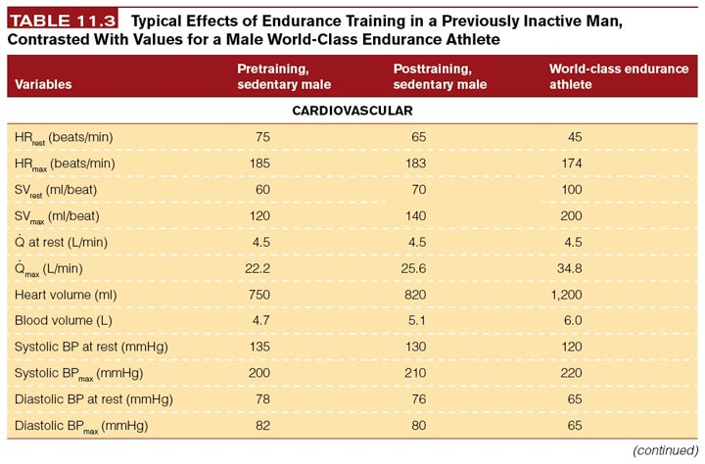
Notes:
World class athletes can show us a dramatic difference. Now obviously some of this is genetic but look at how much can be accomplished with training!
Now the “how” of how these adaptations occur is still somewhat a mystery.

Slide 17
Target Heart Rate Zones
Very Light: 50-65%*
Light: 60%-70%
Moderate:70%-80%
Vigorous:80-90%+
Age predicted max heart rate
MHR = 220-age
Notes:
Note that very light intensities may be appropriate for deconditioned persons or those with musculoskeletal injuries or physical limitations (such as chronic diseases or obesity). As fitness improves, these lower intensities will not be enough to elicit any improvements in cardiovascular fitness, but may only be enough to maintain it. Although this is a relative method to measure intensity and self-advancing (eventually you will have to run faster and work harder to achieve the desired heart rate) a fitter person will also need to work at higher intensities to achieve smaller incremental improvements in fitness.

Slide 18
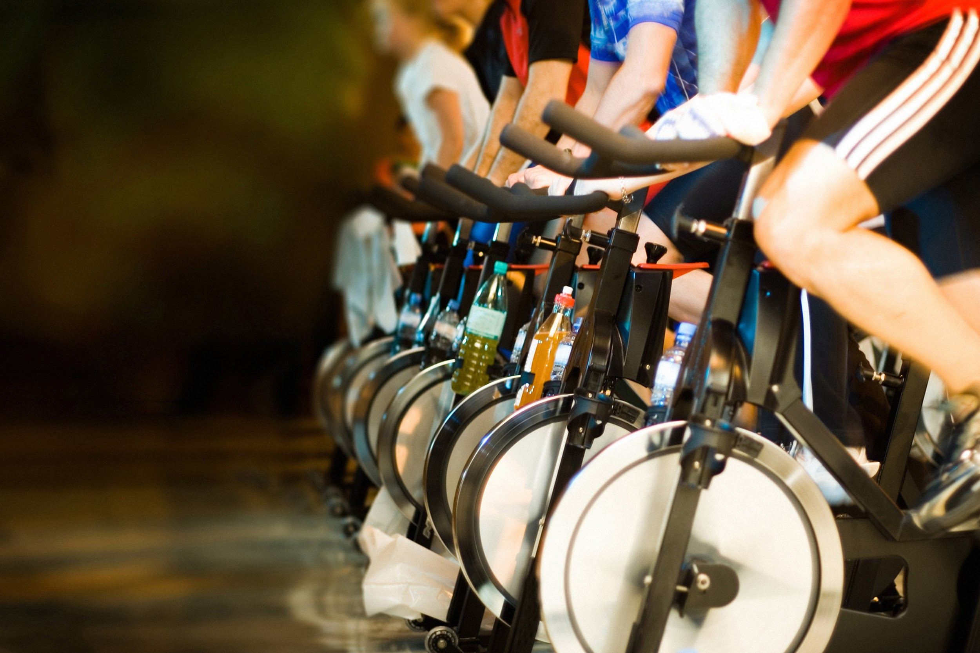
JUST
MOVE
IT.
Myzone

Slide 19
All other illustrations, tables and figures not otherwise cited are from:
Kenney, WL, Wilmore, JH, & Costill, DL. (2012). Physiology of Sport and Exercise (5th Ed.). Human Kinetics. ISBN: 978-0-7360-9409-2.

