Slide 1
Sleep, Well Being, & Nutrition
Michelle Marquez
California State Polytechnic Univeristy, Pomona
Dietetic Intern 2017-2018

Slide 2
What does lack of sleep do to your body?
The CDC targets sleep insufficiency as an important public health challenge with 50 to 70 million adults diagnosed with sleep disorders (CDC 2014c).
Sleep specialist report sleep is one of the most “anti-inflammatory” activities (Lombardo, 2005).
Habits such as watching tv right before bed, produce penetrating light that reduces the body's production of melatonin.
Without quality sleep, the body does not get quality parasympathetic healing time that calms the inflammation of the day.

Slide 3
How does lack sleep affect you?
Insufficient sleep duration is associated with elevated body mass index (BMI).
Insufficient sleep may result in decreased glucose tolerance and increased risk for type 2 diabetes.
Increased risk hypertension incidence with short sleep duration, even after controlling for obesity and diabetes.
Sleep deprivation increases blood pressure.
Increased risk for metabolic syndrome.
Notes:
http://web.a.ebscohost.com.proxy.library.cpp.edu/ehost/pdfviewer/pdfviewer?vid=1&sid=8c2c6ecf-74ba-4c7a-8a55-0af150dd93c4%40sessionmgr4008

Slide 4
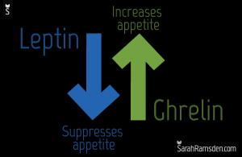
The cumulative effects of poor sleep affect metabolic activities that lead to weight gain, mood disorders, stressful emotions, and increased nutrient requirements (Heaney, 2012).
Lack of sleep can lead to chronic stress with constantly elevated cortisol levels which can lead to increased eating or changes in appetite.
Lack of sleep decrease leptin and increases ghrelin.
Notes:
Cortisol is hormone which is released when individual is under stress, and stimulates insulin release to maintain blood glucose levels in the “fight or flight” response.
Leptin is a hormone, made by fat cells, that decreases appetite. Ghrelin is a hormone that increases appreite and plays a role in body weight.

Slide 5
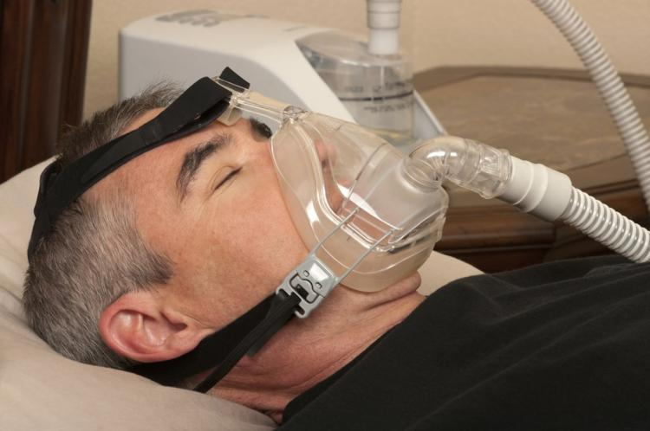
Sleep and Obesity
Obesity has been associated with both shorter sleep duration and poorer sleep quality.
obesity has been associated with higher prevalence of sleep related problems, such as obstructive sleep apnea.
Study done by the Academy of Nutrition and Dietietics determined insuffient sleep causes-Eat more overall and more eating at night.
Notes:
http://web.a.ebscohost.com.proxy.library.cpp.edu/ehost/pdfviewer/pdfviewer?vid=1&sid=79452d44-1f54-414b-bc06-0ce108497254%40sessionmgr4010

Slide 6
The American Heart Association’s Epidemiology and Prevention/Nutrition Study 2012
The researchers studied 17 normal, healthy young men and women for eight nights, with half of the participants sleeping normally and half sleeping only two-thirds their normal time.
The sleep deprived group, who slept one hour and 20 minutes less than the control group each day consumed an average 549 additional calories each day.
Lack of sleep was associated with increased leptin levels and decreasing ghrelin.
The amount of energy used for activity didn’t significantly change between groups, suggesting that those who slept less didn’t burn additional calories.
Notes:
https://sleepfoundation.org/sleep-news/lack-sleep-may-increase-calorie-consumption

Slide 7
Foods that affect sleep
Drinks containing caffeine such as coffee, or even energy drinks like Monster or Red Bull these act as stimulating agents and can cause restlessness and even anxiety.
Spicy food can lead to heartburn which can make it uncomfortable to lay down and sleep.
Fat, A high fat diet alters the production of orexin, one of the neurotransmitters that helps regulate the sleep/wake cycle along with melatonin.
Notes:
http://www.eatingwell.com/recipe/250220/chocolate-cherry-snack-bars/

Slide 8
Obesity and Sleep
More than one-third (36.5%) of U.S. adults are obese (2015 CDC).
Being overweight or obese can lead to disrupted sleep.
Can cause snoring or sleep apnea.

Slide 9
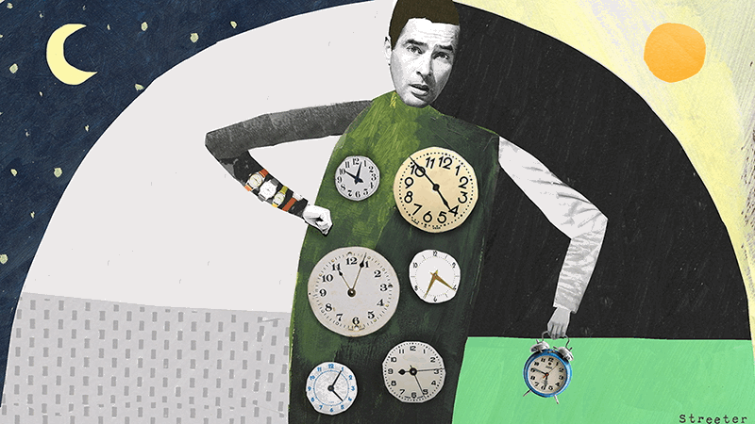
Not getting enough sleep?
Just recently 3 scientist earned nobel prizes for their research on the effects of sleep on health regarding circadian rhythms.
The research demonstrates the importance of keeping our internal clocks regular (circadian rhythm).
As Humans we need regular sleep and eating schedules to regulate critical functions such as behavior, hormone levels and metabolism.
By disrupting our sleep wake cycles we increase our blood pressure, hunger goes up and blood sugars decrease.

Slide 10
Long term effects
Over time is prolonged sleep deprivation occurs this can lead to weight gain and even type 2 diabetes.
If we disrupt our circadian rhythms it can lead us to not be able to sleep at night and instead eat late.
Research that was published in the International Journal of Obesity suggest that the timing of when we eat can affect weight showing people in the study who had meals earlier in the day were much more successful with weight loss.

Slide 11
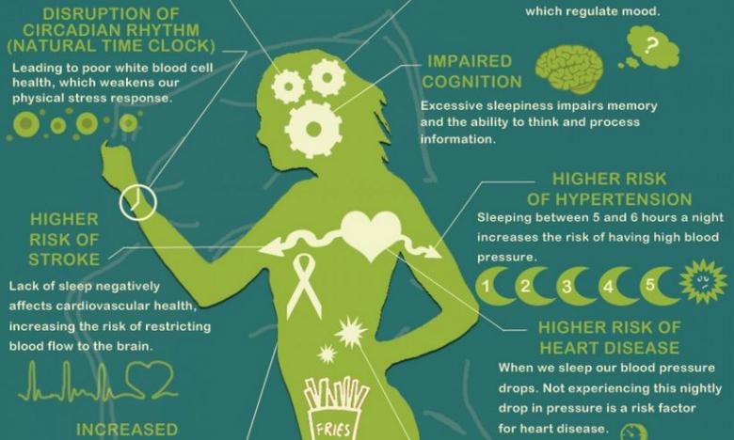

Slide 12
So what foods promote sleep?
Tryptophan is an amino acid that when ingested gets turned into the neurotransmitter serotonin and then converted into the hormone melatonin.

Slide 13
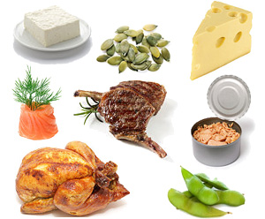
Foods rich in Tryptophan
Dairy products (milk, low-fat yogurt, cheese)
Poultry (turkey, chicken)
Seafood (shrimp, salmon, halibut, tuna, sardines, cod)
Nuts and seeds (flax, sesame, pumpkin, sunflower, cashews, peanuts, almonds, walnuts)
Legumes (kidney beans, lima beans, black beans split peas, chickpeas)
Fruits (apples, bananas, peaches, avocado)
Vegetables (spinach, broccoli, turnip greens, asparagus, onions, seaweed, carrots, )
Grains (wheat, rice, barley, corn, oats)

Slide 14
Magnesium
Magnesium is a powerful mineral that is instrumental in sleep and is a natural relaxant that helps deactivate adrenaline. A lack of magnesium can be directly linked to difficulty going and staying asleep. Magnesium is often referred to as the sleep mineral.

Slide 15
Excellent sources of Magnesium are
Dark leafy greens (baby spinach, kale, collard greens)
Nuts and seeds (almonds, sunflower seeds, brazil nuts, cashews, pine nuts, flaxseed, pecans)
Wheat germ
Fish (salmon, halibut, tuna, mackerel)
Soybeans
Banana
Avocados
Low-fat yogurt

Slide 16
Calcium
Calcium is another mineral that helps the brain make melatonin. A lack of calcium can cause you to wake up in the middle of the night and have difficulty returning to sleep. Calcium rich diets have been shown to help patients with insomnia. Dairy products that contain both tryptophan and calcium are among the best sleep inducers.

Slide 17
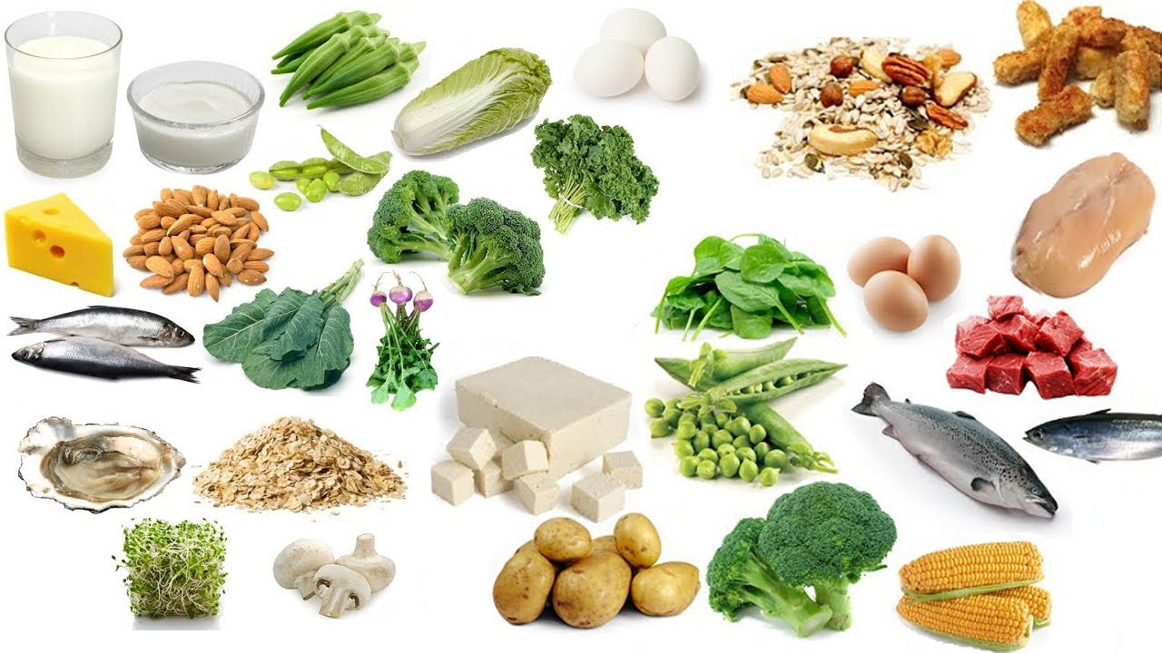
Calcium rich foods include
Dark leafy greens
Low-fat milk
Cheeses
Yogurt
Sardines
Fortified cereals
Soybeans
Fortified orange juice
Enriched breads and grains
Green snap peas
Okra
Broccoli

Slide 18
B6 (pyriodoxine)
Vitamin B6 also helps convert tryptophan into melatonin. A deficiency in B6 has been linked with lowered serotonin levels and poor sleep. A deficiency in B6 is also linked to symptoms of depression and mood disorders which can lead to insomnia.

Slide 19
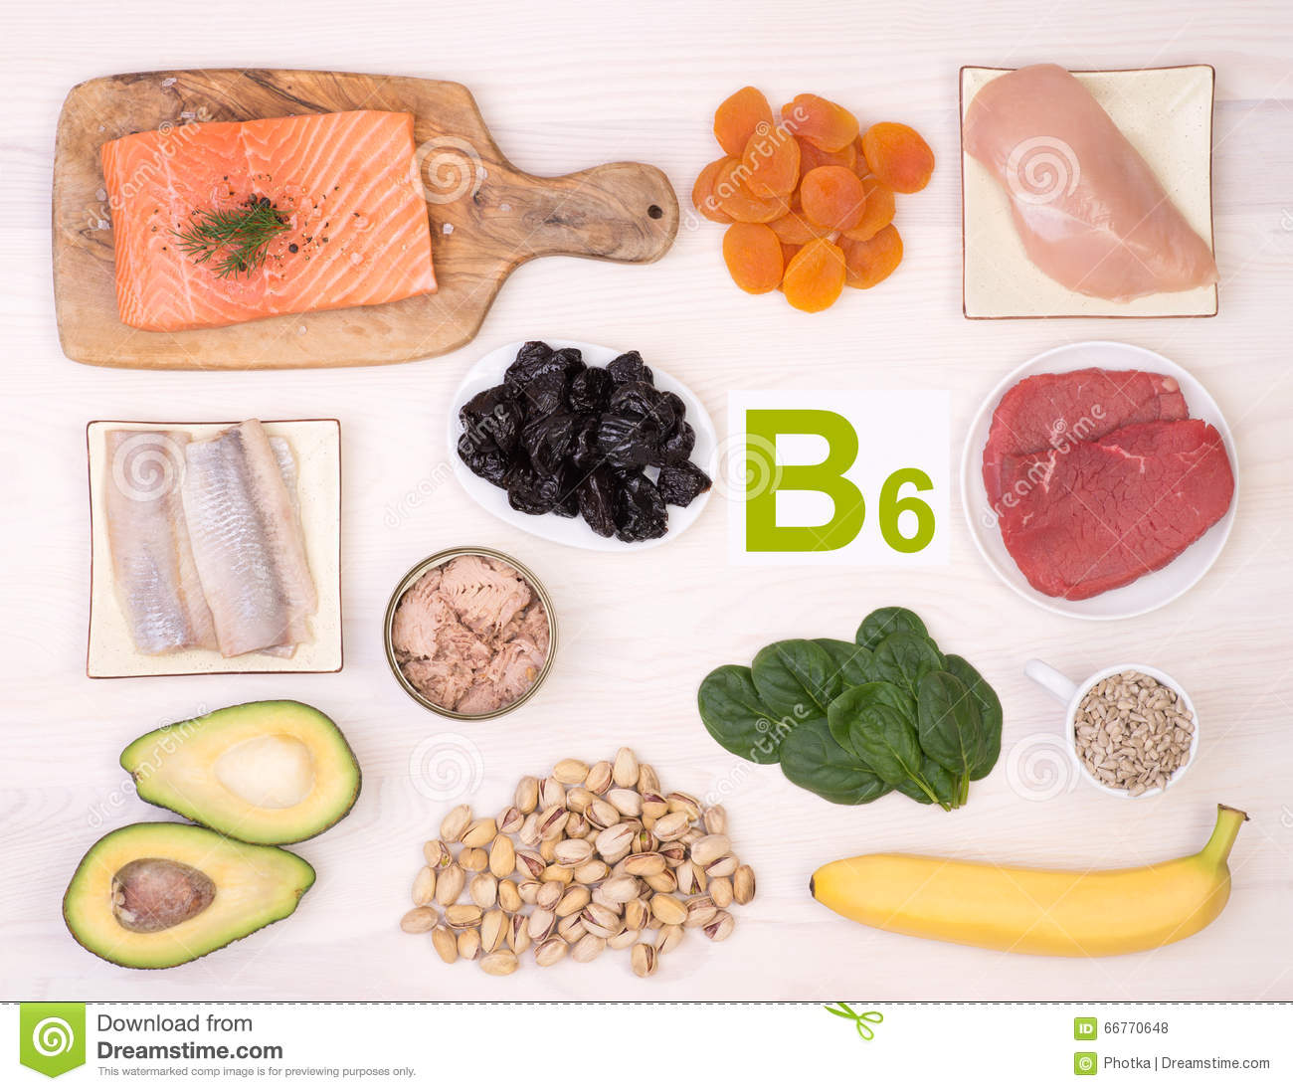
Food sources of vitamin B6
Sunflower seeds
Pistachio nuts
Flaxseed
Fish (tuna, salmon, halibut)
Meat (chicken, tuna, lean pork, lean beef,)
Dried Prunes
Bananas
Avocado
Spinach

Slide 20
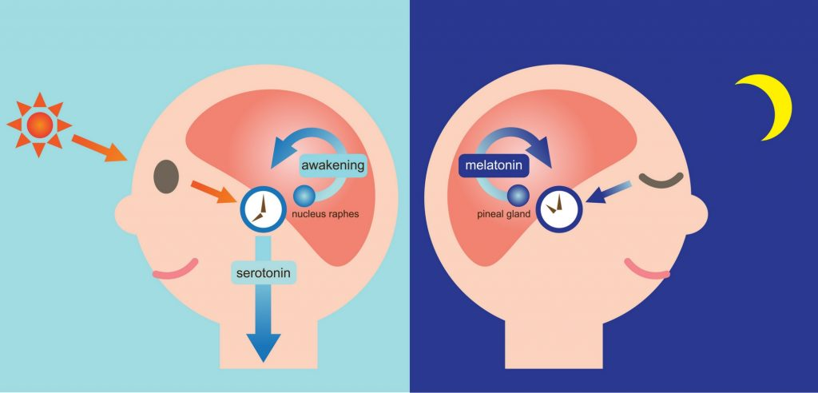
Melatonin
Many of the vitamins and minerals that are on this list are there because they help aid in the production of turning serotonin into melatonin. However, there are a few excellent sources of naturally occuring melatonin in food.

Slide 21
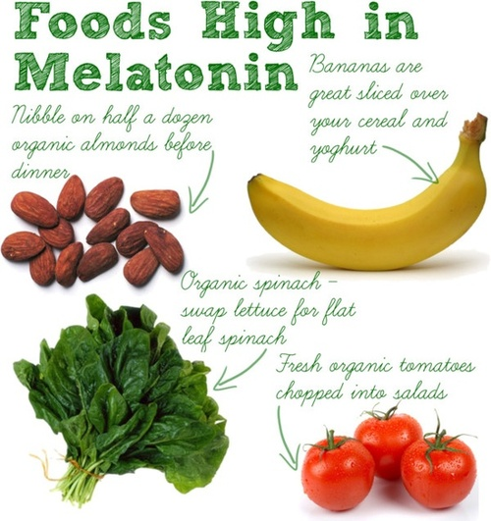
Sources of melatonin
Fruits and vegetables (tart cherries, corn, asparagus, tomatoes, pomegranate, olives, grapes, broccoli, cucumber)
Grains (rice, barley, rolled oats)
Nuts and Seeds (walnuts, peanuts, sunflower seeds, mustard seeds, flaxseed)

Slide 22
Other things that can help you sleep
Warm milk
Almond milk
Valerian tea
Chamomile tea
Tart cherry juice
Passion fruit tea
Peppermint tea
Most of all don’t forget to set the mood for sleep.
Turn or put electronics away.
Wear comfortable clothing.
Make yourself comfortable in bed.
Relax your mind and enjoy your rest.

Slide 23
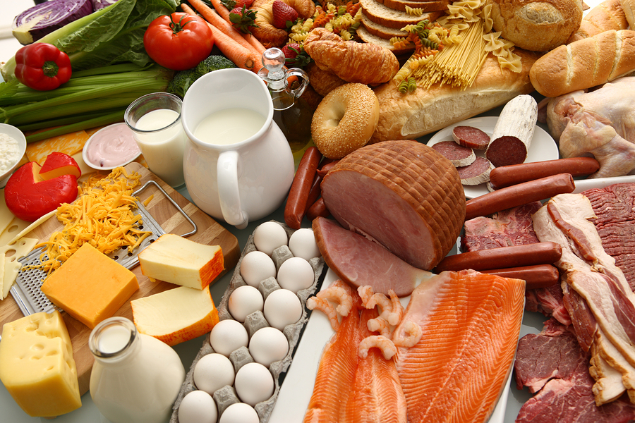
Nutrition
Food variety means eating a wide variety of foods from each of the five food groups, in the amounts recommended. Eating many different foods helps maintain a healthy and interesting diet which provides a range of different nutrients to the body. Eating a variety of foods promotes good health and can help reduce the risk of disease.

Slide 24
5 major food groups
The five food groups are:
vegetables and legumes/beans
fruit
lean meats and poultry, fish, eggs, tofu, nuts and seeds, legumes/beans
grain (cereal) foods, mostly whole grain and/or high cereal fiber varieties
milk, yogurt, cheese and/or alternatives, mostly reduced fat.

Slide 25
Add variety to your food
Eating a varied, well-balanced diet means eating a variety of foods from each food groups daily, in the recommended amounts.
It is also important to choose a variety of foods from within each food group because different foods provide different types and amounts of key nutrients.
Choosing a variety of foods will help to make your meals interesting, so that you don’t get bored with your diet.

Slide 26
Turkey noodle soup Ingredients:
3 turkey drumsticks.
3 quarts of water.
2 onions chopped.
4 carrots chopped.
3 stalks of celery chopped.
.
4 cloves of garlic chopped.
1 tablespoon of salt.
1/2 tsp of black pepper.
1/2 tsp ground sage.
1/2 tsp dried thyme.
1/2 tsp dried rosemary.
1/2 tsp of celery salt.
2 cups of uncooked egg noodles

Slide 27
Nutrition Information
Amount Per Serving
Calories: 234
Calories from Fat: 52
% Daily Value *
Total Fat: 5.8
Saturated Fat: 1.8
Cholesterol: 75
Sodium: 1093
Total Carbohydrates: 14.9
** Sugars: 3.7
Dietary Fiber: 2.3
Protein: 29.5
Vitamin A - IU: 6097
Vitamin C: 6
Calcium: 70
Iron: 3
Potassium: 487
** Thiamin: 1
** Niacin Equivalents: 10
Vitamin B6: 1
Magnesium: 43
Folate: 50

Slide 28
References
https://sleepfoundation.org/sleep-news/lack-sleep-may-increase-calorie-consumption
http://web.a.ebscohost.com.proxy.library.cpp.edu/ehost/pdfviewer/pdfviewer?vid=1&sid=8c2c6ecf-74ba-4c7a-8a55-0af150dd93c4%40sessionmgr4008
http://web.a.ebscohost.com.proxy.library.cpp.edu/ehost/pdfviewer/pdfviewer?vid=1&sid=79452d44-1f54-414b-bc06-0ce108497254%40sessionmgr4010
http://www.npr.org/sections/thetwo-way/2017/10/02/554993385/nobel-prize-in-medicine-is-awarded-to-3-americans-for-work-on-circadian-rhythm
Mahan, L. Kathleen., Escott-Stump, Sylvia., Raymond, Janice L.Krause, Marie V. (Eds.) (2012) Krause's food & the nutrition care process /St. Louis, Mo. : Elsevier/Saunders,

Slide 29
Please enjoy some warm soup!

