Slide 1
Presented by Glendale College Student Outreach Services
Week 3: Concurrent Students, Summer

Slide 2
Counselor Cafe Series
Hosted by GCC Student Outreach Services with intent to create conversation, share information and connect with high school counselors.
Thursday, April 16, 2020 2-3pm (Supporting High School Seniors)
Tuesday, April 21st, 2020 2-3pm (Supporting High School Seniors, Virtual College Night, Dual)
Tuesday, April 28, 2020 2-3pm (Concurrent Enrollment and Summer School)
Tuesday, May 5th, 2020 2-3pm (Scholars, Athletics)
Tuesday, May 12, 2020 2-3pm
www.glendale.edu/k12resources

Slide 3
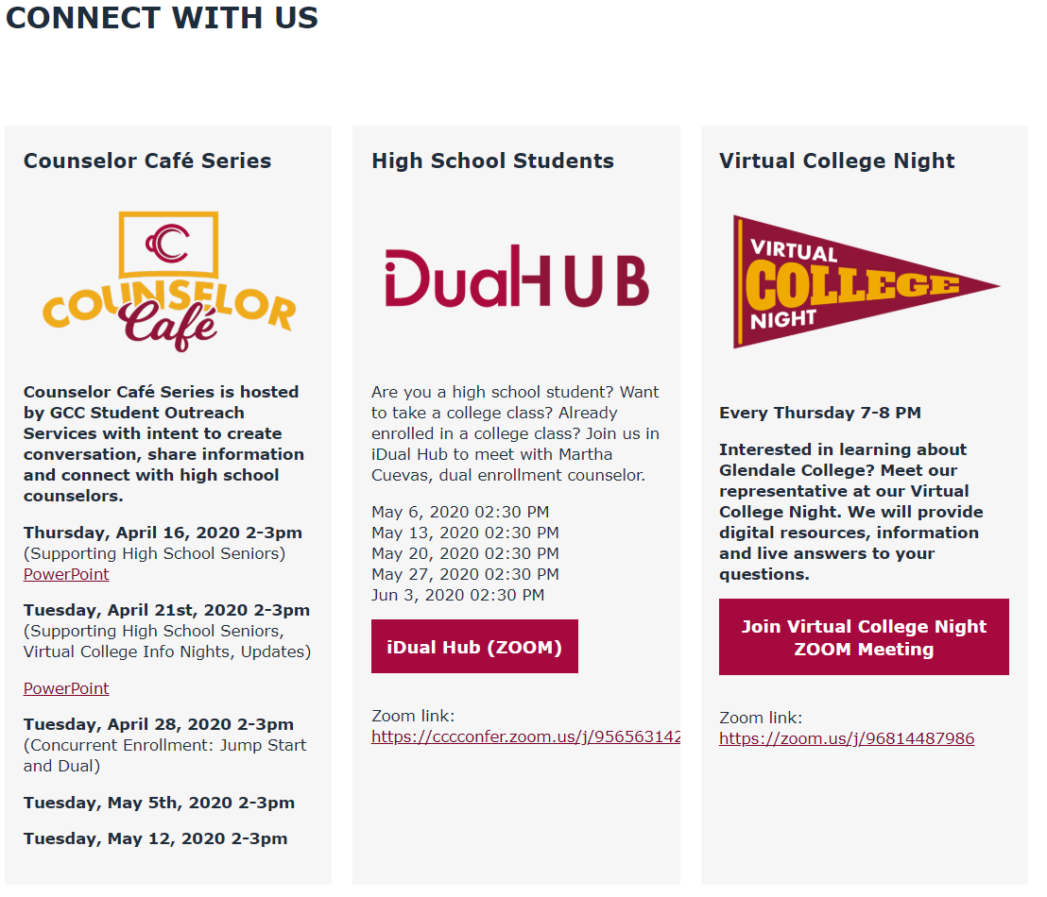
Connect With Us www.glendale.edu/ConnectWithUs

Slide 4
www.glendale.edu/connectwithus
Hosted by Martha Cuevas, Dual Enrollment Counselor
Email: mcuevas@glendale.edu Phone: 818-240-1000 x. 3031
Dual and Jump Start Student Cafe- any student interested in concurrently enrolling in high school and GCC.
Wednesdays 2:30-3:30pm
May 6, 2020 02:30 PM
May 13, 2020 02:30 PM
May 20, 2020 02:30 PM
May 27, 2020 02:30 PM
Jun 3, 2020 02:30 PM
Zoom link: https://cccconfer.zoom.us/j/95656314296
Meeting ID: 956 5631 4296

Slide 5
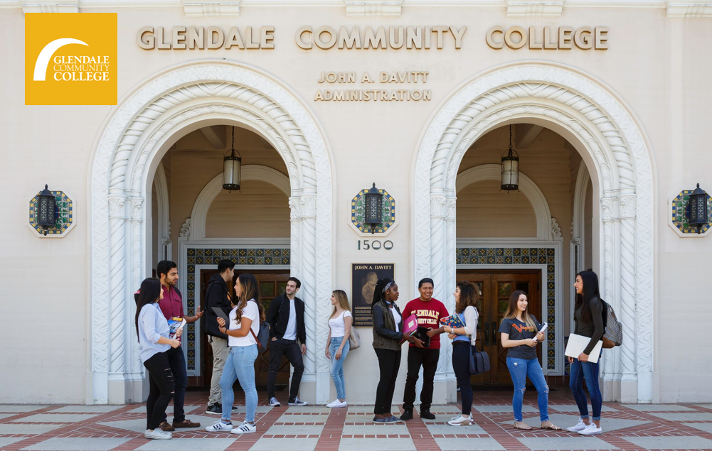
Virtual College Night
Every Thursday 7-8 PM
Zoom link:
https://zoom.us/j/96814487986

Slide 6
Support Through Glendale College
Virtual Welcome Center www.glendale.edu/WelcomeCenter
K12 Resources www.glendale.edu/K12Resources
LIVE Webchat (Available on the GCC homepage M-F 9am-4pm)
Live Canvas Help www.glendale.edu/Canvas
GCC Virtual College Info Night- Every Thursday 7-8pm
iDual Hub - Wednesdays 2:30-3:30pm
Virtual Tours (Pending)
GCC Promise- 2 Years of Free College Tuition www.glendale.edu/gccpromise
Meet with a GCC Counselor www.glendale.edu/counseling
Instructional Support
Student Services Support
All Services Open Virtually, by phone and email.

Slide 7
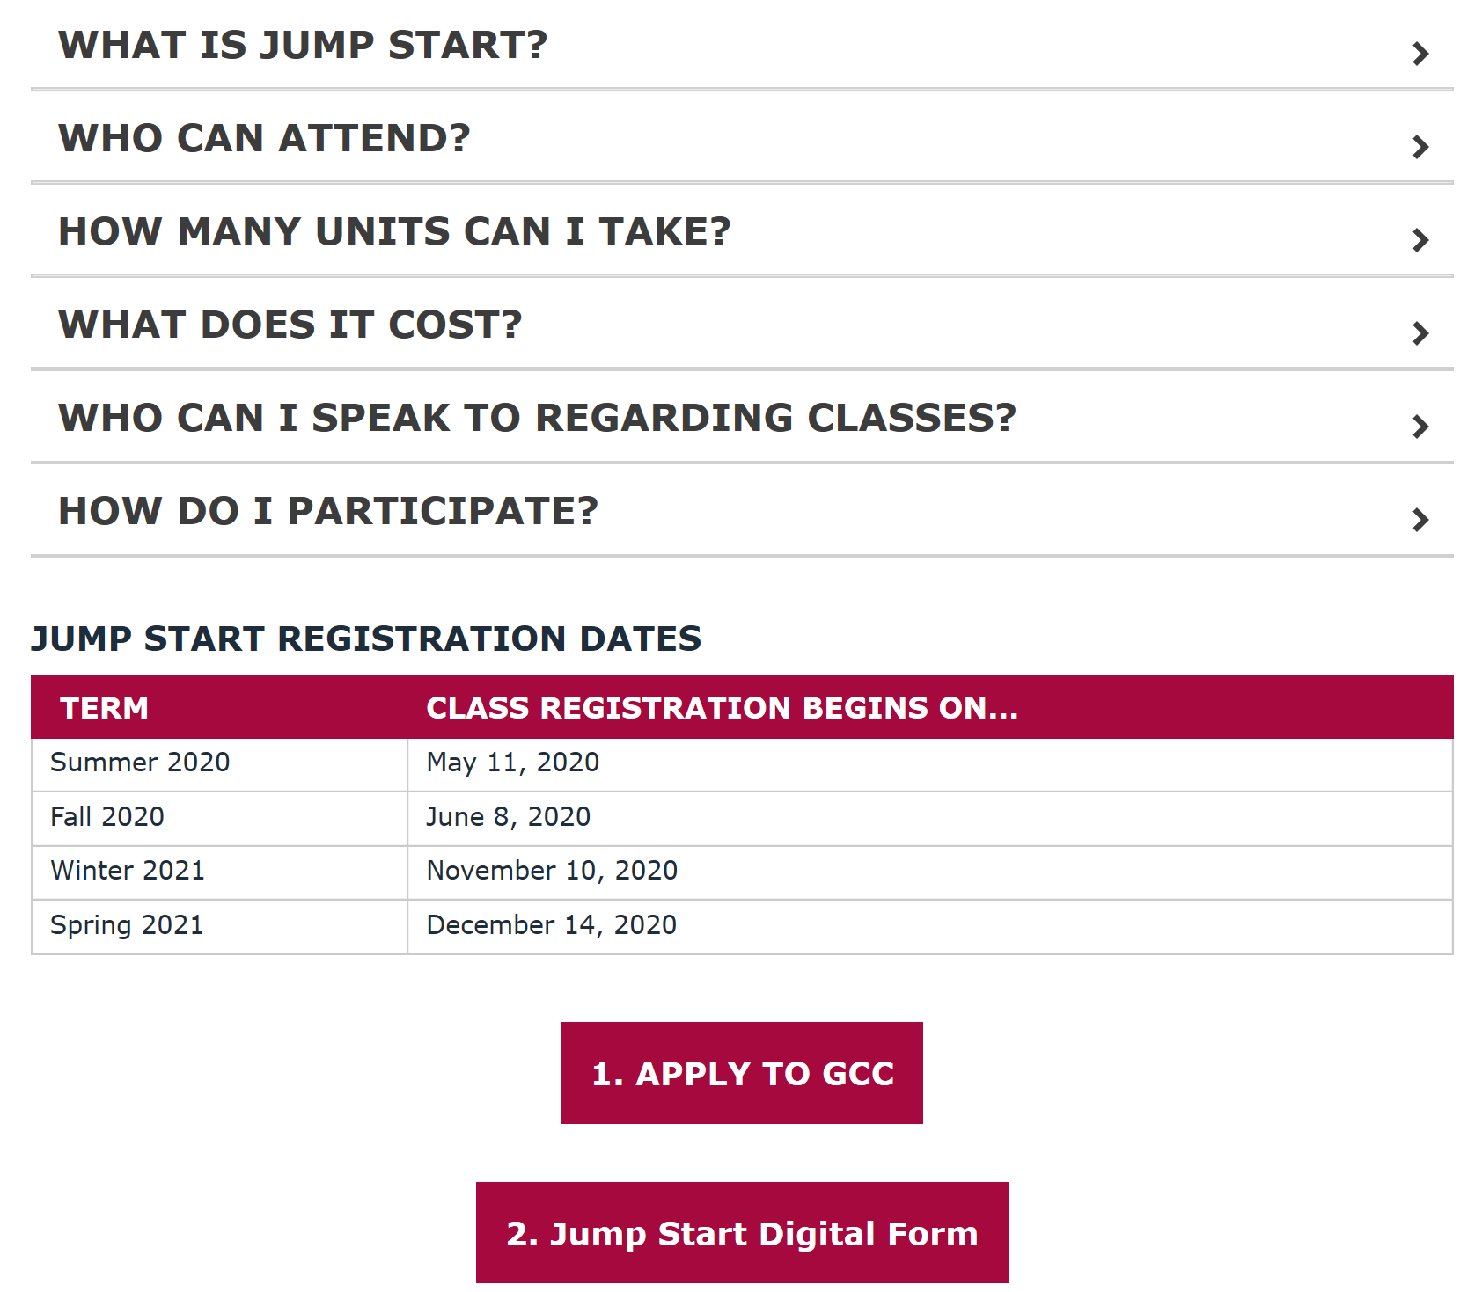
New High School
Student Enrollment (Jump Start and Dual)
www.glendale.edu/JumpStart

Slide 8
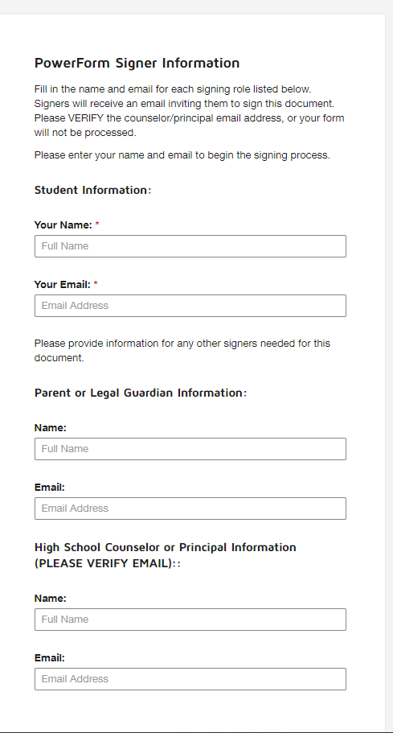
Digital Form
Paperless
Completely digital, device friendly
All forms submitted to jsforms@glendale.edu
Upon completion, all parties will receive a copy of completed form

Slide 9
Can high school students take a GCC Summer Class?
YES, high school students can enroll at GCC for the Summer… and also Fall. www.glendale.edu/JumpStart
Summer sessions will be all online.

Slide 10
Summer School:
High School Student Credit Recovery

Slide 11
Questions?
What are some of the current questions students have about college?
Which departments would you like to see showcased in our Counselor Cafe?
What are some of the challenges/hurdles students have talked about?

