Slide 1
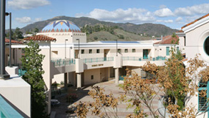
Facilities and Capital Projects
Overview
GCC Managers and Confidential Employees Meeting
December 18, 2019

Slide 2
Agenda
AGENDA
Facilities Dept. Overview
Team Introductions
Projects Overview
Q & A

Slide 3
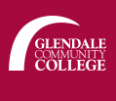
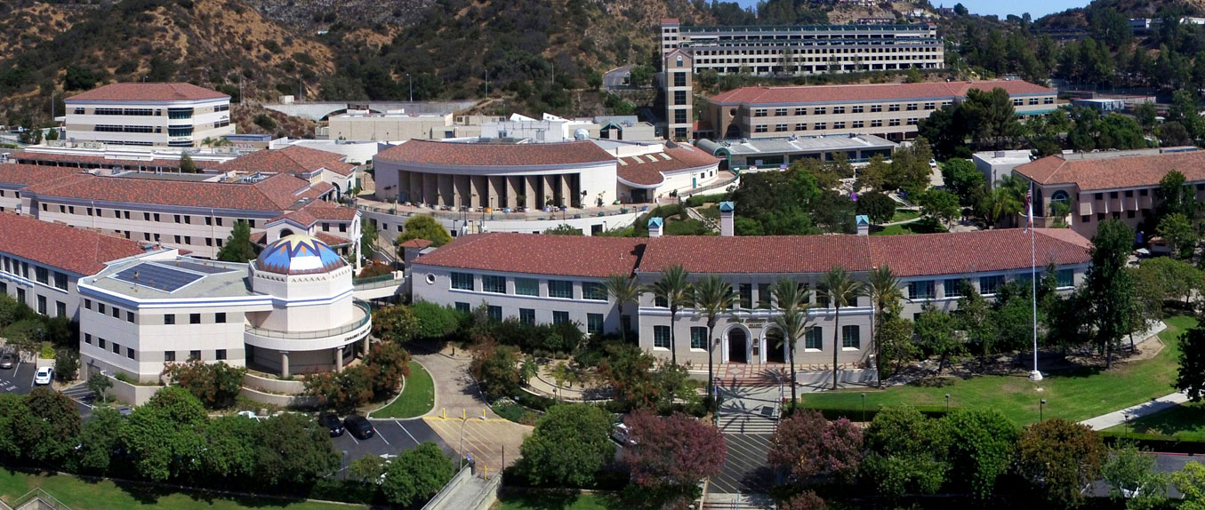
GCC Capital Projects and Enhancements
Enhancing excellence
Building the future

Slide 4
Glendale Community College District’s
Mission
“Glendale Community College is a public community college granting certificates and associate degrees. The college serves people from a variety of geographical areas but primarily serves a diverse population of the Greater Los Angeles region that is capable of benefiting from instruction in credit, noncredit, and community education programs.
Glendale Community College exists to ensure students identify their educational goals and needs and successfully accomplish student learning in the following broad educational areas:
  Basic skills education to achieve basic foundation skills in reading, writing, mathematics, English as a Second Language, and learning and study skills which are necessary for students to succeed in college-level work.
  Lower division post-secondary education to achieve transfer to and success in obtaining a degree at a college or university.
  Career and technical education to achieve employment or enhanced career skills for job advancement.
  General education to achieve knowledge, skills and attitudes for postsecondary education success, personal enrichment, self-development, and a purposeful and meaningful life as a member of a global community.”

Slide 5
Facilities Department and
Capital Projects Overview
Facilities Department’s Mission
The Facilities Department and Capital Projects exist to support GCCD’s mission and student success by enabling, facilitating, and serving Glendale College’s People and Programs.
Programs: Academic, Administrative, and Co-curricular/student success
People and Programs drive Facilities’ purpose and services
Programs and safety drive projects and priorities

Slide 6
Facilities and Capital Projects exist to
enable and support GCC’s Programs
Programs drive facilities’ purpose
Programs drive projects and priorities
Academic
Admin
Co-curricular
Ongoing Programs
Program A
Program B
Program C
Program A
Program B
Program A
Program B
Program C
Physical Plant Protection, Maint. & Repair
Master Plan
Facility-based Services
Proj. A1
Proj. B
Proj. C1
Proj. A
Proj. B
Proj. A1
Proj. B1
Proj. C
Proj. A2
Proj. C2
Proj. A2
Proj. B2
Discrete Projects
Physical Plant

Slide 7
Facilities and Capital Projects exist to
enable and support GCC’s Programs
Examples
Academic
Admin
Co-curricular
Ongoing Programs
Chemistry Lab Teaching
Campus Operation
Student Athletics
Renovation and Construction
Infrastructure Enhancement
Events and Access Services
New Science Building Project
Garfield Sewer Project
PE Building Project
Discrete Projects
Physical Plant

Slide 8
Funding and Tracking
Fund
Cost
Center 1
Cost
Center 2
Cost
Center 3
Ongoing
Operations
Program 1
Program 2
Program 3
Program 4
Program 5
Program 6
Program 7
Proj. A
Proj. A
Proj. A
Proj. A
Proj. A
Proj. A
Proj. A
Proj. B
Proj. B
Proj. B
Proj. B
Proj. B
Proj. C
Proj. C
Proj. C
Finite Capital Funding (e.g., Meas. GC)

Slide 9
Staffing and Management
Crafts
Proj. C
Proj. 3
Proj. 3
Proj. 3
HVAC
Proj. B
Proj. 2
Proj. 2
Proj. 2
Plumb.
Proj. A
Proj. 1
Proj. 1
Proj. 1
Ship & Rec Crew
Electr.
Projects
PMs
Architects
Custod. Crew
Grounds Crew
Locks
Custod. Supers.
Ship & Rec.
Grounds Sup.
Maint. Techs.
Asst. Proj. Manager
Maint. & Ops. Facilities
Project Manager
Admin. Asst. I
Admin. Asst. III
Dir.
Facilities

Slide 10
GCC Capital Projects and Enhancements
Bond Measure GC: Capital Outlay Projects
 | Current Project Listing: | Architect: |  |  | PM / CM:
1 | Garfield Campus: Mariposa Renovations | MMA | James Moreto |  | Cumming | Gary Tasich
2 | Infrastructure: Sewer Project | MMA | James Moreto |  | Cumming | Gary Tasich
3 | Instructional Building & Conference Center (IBCC) | HMC Architects | Mark Schoeman |  | BRJ | Mark Edwards
4 | Montrose Campus: Citibank & Professional Development Center (PDC) | TBD | TBD |  | Gafcon | Keith Kaneko
5 | New Science Building (NSB) | HMC Architects | Mark Schoeman |  | Gafcon | John Leopardi
6 | Physical Education (PE), Verdugo Gymnasium | Little | Rita S. Carter |  | Cumming | Thomas Hughes

Slide 11
GCC Capital Projects and Enhancements
Bond Measure GC: Capital Outlay Projects
 | Current Project Listing: | Architect: |  |  | PM / CM:
7 | San Gabriel 1st Floor – Disabled Student Programs & Services (DSPS) | Little | Rita S. Carter |  | BRJ | Mark Edwards
8 | San Gabriel Remodel/ Math Dept. | HMC Architects | Mark Schoeman |  | Gafcon | John Leopardi
9 | San Rafael 2nd Floor Renovations | MMA | James Moreto |  | BRJ | Mark Edwards
10 | Sierra Vista | Little | Rita S. Carter |  | Cumming | Thomas Hughes
11 | Welding Lab Alteration, Aviation Arts Building | Little | Rita S. Carter |  | Cumming | Thomas Hughes
12 | Window Replacement, Administration Building | 19six (fka PMSM) | Jason Currie |  | BRJ | Mark Edwards

Slide 12
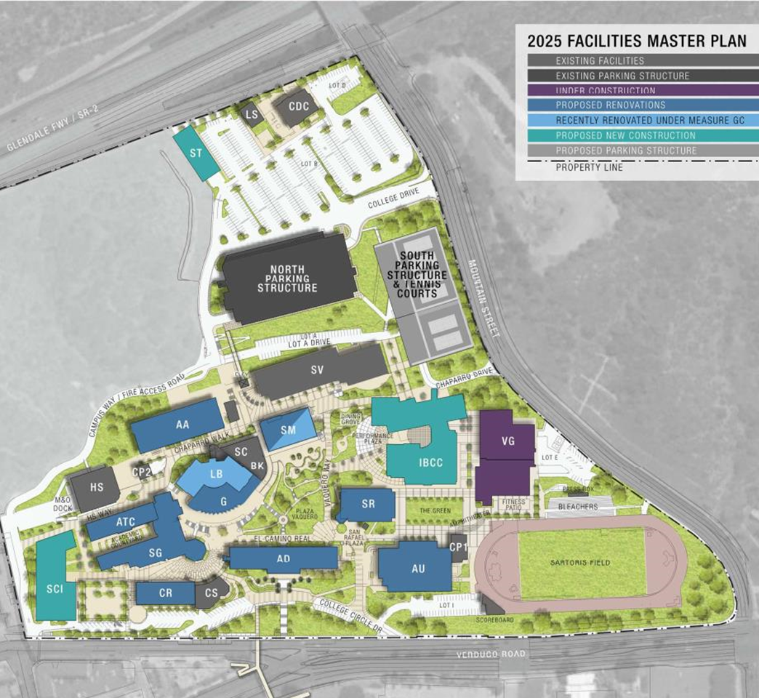
GCC Capital Projects and Enhancements
Facilities Master Plan:
Overall guide for all new construction projects and renovations
Aligned with GCCD’s Strategic plan
Currently have $337 million availble from Measure GC
$478.6 million of identified projects

Slide 13
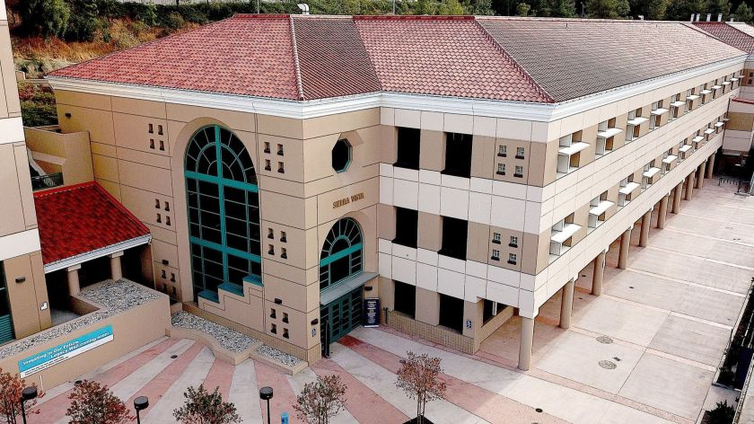
Recently Completed
Sierra Vista:
Achieved LEED Silver Certification Summer 2019
Starbucks Kiosk on ground floor nearing final DSA closeout
VP office alteration on 3rd floor nearing completion

Slide 14
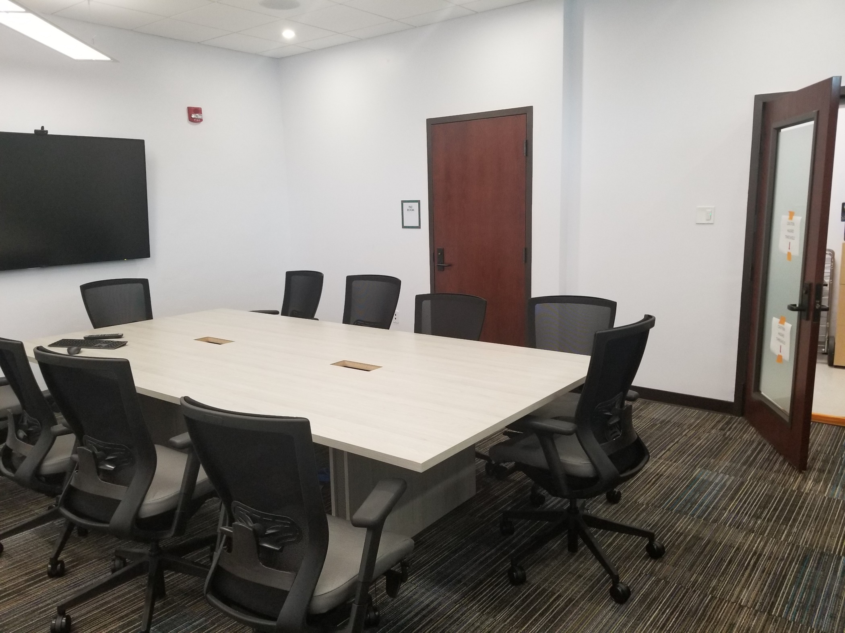
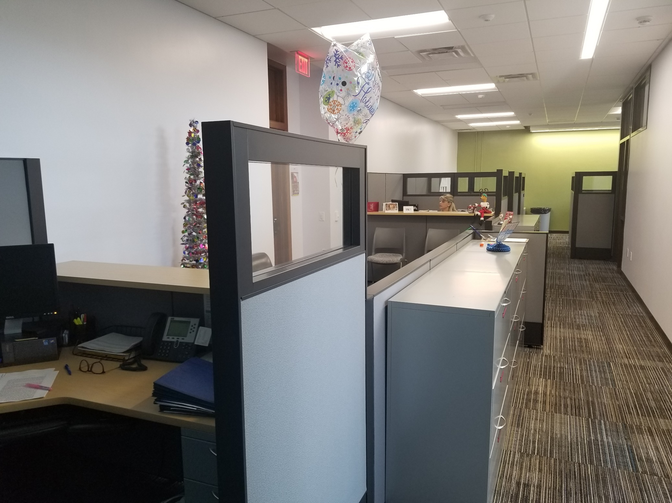
Recently Completed
AD 1st FL Remodel – HR Offices:
State of art conference room
Offices and secure storage
Bright/light design

Slide 15
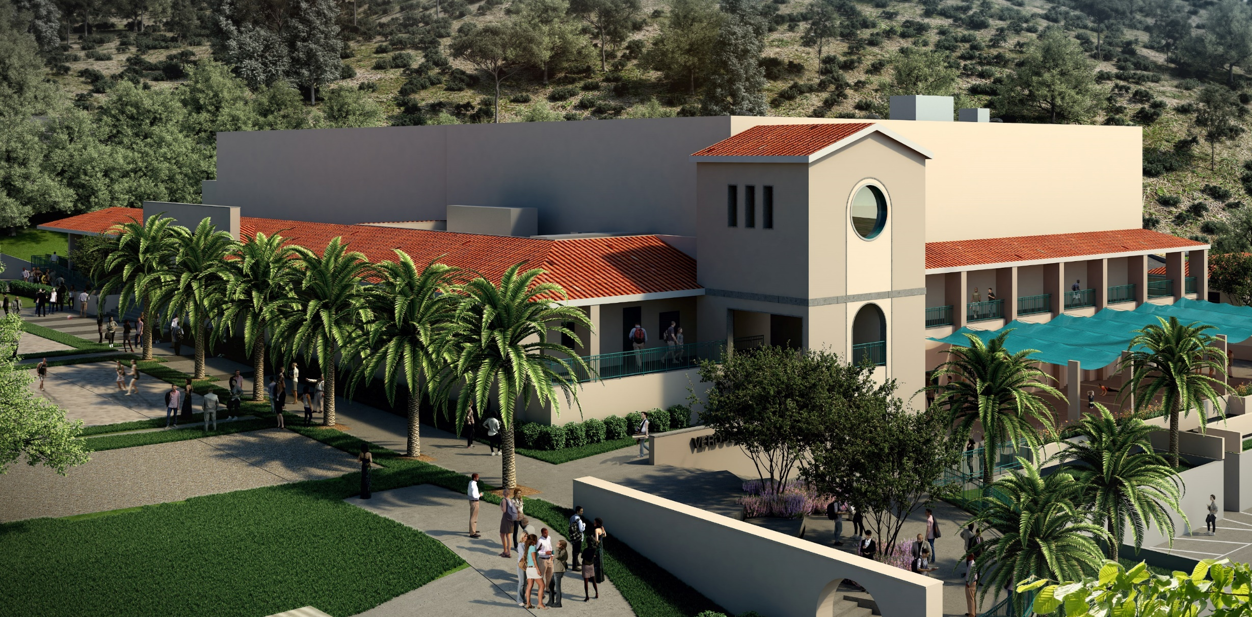
Currently In Construction
PE/Verdugo Gym:
Replacement & Seismic Upgrade
55,000 SF new addition
16,400 SF Gym, Indoor & Outdoor Weight Areas, Lockers, Offices
Est Completion Q3 2021

Slide 16
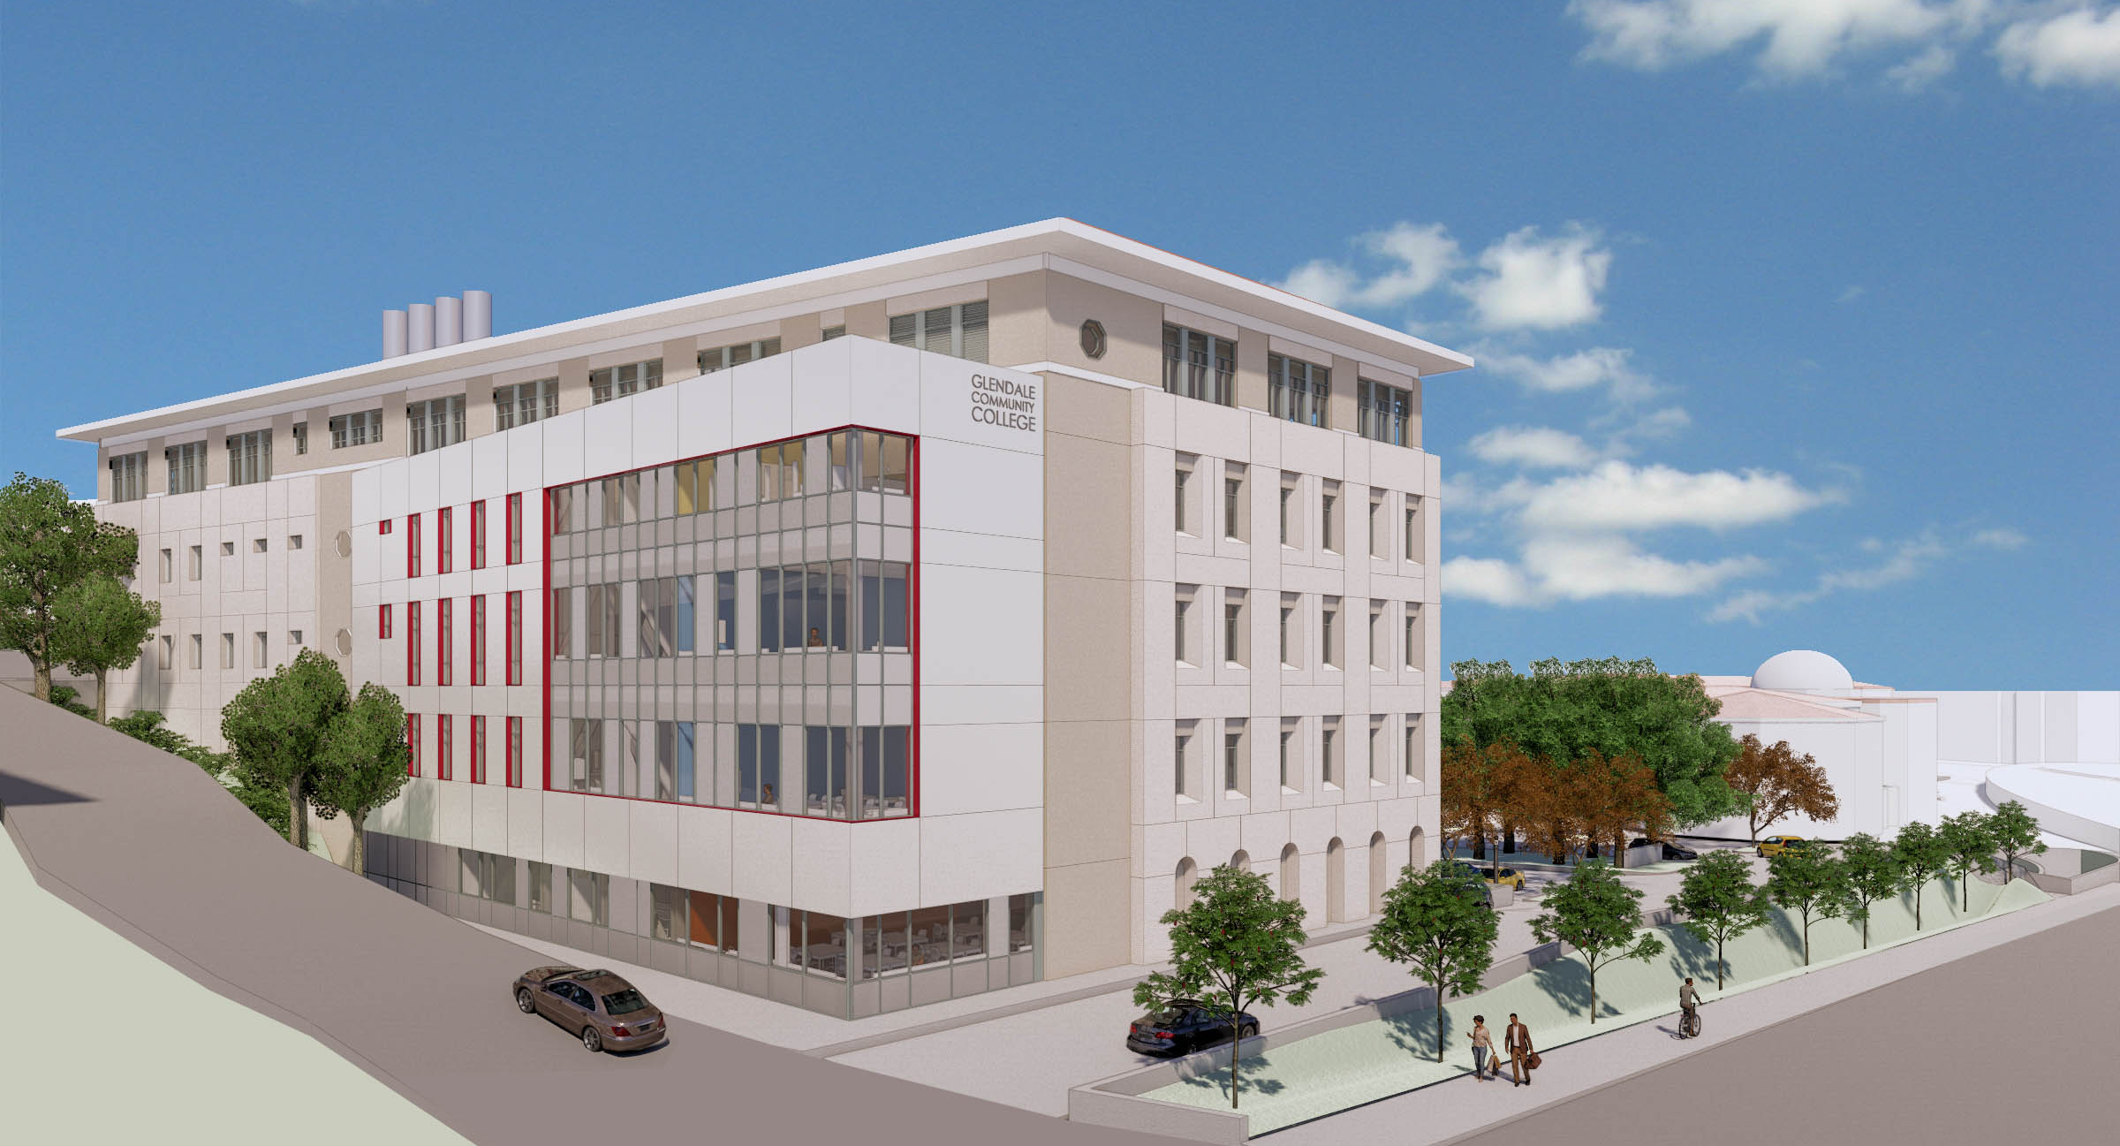
Pending Projects
New Science Building:
100,000 SF
31 Science Labs
Multi-Purpose Science Academy
100 Seat Lecture Hall
Student-Centric Collaboration
30 Faculty Offices
Construction Start Date: 2021
Target Completion Date: 2023

Slide 17
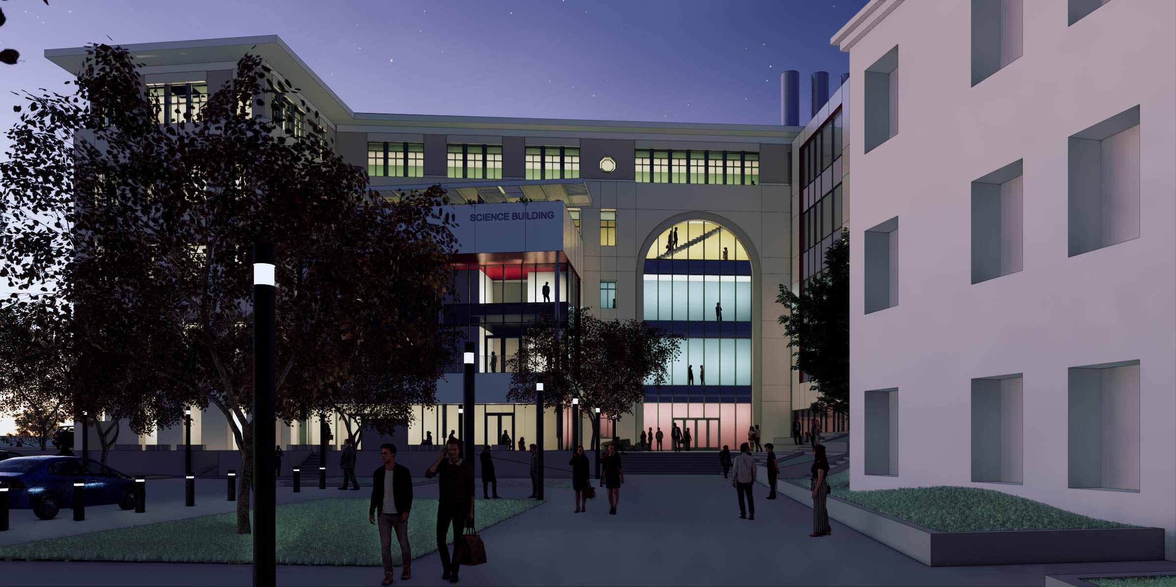
NSB

Slide 18
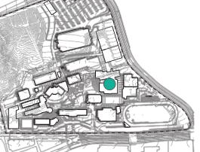
Pending Projects
IBCC
Planned 74,000 SF
Conference Center
Dance
Music
Media Arts
Kinesiology
Replaces Sierra Nevada
Displaces San Fernando
Construction Start Date TBD

Slide 19
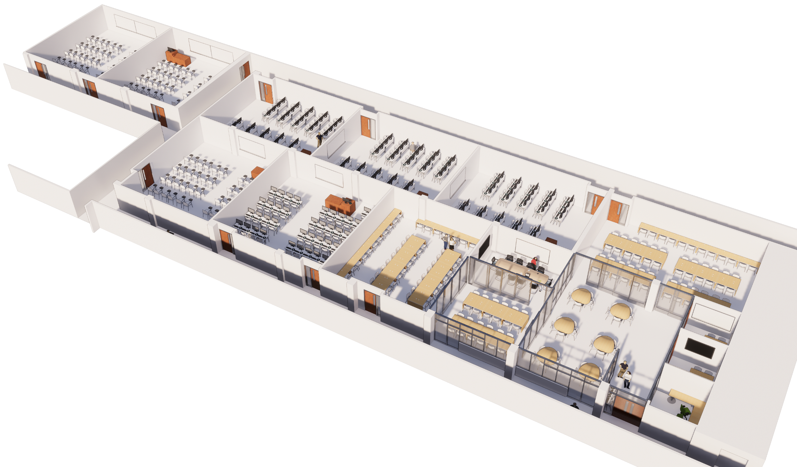
Pending Projects
Math Dept. Relo/Renovation:
15,000 SF TI of San Gabriel
5 Classrooms
4 Computer Labs
Multi Purpose Math Lab
Construction Start Date: 2023
HMC ARCHITECTS

Slide 20
Pending Projects
San Rafael 2nd Floor:
9,200 SF renovation
Complete gut and reconstruction
Five office suites
Construction Start Date: 01/2020
Target Completion Date: 08/2020

Slide 21
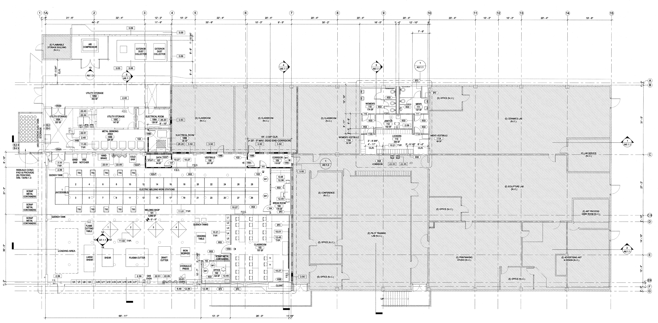
Pending Projects
Aviation Arts – Welding Shop:
9,745 SF
Conversion of existing aero tech laboratory spaces into a welding shop and associated spaces
Welding shop to receive equipment from ATC building
Installation of new HVAC units (To be completed in Phase 2)
Estimated Completion Q3 2020

Slide 22
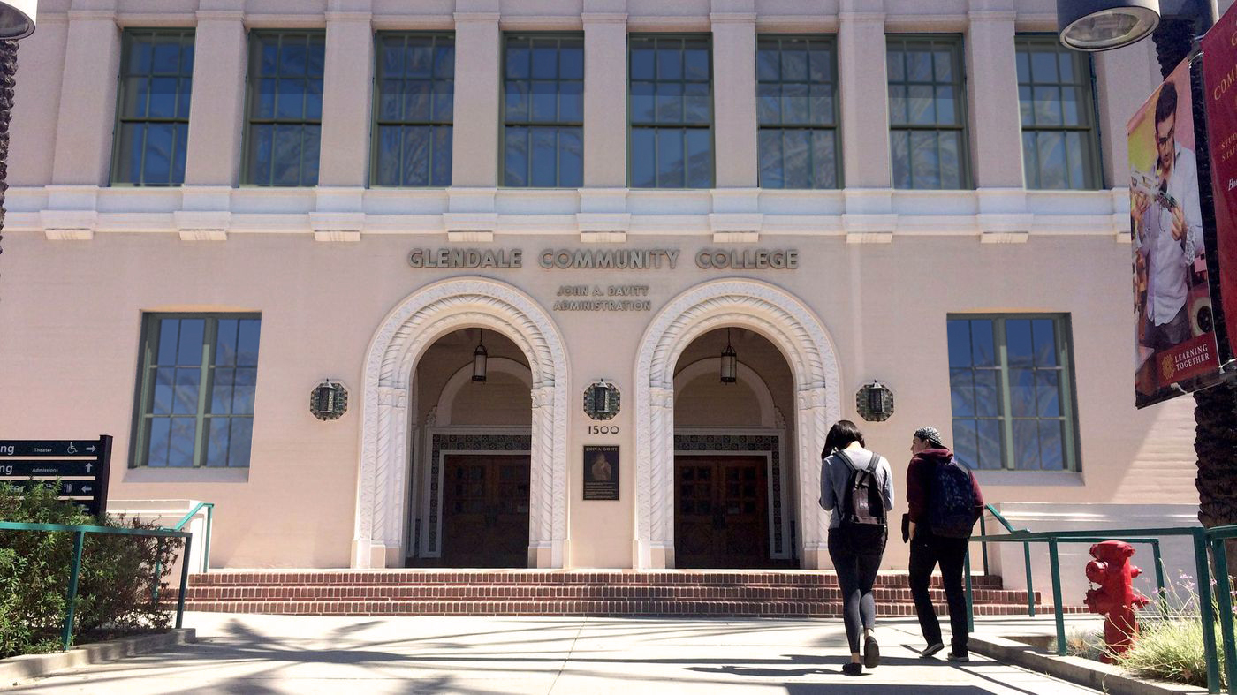
Pending Projects
AD Building Window Replacement:
Built 1935, 26,000 SF
Replacement of 4,775 SF of existing steel windows with energy efficient dual glazed metal-clad wood, operable windows
Construction Start Date: Jan 2020
Target Completion Date: Jun 2020

Slide 23
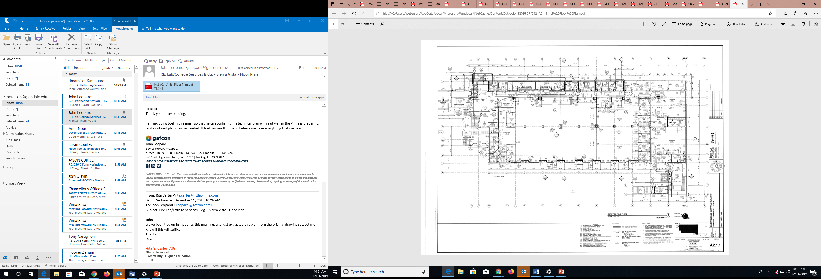
Pending Projects
San Gabriel 1st Floor Renovation:
15,750 SF Class & Office
DSA Addendum Backcheck
Estimated Completion Q3 2020

Slide 24
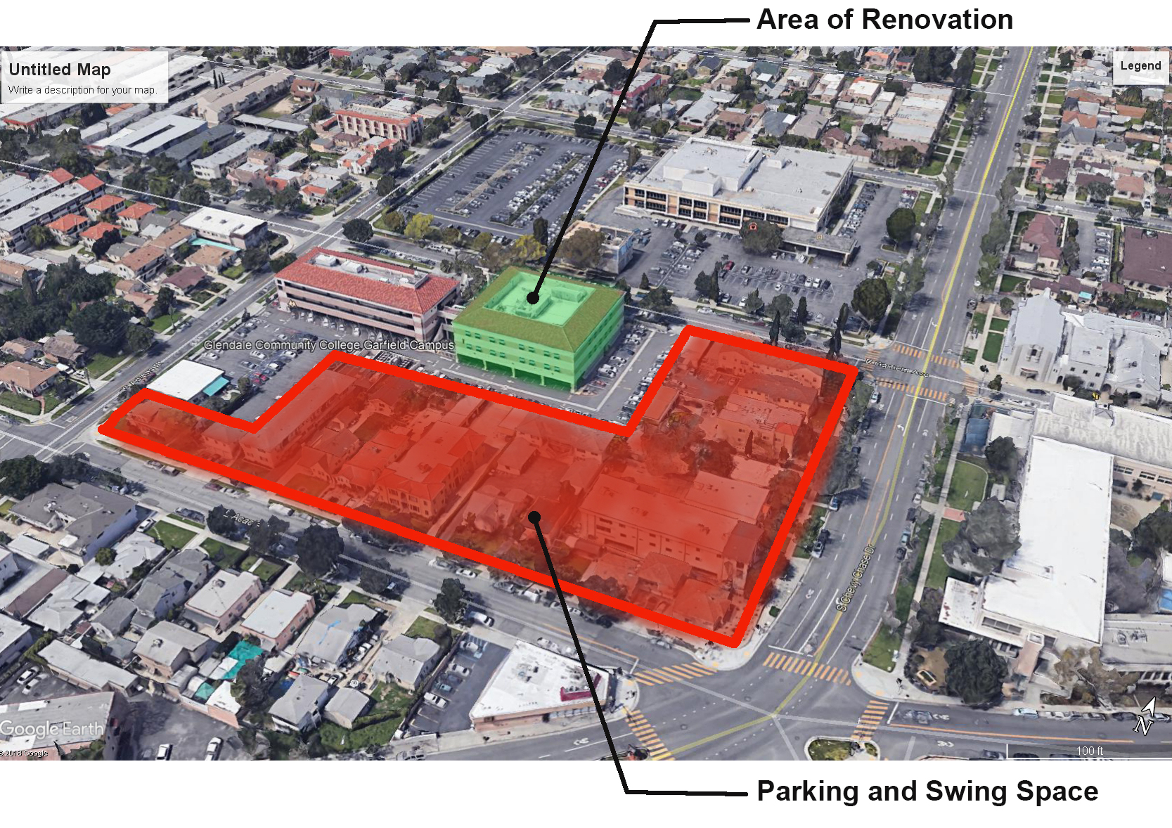
Garfield Campus Enhancements
Mariposa Renovation:
9500 SF renovation
Classroom renovation and reconfiguration
New Cafe
Construction Start Date: 06/2020
Target Completion Date: 12/2020
Sewer Retrofit:
Sewer line replacement to repair slope issues.
Construction Start Date: 12/2019
Target Completion Date: 2/2020

Slide 25
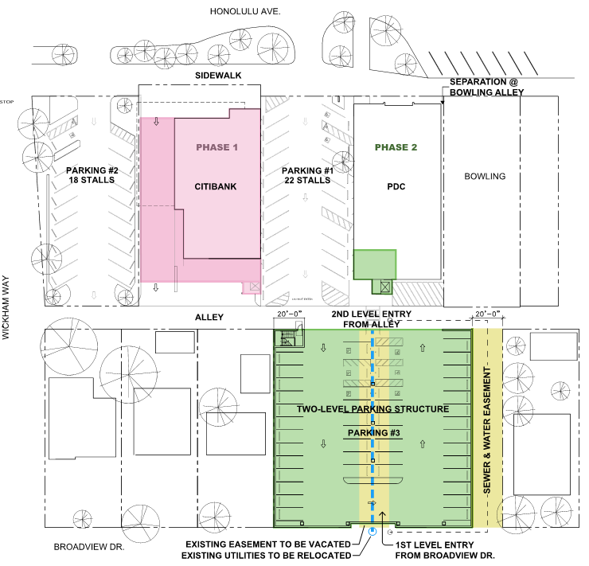
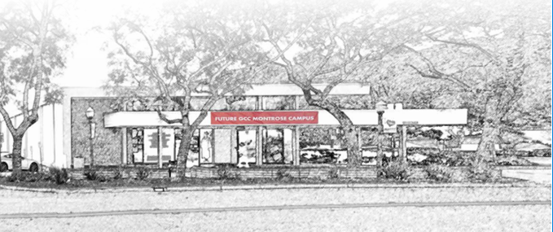
Montrose Campus Enhancements
PDC & Citibank Renovation:
21,964 Total SF
Remodel of Citibank Building to Classrooms
Minor seismic retrofit and ADA/elevator code compliance
Estimated Start: 2021
Estimated Completion: 2023

Slide 26
0.41
Construction and Campus Safety
Safety Culture
Experience Modification Rate (EMR) is a score given to contractors by the insurance companies – industry average is 1.00.

Slide 27
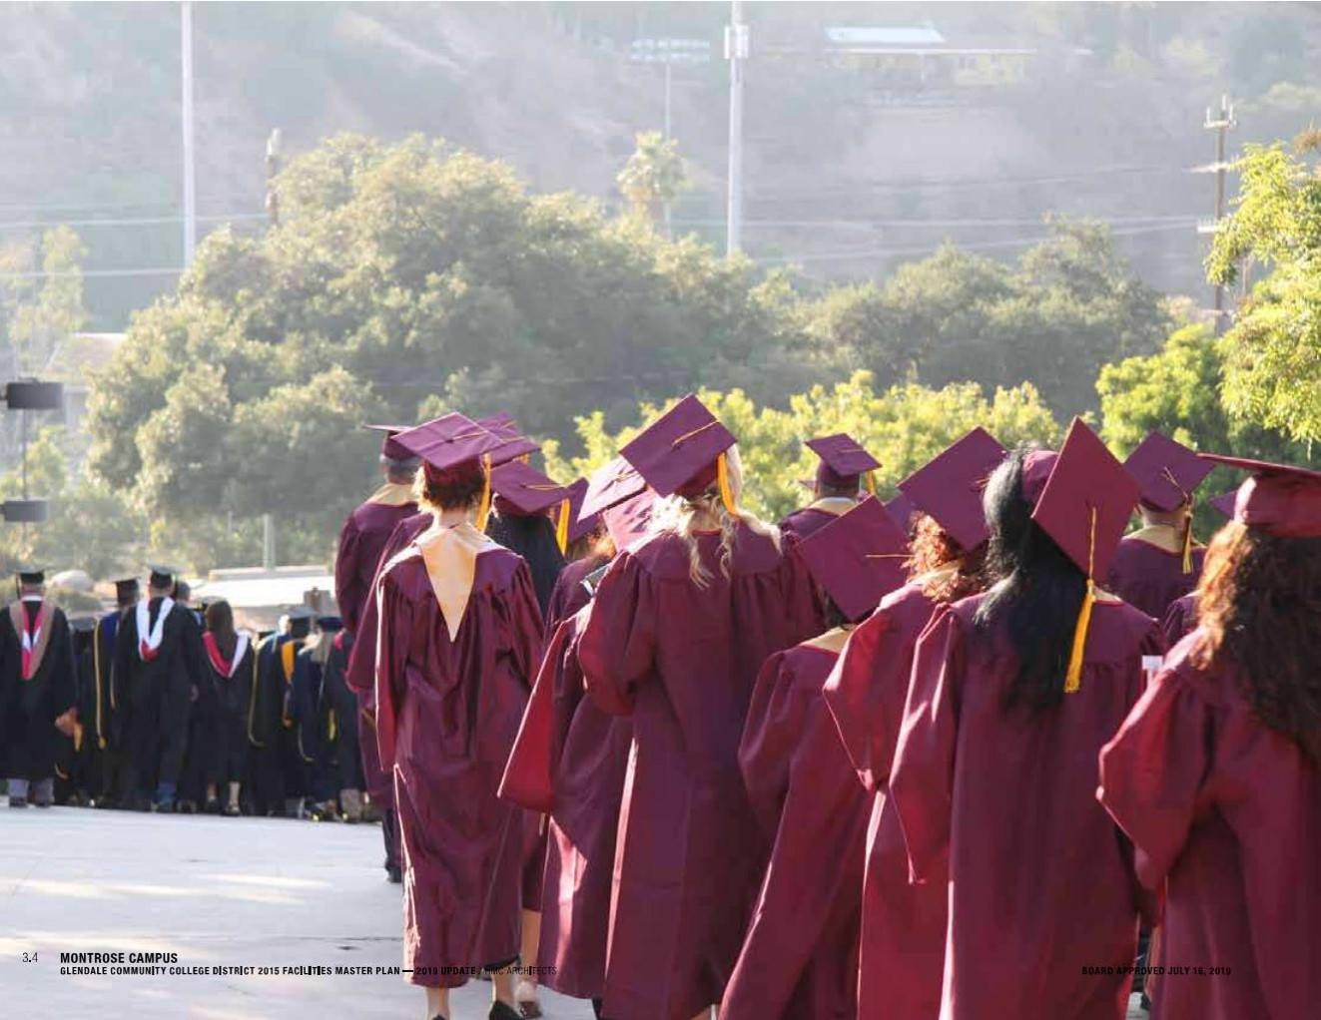
Thank You
To
Our Partners and Teammates at Glendale College

Slide 28
Questions & Answers

