Slide 1
Benefits Overview
Notes:
Welcome to Delta Dental, your ally in protecting your smile.

Slide 2
Delta Dental PPO™
Your plan:
Notes:
You’re covered under a Delta Dental PPO plan. Let’s take a look.

Slide 3
Choose a PPO dentist to save
Delta Dental PPO
Delta Dental Premier®
Non–Delta Dental
Notes:
Maximize your savings by visiting a Delta Dental PPO dentist. Your second best bet is a Delta Dental Premier dentist.
If you choose a non–Delta Dental dentist, you’ll receive coverage, but your out-of-pocket expenses may be higher. If your dentist charges more than the set fee for that service, you will be responsible for the difference. (This is called balance billing.)

Slide 4
Find a PPO dentist
Go to deltadentalins.com.
Enter your location.
Select Delta Dental PPO as your network.
Click Search.
Notes:
It’s easy to find a PPO dentist using our online directory.

Slide 5
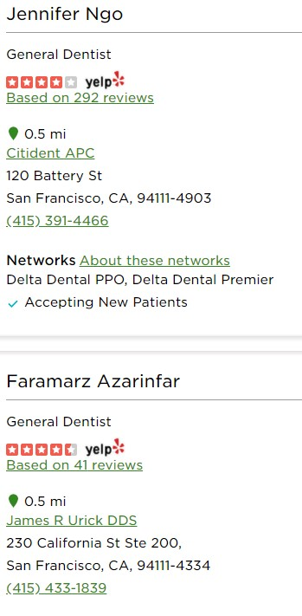
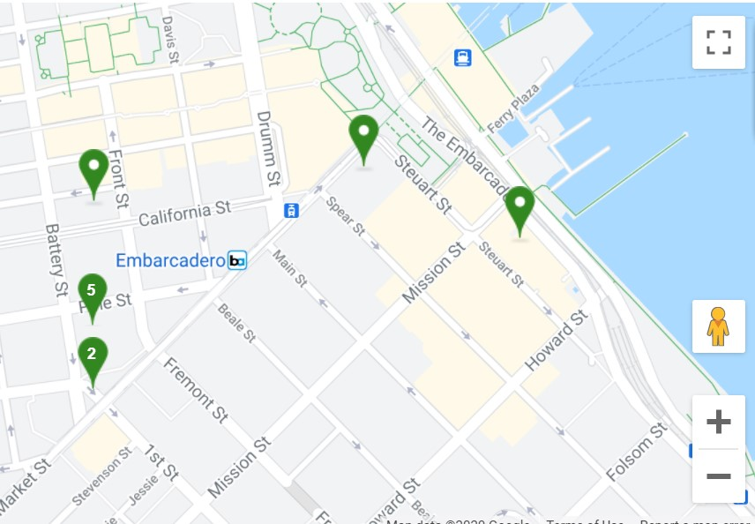
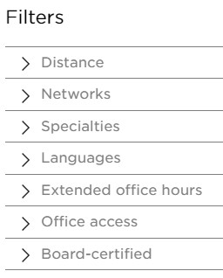
Find a PPO dentist
Click on Refine search to adjust the distance of the search or filter by specialty or language.
Notes:
You can adjust the range of your search, or filter the results by specialty, language and more.

Slide 6
Where’s my ID card? You don’t need one!
Just tell your dentist you’re covered by Delta Dental and provide:
Your name
Your date of birth
Your enrollee ID number
Your employer
Notes:
When you visit the dentist, you don’t need an ID card to check in. Just tell the dentist you’re covered by Delta Dental and provide your name, date of birth, enrollee ID number or Social Security number and the name of the employer through which you receive benefits. Family members covered under your plan will need to provide your details.
If you’d prefer an ID card, you call access an electronic ID on your phone by logging in to deltadentalins.com or printing out a paper copy.

Slide 7
Boost your wellness IQ
deltadentalins.com/wellness
Articles
Recipes
Videos
Interactive quizzes
Free wellness e-magazine
Risk assessment
Notes:
Learn more about dental health. At deltadentalins.com/wellness, you’ll find articles, recipes, videos, interactive quizzes, a free wellness e-magazine and even a survey to assess your oral health risks.

Slide 8
Together we shine
Notes:
When you choose Delta Dental PPO, it’s easy to protect your smile and keep it healthy. Together we shine.

