Slide 1
Delta Dental & DeltaCare USA
Open Enrollment 2020

Slide 2


Delta Dental PPO™

Slide 3

Your smile is covered
  You can visit any licensed dentist
    Visit a PPO dentist to save the most.
    You won’t be charged more than your expected share of the bill.
Delta Dental PPO

Slide 4
Your smile is covered
  You don’t need an ID card to check in.
  We’ll coordinate dual coverage.
  Create an online account to check your benefits and claims online.
Delta Dental PPO

Slide 5
Pre-treatment estimate
It’s easy to plan for dental expenses
1ST
Ask your dentist for an estimate
2ND
Dentist sends details to Delta Dental
3RD
You and your dentist receive a cost estimate

Slide 6

Emergency coverage
Visit any dentist worldwide and receive benefits
Submit a claim for reimbursement

Slide 7
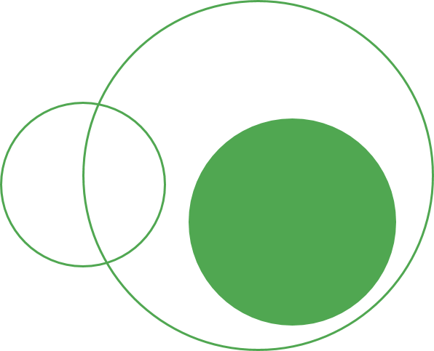
Your PPO Incentive Plan
In this incentive plan, Delta Dental pays 70% of the PPO contract allowance for covered diagnostic, preventive and basic services and 70% of the PPO contract allowance for major services during the first year of eligibility. The coinsurance percentage will increase by 10% each year (to a maximum of 100%) for each enrollee if that person visits the dentist at least once during the year. If an enrollee does not use the plan during the calendar year, the percentage remains at the level attained the previous year. If an enrollee becomes ineligible for benefits and later regains eligibility, the percentage will drop back to 70%.
This benefit information is not intended or designed to replace or serve as the plan’s Evidence of Coverage or Summary Plan Description. If you have specific questions regarding the benefits, limitations or exclusions for your plan, please consult your benefits representative.
Your plan Annual Maximum is the Maximum Amount Delta Dental will pay on your behalf for each covered person during a calendar year. $1,400 is the total Maximum Delta Dental will pay for all providers combined.

Slide 8
Your PPO coverage - Maximum
 | Delta Dental PPO
 | PPO dentist | Premier dentist | Non–Delta Dental dentist
Deductible Per calendar year | N/A | N/A | N/A
Annual maximum Per calendar year | $1,400 | $1,200
Reimbursement is based on PPO contracted fees for PPO dentists, Premier contracted fees for Premier dentists and program allowance for non-Delta Dental dentists

Slide 9
Your PPO coverage – D & P Care
 | Delta Dental PPO
 | ^{PPO dentist} | ^{Premier dentist} | ^{Non–Delta Dental dentist}
Dental exam | 70-100% | 70-100% | 70-100%
Child cleaning | 70-100% | 70-100% | 70-100^
Adult cleaning | 70-100% | 70-100% | 70-100%
Sealants | 70-100% | 70-100% | 70-100%
Fluoride treatment | 70-100% | 70-100% | 70-100%
Reimbursement is based on PPO contracted fees for PPO dentists, Premier contracted fees for Premier dentists and program allowance for non-Delta Dental dentists

Slide 10
Your PPO coverage – Basic Services
 | Delta Dental PPO
 | PPO | Premier | Non–Delta Dental
Amalgam (silver) filling, back tooth | 70-100% | 70-100% | 70-100%
Resin (white) filling, front tooth | 70-100% | 70-100% | 70-100%
Root canal, back tooth | 70-100% | 70-100% | 70-100%
Periodontal scaling and root planing | 70-100% | 70-100% | 70-100%
Oral surgery | 70-100% | 70-100% | 70-100%
Reimbursement is based on PPO contracted fees for PPO dentists, Premier contracted fees for Premier dentists and program allowance for non-Delta Dental dentists

Slide 11
Your PPO coverage – Major Services
 | Delta Dental PPO
 | PPO | Premier | Non–Delta Dental
Crown (porcelain to high noble metal) | 70-100% | 70-100% | 70-100%
Complete upper denture | 50% | 50% | 50%
Complete lower denture | 50% | 50% | 50%
Bridge | 50% | 50% | 50%
Dental implant | 50% | 50% | 50%
Reimbursement is based on PPO contracted fees for PPO dentists, Premier contracted fees for Premier dentists and program allowance for non-Delta Dental dentists

Slide 12

The Delta Dental Difference®

Slide 13
Network advantage
The Delta Dental Difference®
2 levels of savings:
PPO network
160,000 network dentists
352,000 locations
8 in 10 U.S. dentists are in a
Delta Dental PPO or Premier network
35-41%
average discount
Premier network
9-29%
average discount

Slide 14
Choose PPO to save
Claim example: Crown, covered at 100%
 | Delta Dental PPO | Delta Dental Premier® | Non-Delta Dental dentist
Dentist charges | $1,400 | $1,400 | $1,400
Plan allowance | $650 | $800 | $1,100
Your plan pays | $650 | $800 | $1,100
You pay | $0 | $0 | $300
This example is for illustrative purposes only. Refer to your plan of benefits for
details on your district specific plan. This illustration assumes no deductibles apply.

Slide 15


Web/mobile resources

Slide 16

Contact Customer Service
Get help by phone or online
Call us toll-free at 866-499-3001
Speak to a Customer Service representative Monday through Friday, 5 am to 5 pm PST
For simple questions, use our automated phone system, available 24/7
Ask online: Go to deltadentalins.com > Contact Us > Delta Dental of California > Customer Service Form

Slide 17
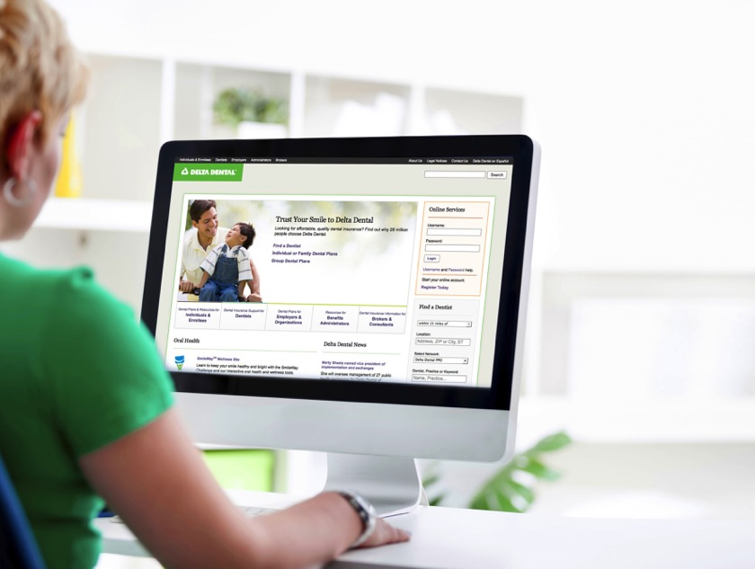
Check out the website
  Search for a network dentist in your area.
  Get answers to common questions about your dental plan.
  Read articles, browse recipes and watch videos about oral health on the SmileWay® Wellness site.
  Subscribe to Grin!, our quarterly wellness e-magazine.
deltadentalins.com

Slide 18

Sign up for an online account
  Check your plan details: eligibility, covered services and level of benefits.
  Look up claim statements for recent dental visits.
  View or print your ID card.
  Estimate the cost of your next procedure.
  Submit questions to Customer Service.
Check your benefits information online

Slide 19

Go paperless
View your documents online: claims, pre-treatment estimates and plan details
  Convenience. Get an email alert every time a new document is available.
  Efficiency. No need to wait for “snail mail.”
  Save paper. Reduce your ecological footprint.
  Log in to your account at deltadentalins.com, click on the My Profile tab and select the Online setting.

Slide 20
Go mobile
Download the app to have all the information you need at your fingertips
 | Find a dentist | Coverage details | Electronic ID card | Cost estimator | Musical timer
What can you do with the app? | ✓ | ✓ | ✓ | ✓ | ✓
To find the app, visit the App Store or Google Play and search for “Delta Dental.” Then download the Delta Dental app by Delta Dental Plans Association.

Slide 21
Find a network dentist
Use the online dentist search tool
  Go to deltadentalins.com.
  Look for the Find a Dentist tool on the right.
  Search by name, address, landmark, city or ZIP code.
  ͏Select your network plan.
  Click Search.
  ͏Narrow your search by location, specialty, network and language.
  Your search results will include a dentist’s Yelp rating, address and phone number.

Slide 22
Cost Estimator
Budget for dental expenses with personalized estimates
Personalized. Estimates are based on your benefits, including maximums and deductibles.
Insightful. Compare the cost of the same procedure at different dentists.
Economical. See how choosing an in-network dentist can help you save.
Available on desktop and mobile

Slide 23
Value-added features

Slide 24
Delta Dental Members Have Access to Hearing Aid and LASIK discounts
Now available to you and your dependents
Amplifon Hearing Health Care
    62% average savings off retail hearing aid pricing
QualSight
    40-50% off traditional LASIK eye surgery

Slide 25
How to get started with Amplifon
Simply call or register online
Call Amplifon at 888-779-1429
A Patient Care Advocate will guide you.
Amplifon will activate your hearing aid discounts.
Or go online at amplifonusa.com/deltadentalins
Answer questions and make an appointment.
You and your provider will get required info.

Slide 26
Get started with QualSight
To sign up, call or register online at
qualsight.com/-delta-dental
1. Get ready
2. Get set
3. Save!
Call QualSight at
855-248-2020 or register online.
When you call, a care manager will explain the program details.
Choose a physician and pay a discounted price for LASIK.

Slide 27
Thanks for your time!

