Slide 1
PrimePay FSA
Glendale Community College Employee Enrollment Presentation
Plan Year: 1/1/21 – 12/31/21

Slide 2
Flexible Spending Account
Allows employees to pay for their family medical and daycare expenses on a pre-tax basis.
Your contribution is pre-tax so your take-home pay is larger.
Can be used for common, qualified medical expenses.
Voluntary – Choose what you need.
Easy Claim Submission

Slide 3
What Flexible Spending Accounts are available?
Health Flexible Spending Account
Out-of-pocket medical costs
Can be used for employee and dependent expenses
Dependent Care Reimbursement Account
Child Care Expense for dependent children under age 13
Adult Day Care Expense for parents and/or dependents incapable of self-care

Slide 4
Health Flexible Spending Account
Your health FSA may be used for:
Co-pays.
Deductibles.
Prescriptions.
Eyeglasses/Contact Lenses.
Dental expenses.
Over the Counter medicines.
Menstrual care products.
Visit www.fsastore.com for other eligible items.

Slide 5
Health Flexible Spending Account
Contribute up to $2,750 for the plan year.
The entire amount is available the first day you participate in the plan.
Up to $550 can rollover to the next plan year if not used.
Any amount above the rollover amount not used by the end of the plan year is forfeited.
Elections can’t be changed unless you have a qualified status change event.

Slide 6
Health Flexible Spending Account
PrimePay FLEX Card is available.
Card coded for approved merchants including Dental, Hospital, Physician, Optometrist.
PrimePay will email request for an itemized bill except for:
Medical Co-pays
RX Co-pays
Key reasons for FLEX Card failure:
Incorrect merchant type/merchant code.
Not enough funds remaining in FSA.
Pharmacy is not part of Inventory Information Approval System (IIAS).
Over 75% of your FLEX Card transactions can be auto-substantiated; meaning no additional documentation is required.

Slide 7
Dependent Care Reimbursement Account
Your DCA may be used for:
Daycare for children under age 13.
Pre-kindergarten expenses.
Summer DAY Camps.
Elder DAY Care – if the elder is claimed as a dependent.
Both spouses need to be working.

Slide 8
Dependent Care Reimbursement Account
Maximum election of $5,000 per year ($2,500 each if married filing separately).
Money is available for reimbursement as deductions are made and after services are rendered.
Elections can’t be changed unless you have a qualified status change event.
PrimePay FLEX Card is not available.

Slide 9
Submitting Claims
Fax or email claim form:
Fax: 877.6FAX.FSA (877.632.9372)
Email: primeflex@primepay.com
Online claim submission: https://primepay.wealthcareportal.com
Free Mobile App:
Download from the App Store or Google Play.
Search for PrimePay or PrimeFlex.

Slide 10
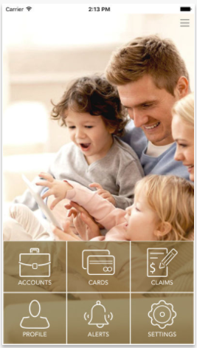
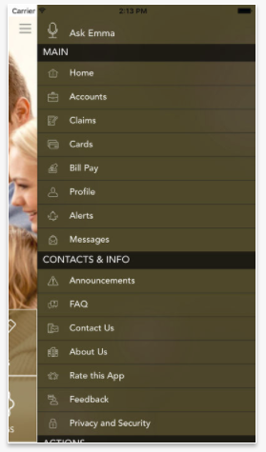
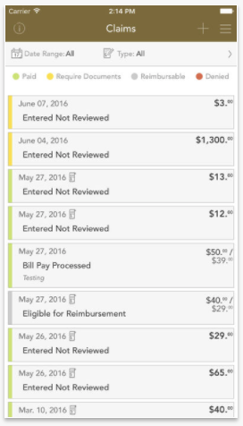
PrimePay/PrimeFlex Mobile App
Provides a single access point for participants to manage their accounts.
Submit claims.
View account balances.
Review recent transactions.
See claim details.

