Slide 1
Glendale Community College Mental Health Resources
Notes:
CORE MARKETS ONLY
Bundle and save a bundle with Benefit Solutions*
​​Effective dates starting on 1.1.2019 Our improved bundling program now applies to groups of 101 up to 1,000! Your clients can save up to 1.75% on their medical premium by bundling dental, vision and life insurance‡ with their medical benefits.
Choose dental and save 1%
Add life insurance and save and additional .5%
Add vision, and save another .25%
3-year rate guarantees on new sales for vision and life.

Slide 2
Agenda
How to search for MHSA providers
How to navigate Teladoc Mental Health
Wellvolution new Mental Health programs
Questions?

Slide 3
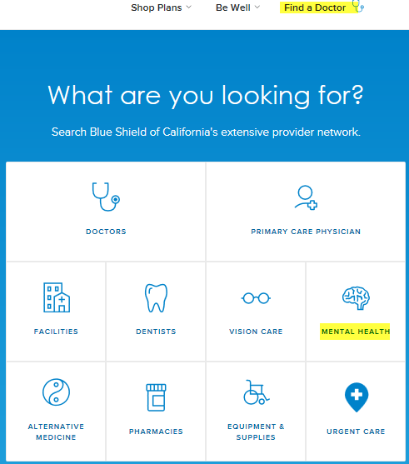
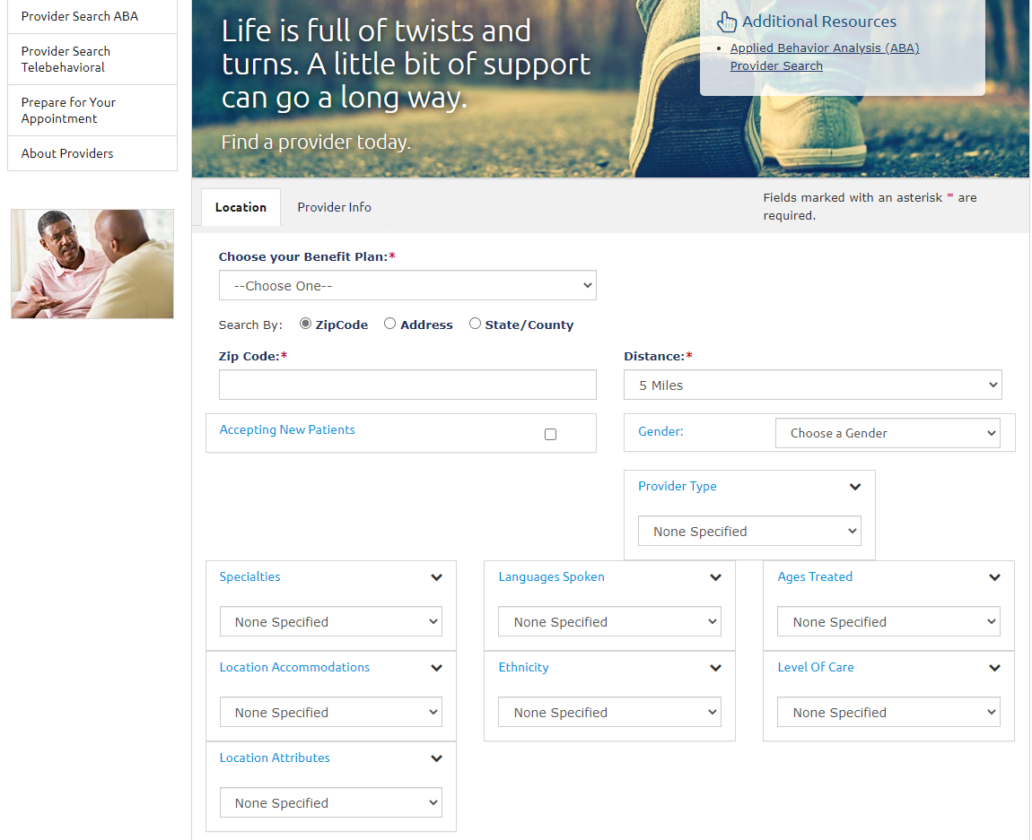
How to find a Mental Health Provider:
1. www.blueshieldca.com
Select Find a Doctor
Then click on Mental Health
2. A new screen pops with the following:
Click on “Visit the MHSA Network”
3. It directs you to a new site.
Choose your benefit Plan: BSC MHSA
Choose a Provider List: Non-medicare Provider
Enter the Zip Code and Distance
Provider type, Specialties, etc.
https://www.magellanassist.com/mem/prov/pps/portableprovsrch.aspx?AccessKey=E05FE1 0E-0A31-4ED2-9361-F647CE085B35

Slide 4
Behavioral health benefits offers support when you need it the most
Our network clinicians, psychologist and psychiatrists can help you and your family with many conditions such as:
Depression, stress and anxiety
Mental illness
Alcohol/substance use disorder
Autism Spectrum Disorder (ASD)
Standard copays/coinsurance applies.
No referral is needed to access the Mental Health benefits.
You can access care through Magellan (MHSA): (877) 263-9952
In-person appointments
Telebehavioral Health (in CA only)
Notes:
Additional programs and services available through Blue Shield’s MHSA:
Behavioral Health Utilization Management Program – Applies clinical expertise and supports optimal use of behavioral health services for the evaluation and treatment of mental health conditions and substance use disorders.
Complex Case Management Program – Optimizes the physical, social, and mental functioning of our members through advocacy, communication and resource management.
Behavioral Health Condition Management– Designed to help members overcome depression so they can more effectively manage their chronic medical conditions(s) and lead a better quality of life.
Life Referrals 24/7 – Offers confidential assistance on a range of topics to assist with life’s challenges.
Autism Connections® - A benefits management program managed by Blue Shield’s MHSA that offers help to Blue Shield members and their families to meet the challenges of Autism Spectrum Disorder (ASD).
Telebehavioral health
(in CA only)
All licensed providers
All have physical offices so you can blend video and in-person visits.
Available to all HMO and PPO members in fully insured groups. Fully insured groups use the Magellan network.
NOTE for Self-Funded members: BSC Self-Funded members utilize the BSC directly contracted behavioral health provider network. Some of these providers also provide Tele BH services in addition to their normal brick & mortar office visits but we don’t know exactly which ones do. A self-funded member would have to call his or her provider.

Slide 5
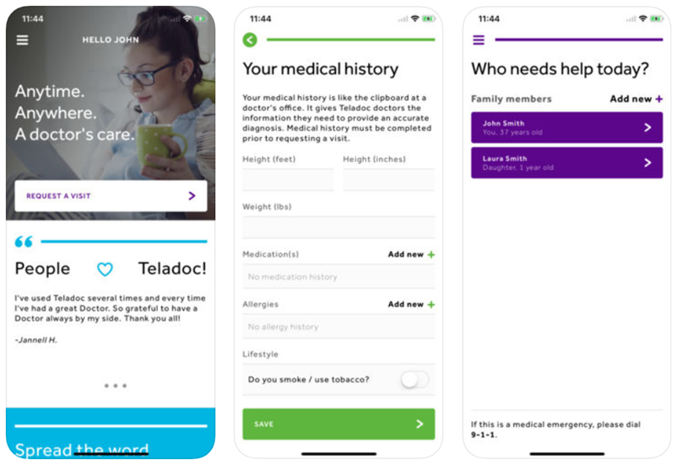
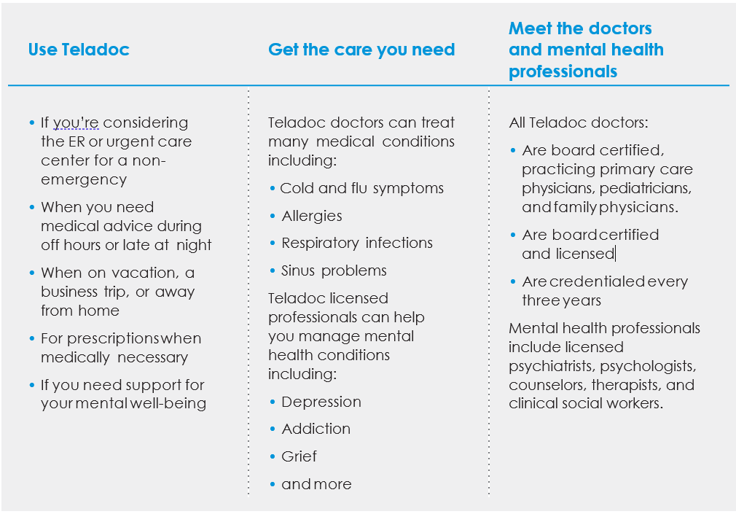
Teladoc/Teladoc Behavioral Health
Get started with Teladoc
 Set up account
Visit www.blueshieldca.com/bsc, complete the required information, and
click on Set up account. You can also call Teladoc at 1-800-Teladoc
(835-2362) for help.
 Provide medical history
Your medical history provides Teladoc doctors with the information
they need to make an accurate diagnosis.
Web: Log in to www.blueshieldca.com/bsc and click Update
medical history.
Mobile: Visit www.teladoc.com/mobile to download the app.
Log in, go to the menu icon on the top left, and click Medical Info.
Phone: Teladoc can help you complete your medical history
over the phone. Call 1-800-Teladoc (835-2362).
 Request a consult
Once your account is set up, request a consult anytime you need care.

Slide 6
Teladoc site: first-time account creation
Website
App
Finish creating your account
By clicking “Complete Registration” below, I certify that I have read and understand the Web and Mobile Privacy Policy and agree to be legally bound by the Web and Mobile Terms and Conditions

Slide 7
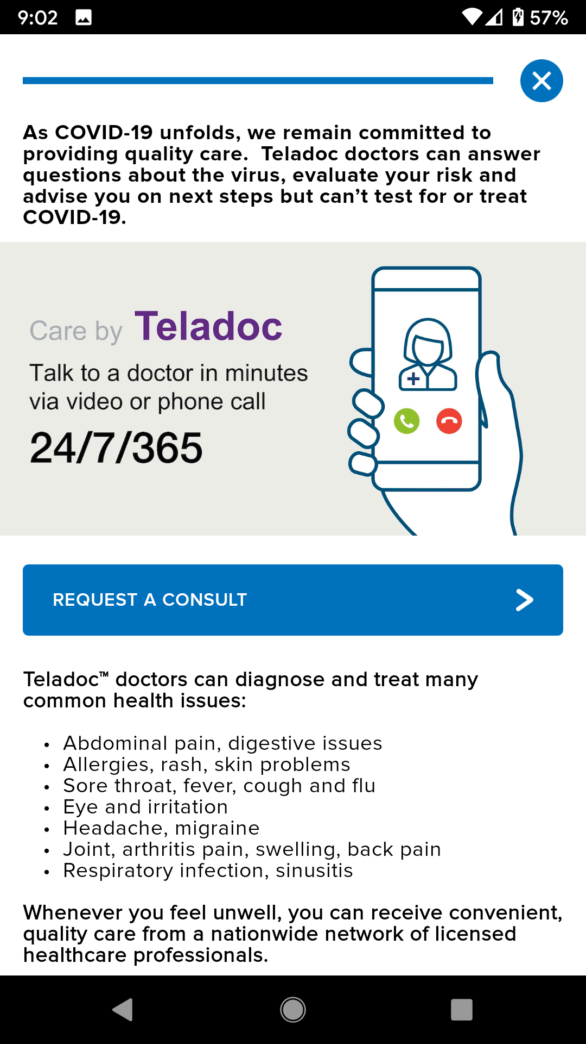
Member requests a consult
Website
App

Slide 8
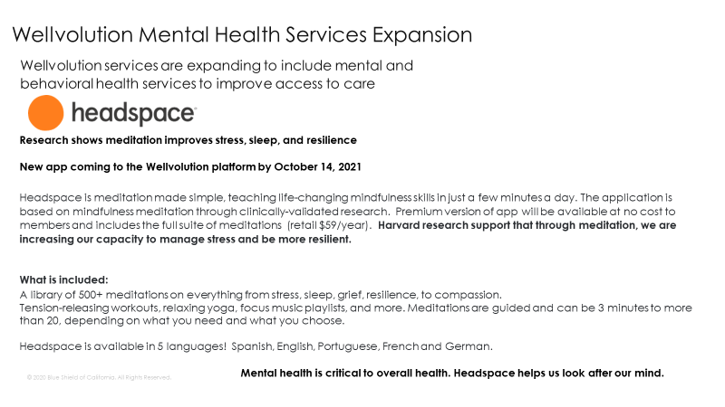
Headspace now available

Slide 9
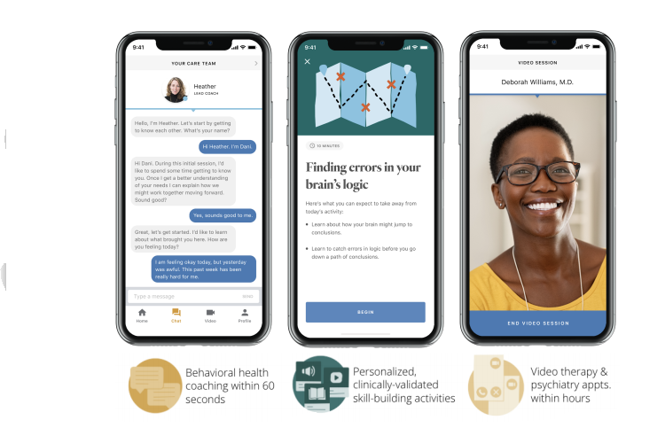
Ginger coming to Wellvolution in 01/01/22
Ginger is an app based licensed medical provider. Ginger assists people across a broad spectrum of need, from the common to the complex. Whether someone needs help navigating a stressful situation in their life or could benefit from a licensed therapist or psychiatrist, Ginger meets people where they are with an integrated, collaborative healthcare system.
Coaching offers members day-to-day support Self-Care Library includes interactive experiences that help members learn about and practice the valuable skills needed to manage stress, anxiety, and other day-to-day challenges via guided meditations, breathing exercises, recorded classes, and more.
More details of the specific services available through Ginger and the Wellvolution platform are still being designed so be on the look out for more detailed information on this offering over the next couple of months.
Cost effective!
85-90% of members are assisted via Masters Level Behavioral Health Coaches.
Coaches refer members to a nationwide team of licensed therapists and psychiatrists using a centralized EMR and shared data for collaboration and personalized care.

Slide 10
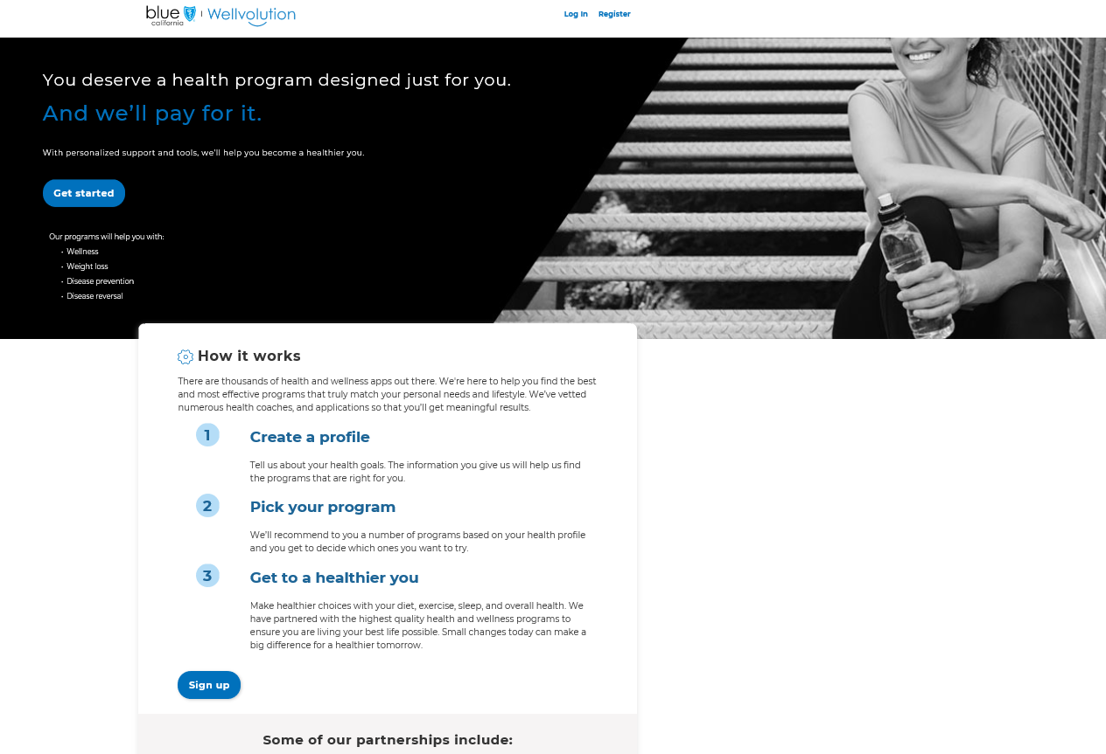

Slide 11
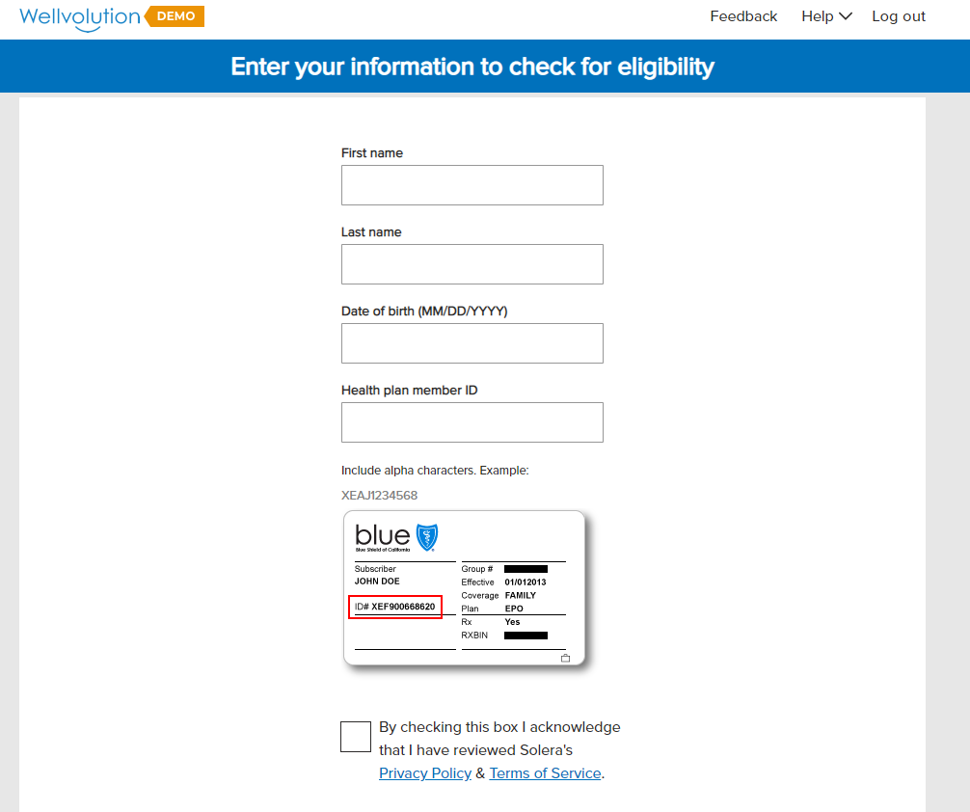

Slide 12
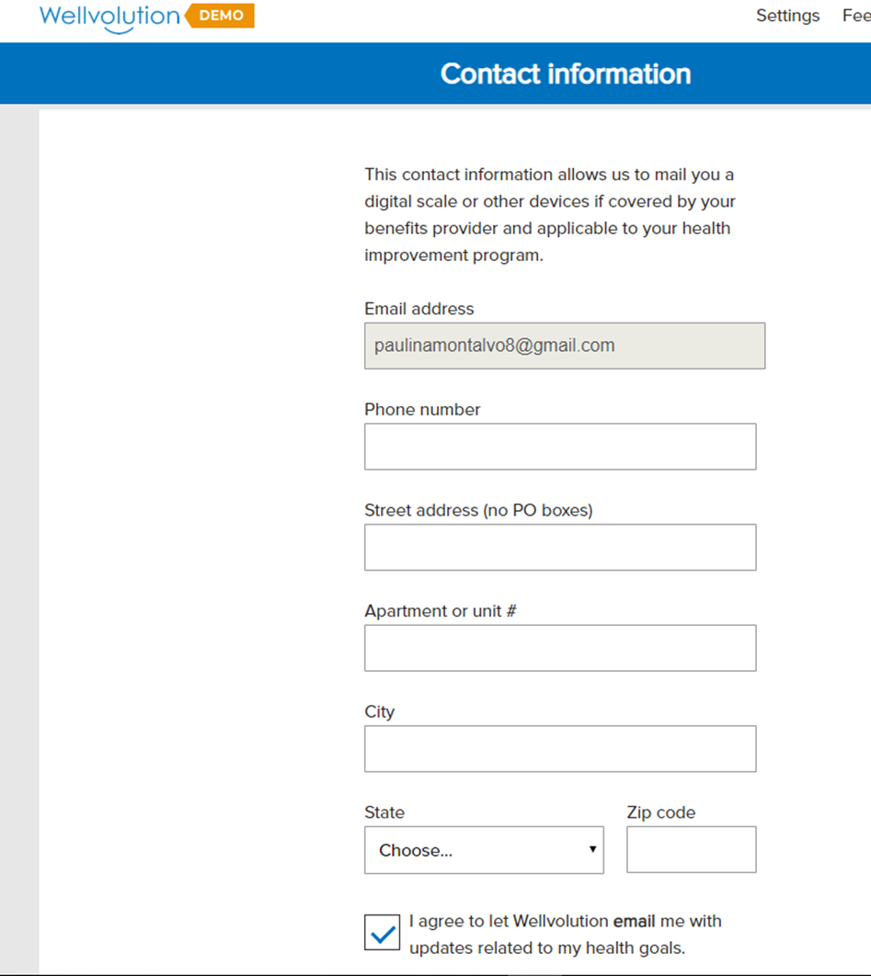

Slide 13
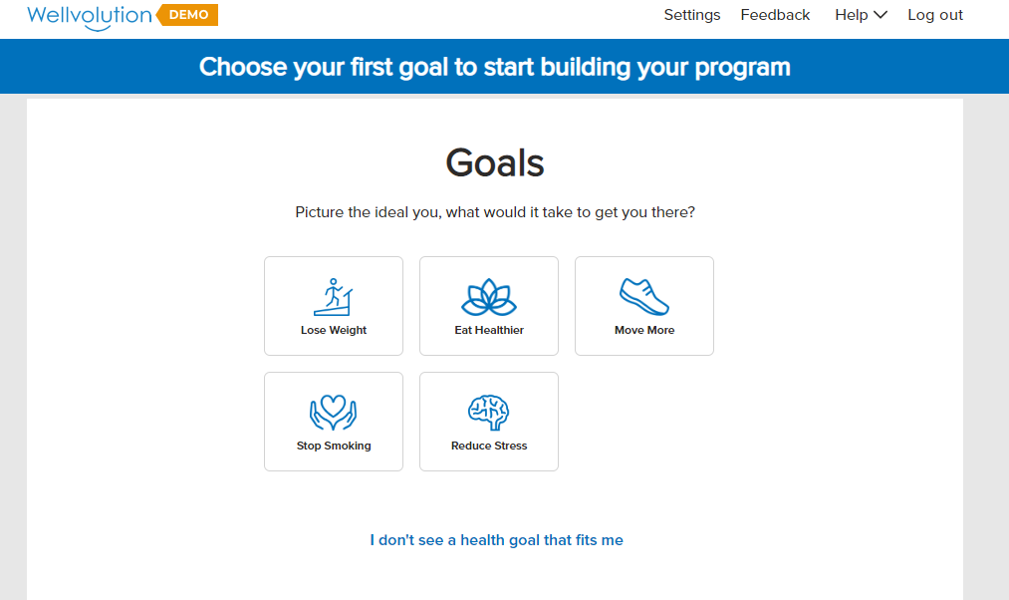

Slide 14
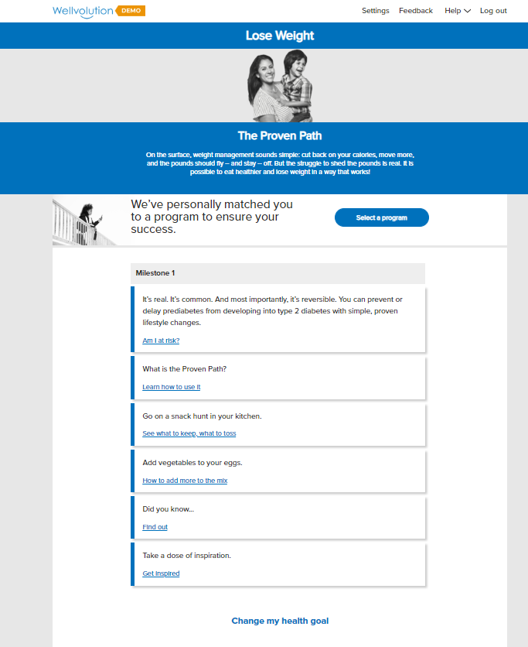

Slide 15
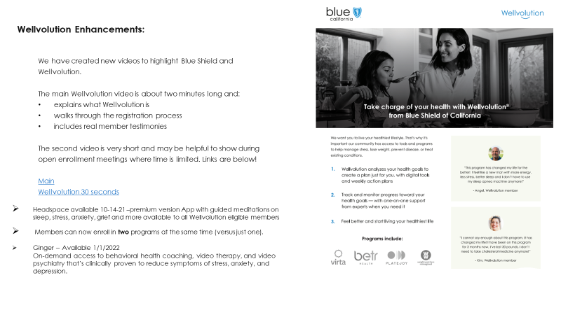
New Enhancements

Slide 16
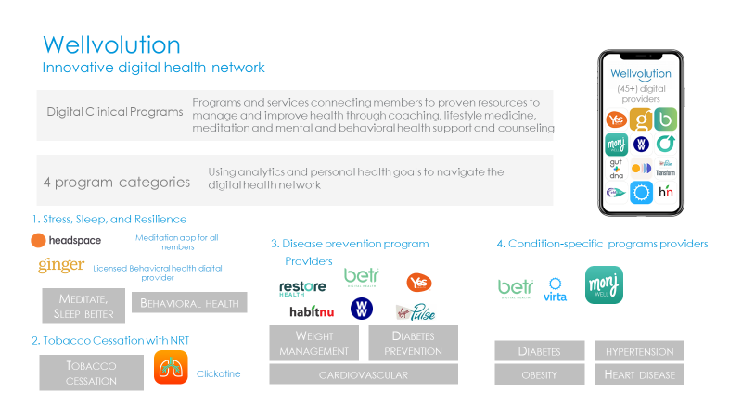
Wellvolution Innovative digital health network

