Slide 1
Oracle Upgrade – iProcurement
High Level Differences:
-Less Scrolling
-Less Screens
-Flashlight Fields more intuitive: Can be filled by typing and clicking tab
(if more than one selection is available, choices will be given)
-The PO Number is on Requisition Status page without drilling down
-To locate Account Information on a submitted requisition still requires a couple of drilldowns:
Click on the brown requisition number you want to look at
Click on the blue square field called “Details”
Click on “Show additional Information”
Similarities:
-Use of Preferential Accounts is encouraged and is really useful for shortening the process
To Create and Name Account Numbers
Click on Preferences at top right of page
Click on iProcurement Preferences top left of page
Scroll down and add accounts as needed
Suggestion: Name accounts related to use by TOPS/OBJECT
(ex. Art Instructional Supplies – Voucher Acct)
If you previously set these up they should be in the upgraded version of Oracle
-Use Non-Catalog Request to enter order
-Although there are still choices for “Item Type,” there is a drop down for selecting.
-All Asterisk Fields Still Required

Slide 2
Requisition Options
There are differing processes to complete requisitions.
Option 1 contains all steps and can be used for any and all requisitions.
Options 2 and 3 can be used in certain situations and will shorten the number of clicks required for the transaction.
Only use shortened options if default is set on account you want to use for the requisition.

Slide 3
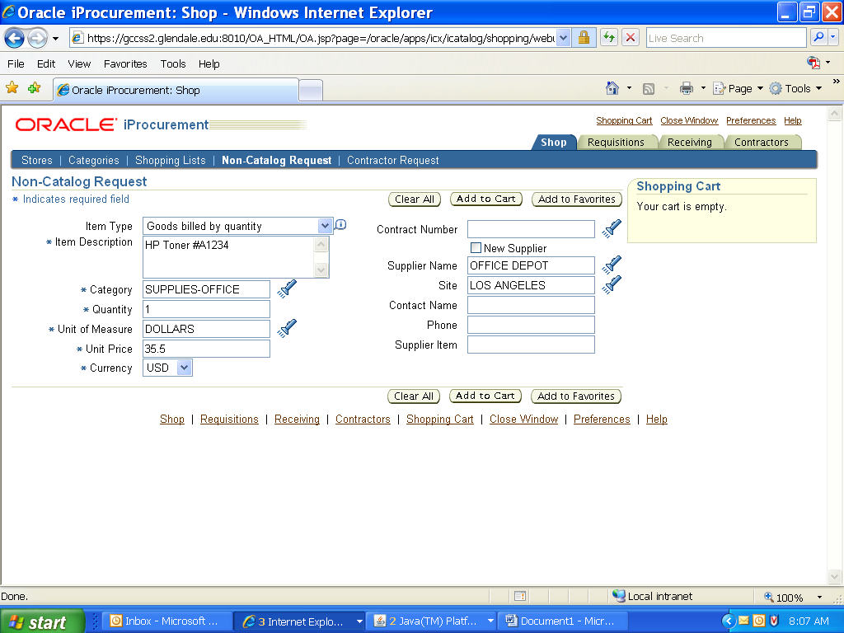
First Screen Under Non-Catalog Request
Complete all Required Fields and Click on “Add to Cart.” You will now see items in cart on upper left side of page. Click on “View Cart and Checkout.” If more items are to be added, change fields as necessary and click “Add to Cart.” When finished with order, click on “View Cart and Checkout.” On next screen click on “Checkout.”

Slide 4
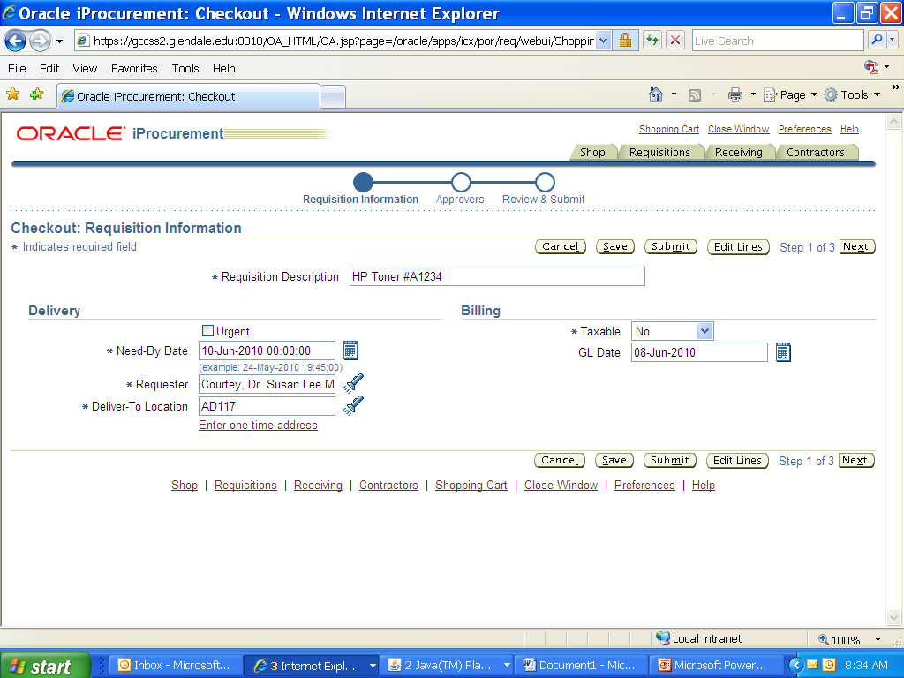
The Requisition Description will default in from first line of Requisition same as the prior version and can be changed to reflect the entire order. You can also save and/or cancel from this page. Most of the time there will be no changes made to this page. However, this page represents the biggest change to process. There are 3 options to complete the requisition. Option 1 contains all steps and can be used for any and all requisitions. Options 2 and 3 can be used in certain situations and will shorten the number of clicks required for the transaction. For Option 1. Click on “Edit Lines.”

Slide 5
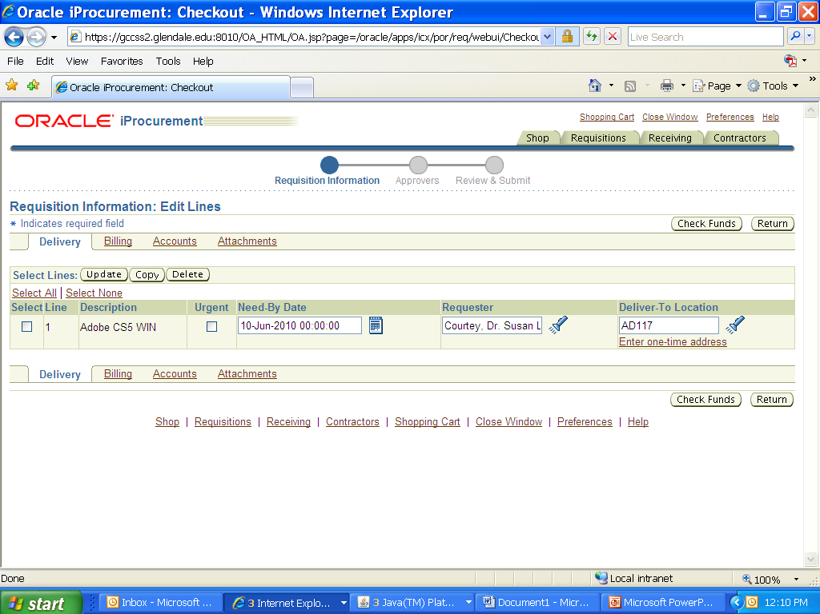
Option 1
There are editing options on this page, the most important being “Accounts.” Click on “Accounts” to edit, verify, and/or input the account number.

Slide 6
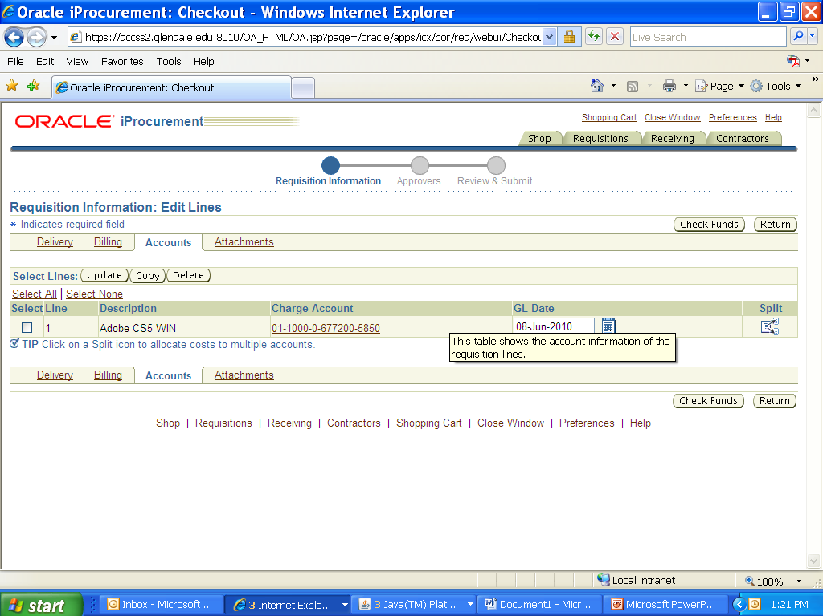
Adding and Creating Accounts
If you have created Accounts/Nicknames your default account will automatically fill the field. To add and/or change the account, click on the “Charge Account” brown field.

Slide 7
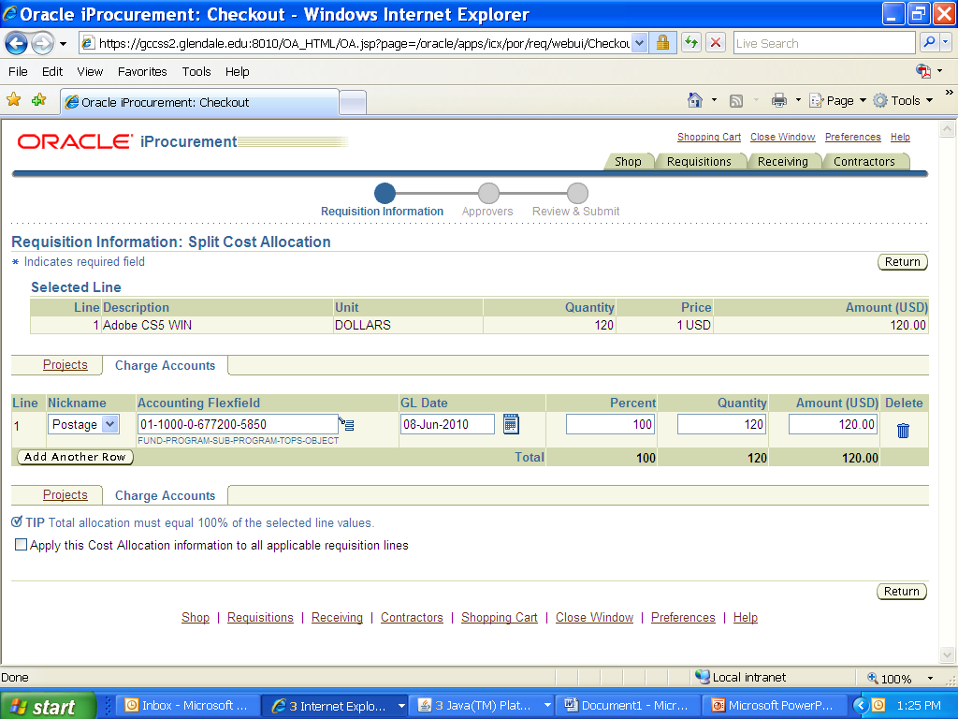
Adding/Creating Accounts
If you have accounts created you can use the drop down under Nickname to change the account. If you have not created your preferences, click on the blue square after the Flexfield and you will be prompted to create an account. If you have created Nicknames but need a new or different account that is not a preference, set the drop down Nickname to the blank field and then click on the blue square after the Flexfield to bring up the page to enter the account number.

Slide 8
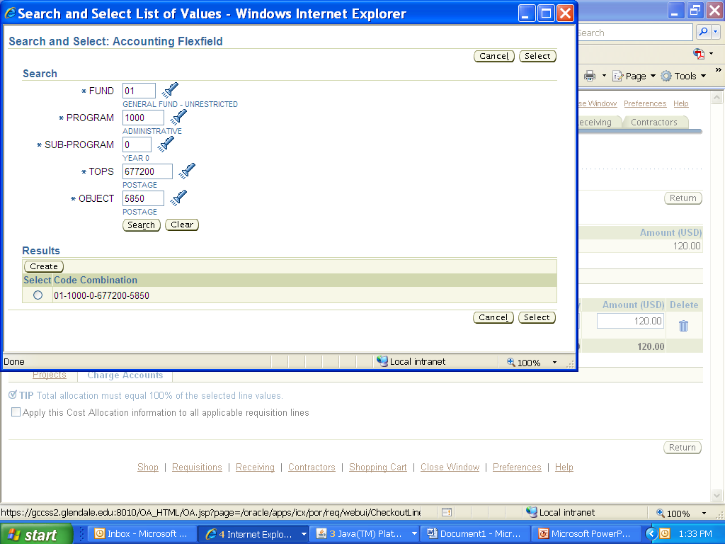
Creating an Account
Fill in fields with the account number. Click on Search. Click in the circle under Select Code Combination on the bottom left of the screen. Click on “Select” on the lower left to fill the field Field will fill on prior page.

Slide 9
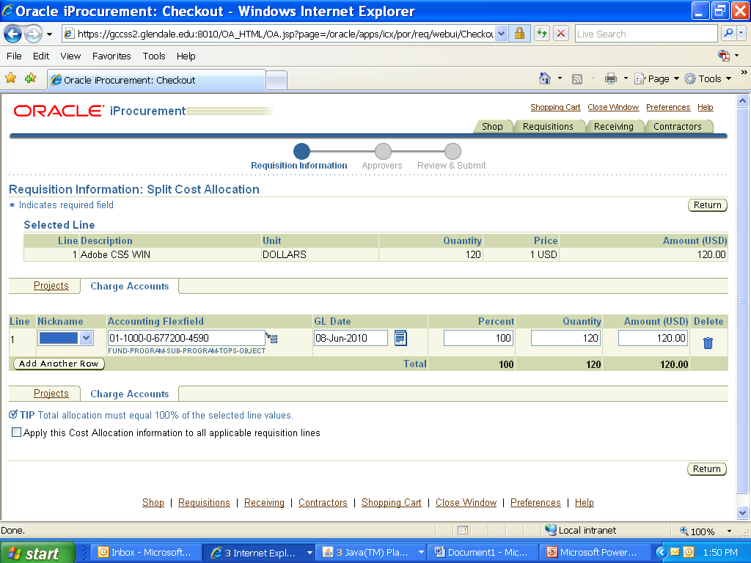
If you need to add additional account lines, click on “Add Another Row” when you return to prior page. If not, click on “Return.”

Slide 10
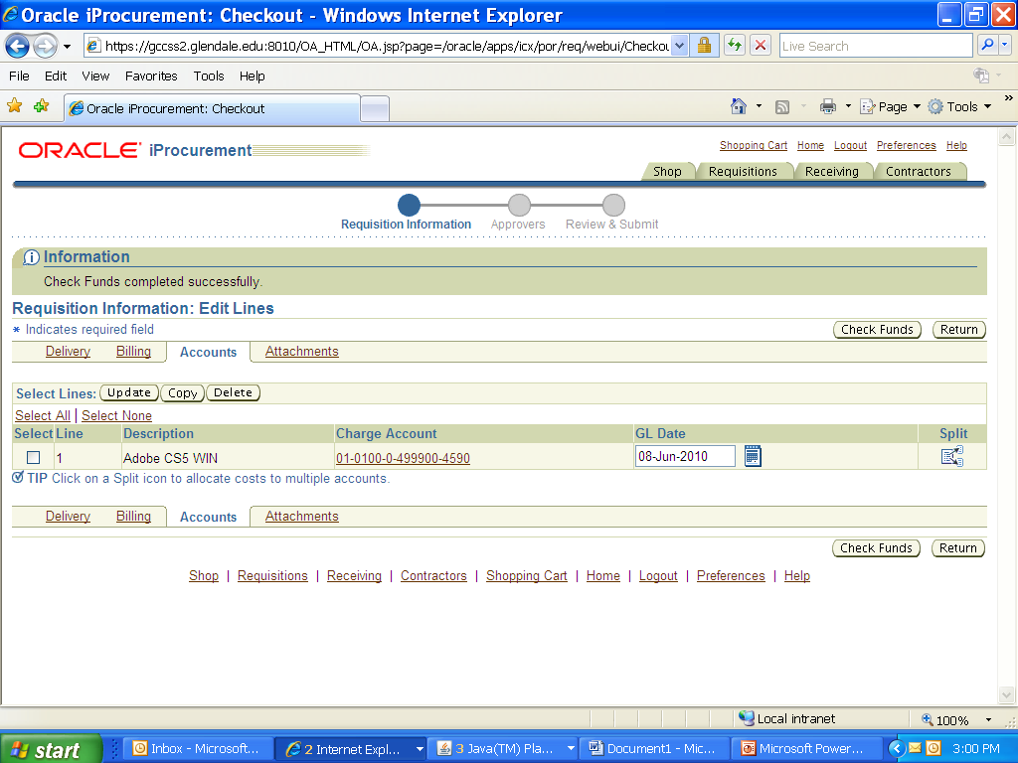
Click on “Check Funds”. If passes, Click on “Return”.

Slide 11
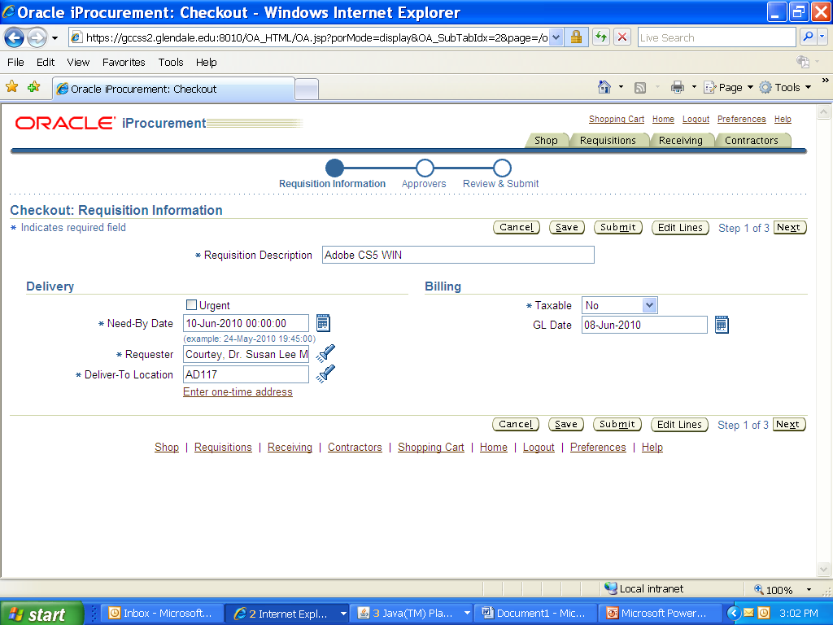
This will return you to the Checkout page again. With verification of account and fund check done, now
Click on “Next.”

Slide 12
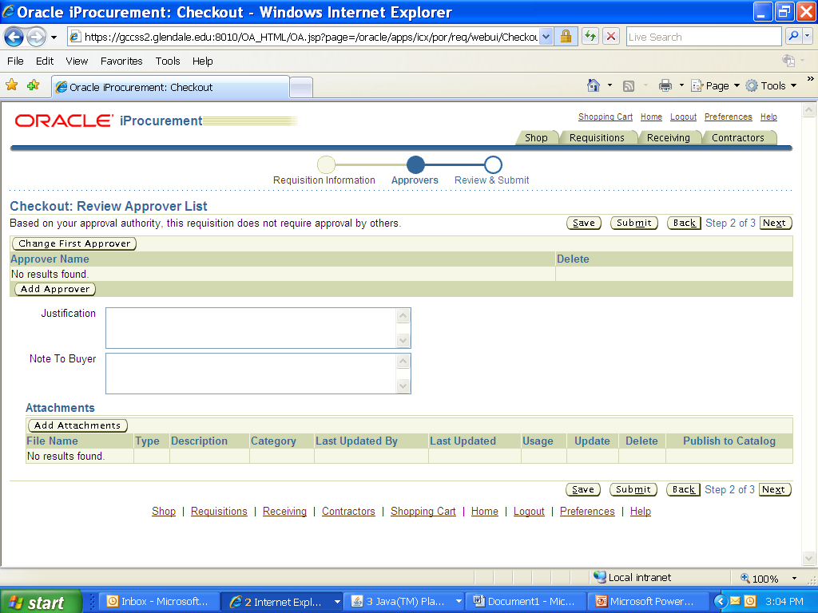
If necessary, change the first approver, add an approver, add notes, and/or add attachments. Then click
“Next.”

Slide 13
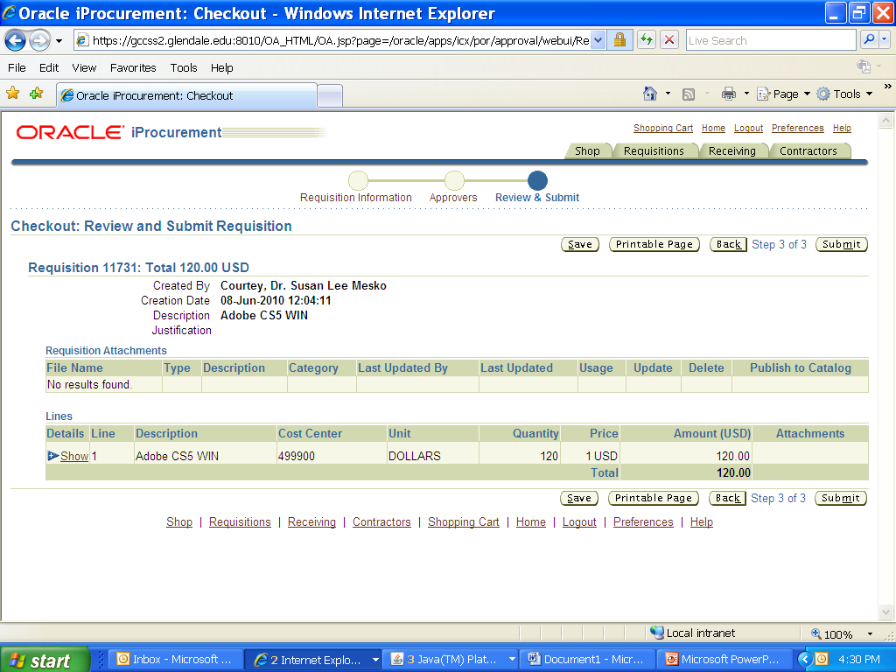
Review and if you desire to print a copy. There is a “Printable Page” option. Then click on “Submit.”
This will take you to the final page and you will get verification of the Requisition Number. This is last step of option 1 for creating a requisition.

Slide 14
Option 2
Option 2 is quicker and less steps than option 1. However, since this shortened process skips the
account field it can only be used if you have set up preferences AND the default account number
is the account you need to use for this requisition.
You also have the option of going into your preferences and changing the appropriate account to the default before starting the requisition.
Use this option if your default account number is the account number you need to use but still need to add approvers, notes, attachments.
Option 2:
Complete first screen
Click on Add to Cart
Click on View Cart and Checkout
Click on Checkout
Click on Next
This will take you to the page to add/change approvers, notes and attachments. Add as needed.
Click Next
This will take you to the review and submit page to finish up.
Click Submit

Slide 15
Option 3
Option 3 is quicker and less steps than option 1 and Option 2.
However, this shortened process also skips the account field so it can only be used if you have set up
preferences AND the default account number is the account you need to use for this requisition.
You also have the option of going into your preferences and changing the appropriate account to the default before starting the requisition.
Use this option ONLY if your preference default account number is the account you need to use AND you do NOT need to add approvers, notes, or attachments.
Option 3:
Complete first screen
Click on Add to Cart
Click on View Cart and Checkout
Click on Checkout
Click on Submit

